Slide 1
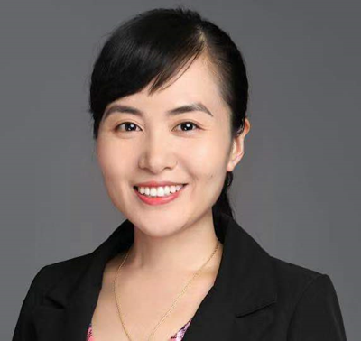
杨红霞
阿里巴巴资深算法专家

Slide 2
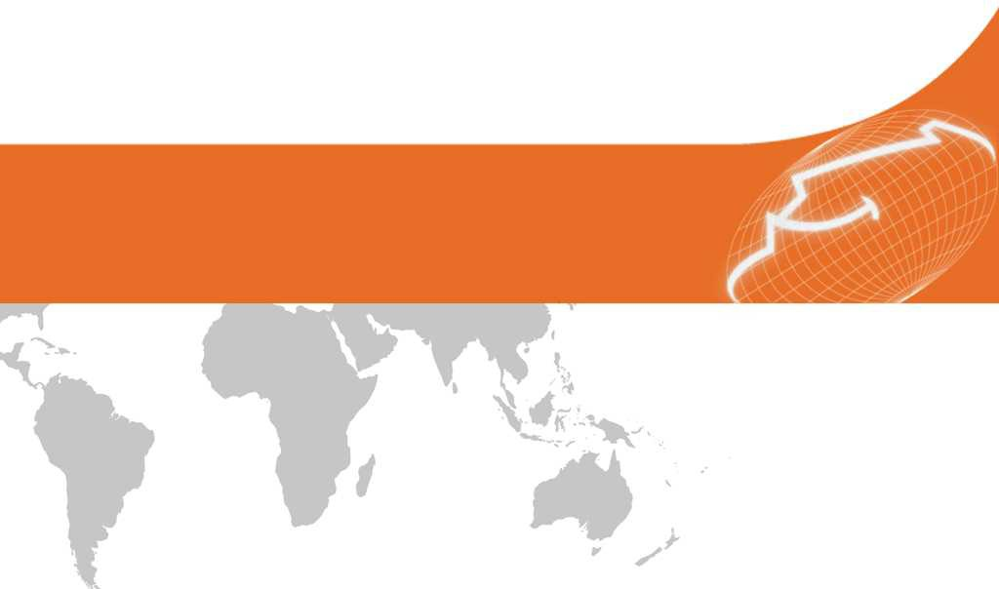
Cognitive Intelligence
Alibaba DAMO Academy
Dr. Hongxia Yang Senior Staff Data Scientist

Slide 3










Overview
04
Impact
Open source/papers/awards
03
Empower
From System 1 to System 2
02
AliGraph
Reasoning Engine: Model & System
01
Cognition
Motivation

Slide 4
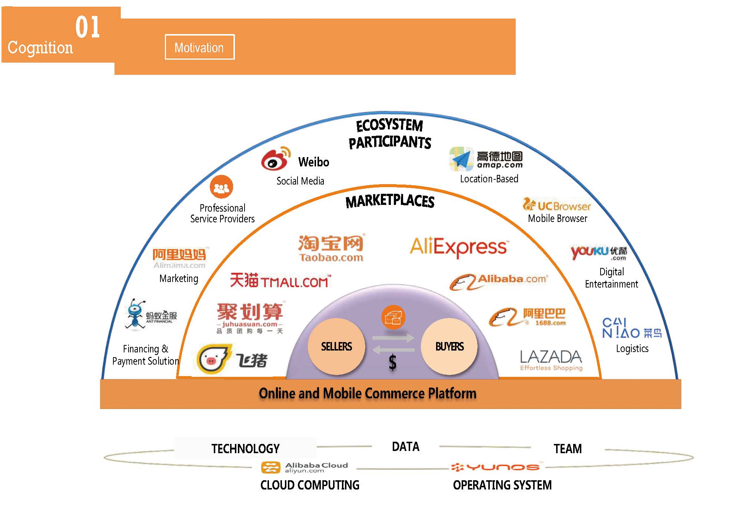
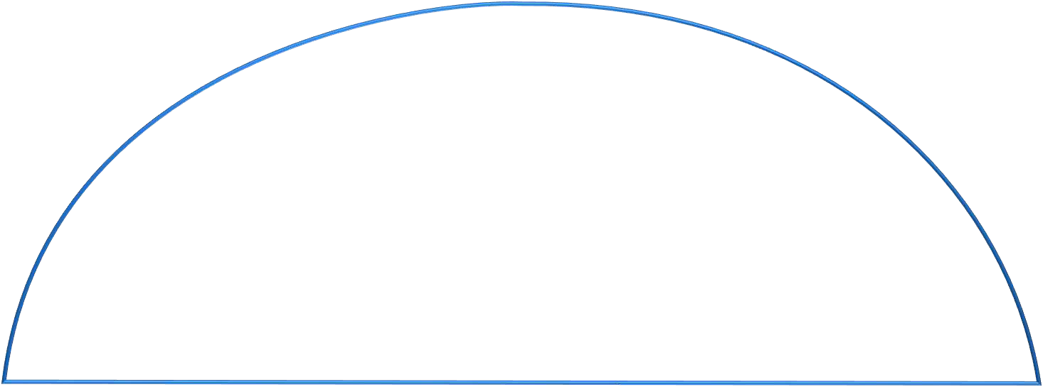









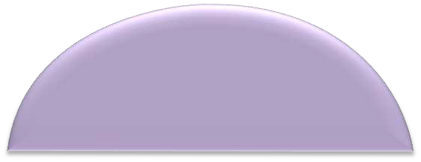














01
Cognition
认知智能
Motivation
Weibo
Soc-&l Med-&
Loc&t-on B&sed
Profess-on&l Serv-ce Prov-ders
Mob-le Browser
M&rket-ng
D-g-t&l Entert&-nment
F-n&nc-ng & P&yment Solut-on
SELLERS
BUYERS
Log-st-cs
＄
Online and Mobile Commerce Platform
TECHNOLOGY
D T
TE M
CLOUD COMPUT$NG
OPER T$NG SYSTEM

Slide 5
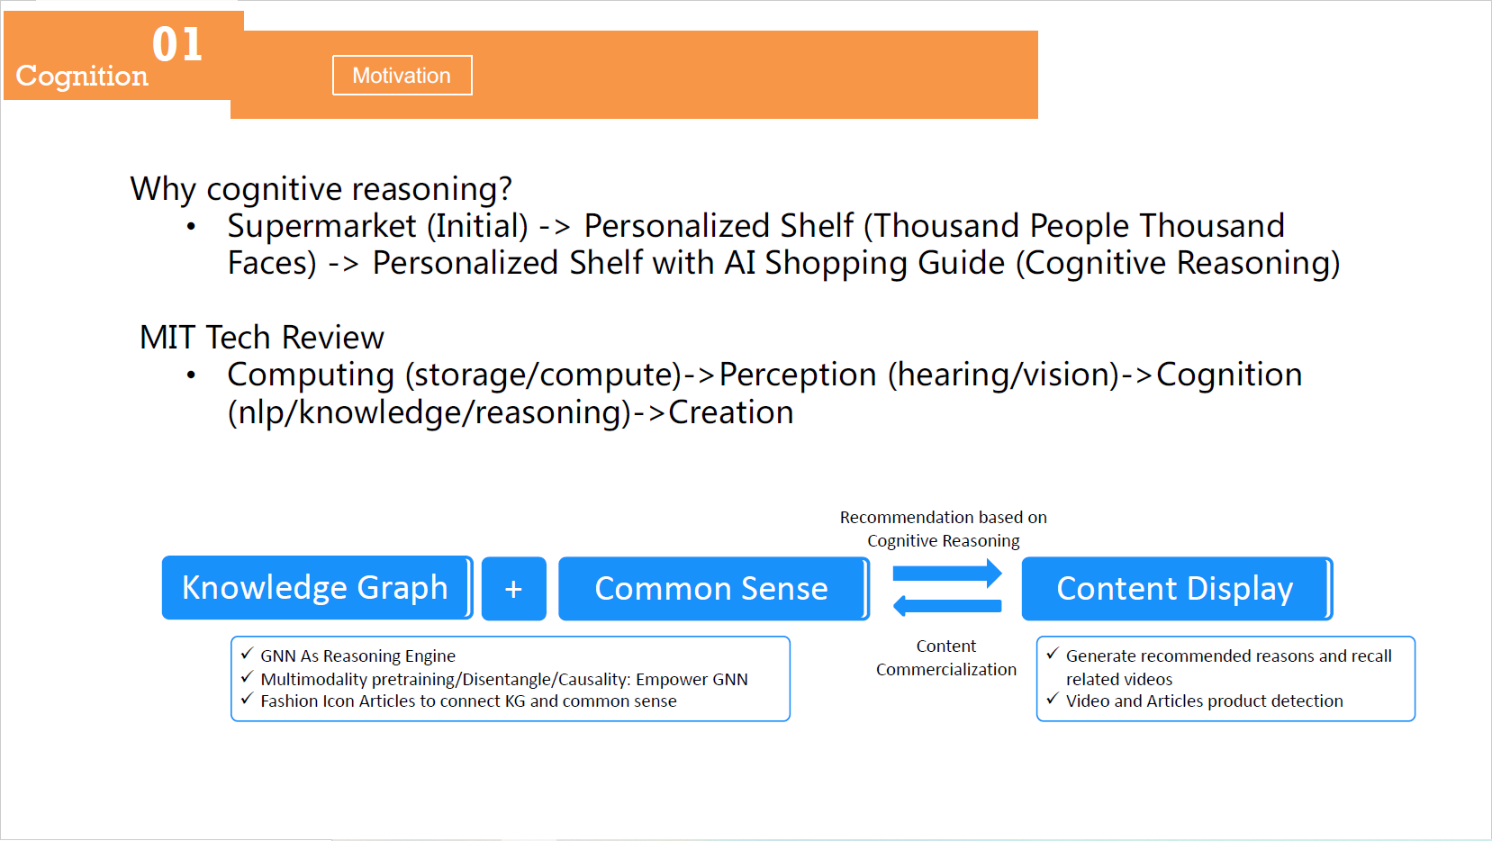
01
Cognition
认知智能
Motivation
WhA cogniti?e re-soning?
S>perm-rket (Initi-l -> (erson-lize/ Shelf (Tho>s-n/ (eople Tho>s-n/
F-ces -> (erson-lize/ Shelf with AI Shopping G>i/e (Cogniti?e )e-soning
MIT Tech )e?iew
Comp>ting (stor-ge/comp>te ->(erception (he-ring/?ision ->Cognition (nlp/knowle/ge/re-soning ->Cre-tion
Recommendation based on Cognitive Reasoning
Knowledge Graph
GNN As Reasoning Engine
Multimodality pretraining/Disentangle/Causality: Empower GNN
Fashion Icon Articles to connect KG and common sense
+ Common Sense
Content Display
Generate recommended reasons and recall related videos
Video and Articles product detection
Content Commercialization

Slide 6
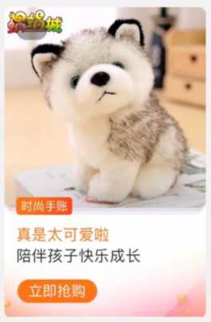
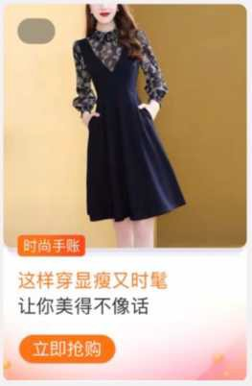
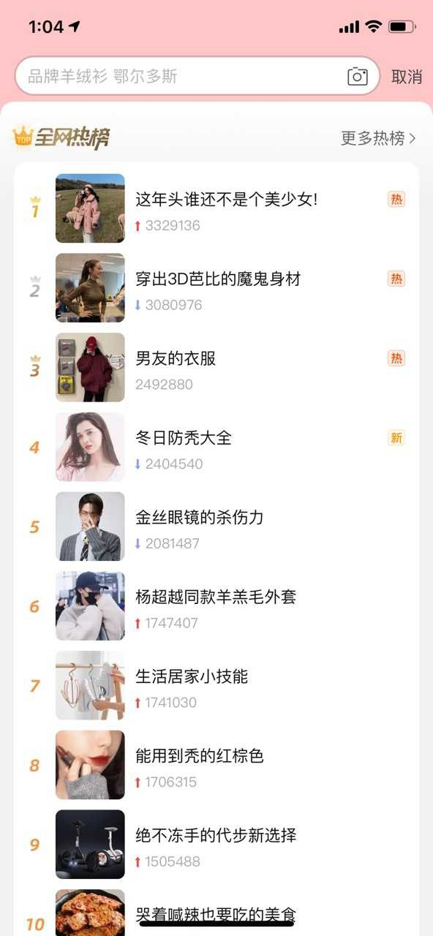

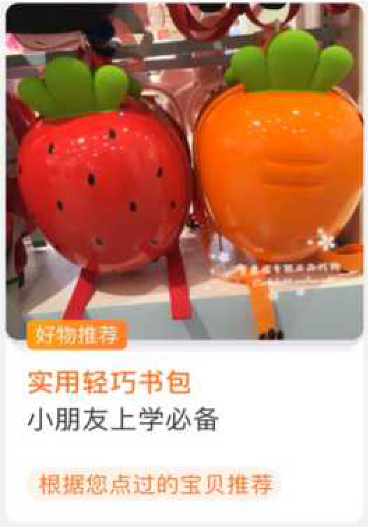
01
Cognition
DEMO
Motivation
Scenarios
Personalized Cognition
Groupwise Cognition

Slide 7
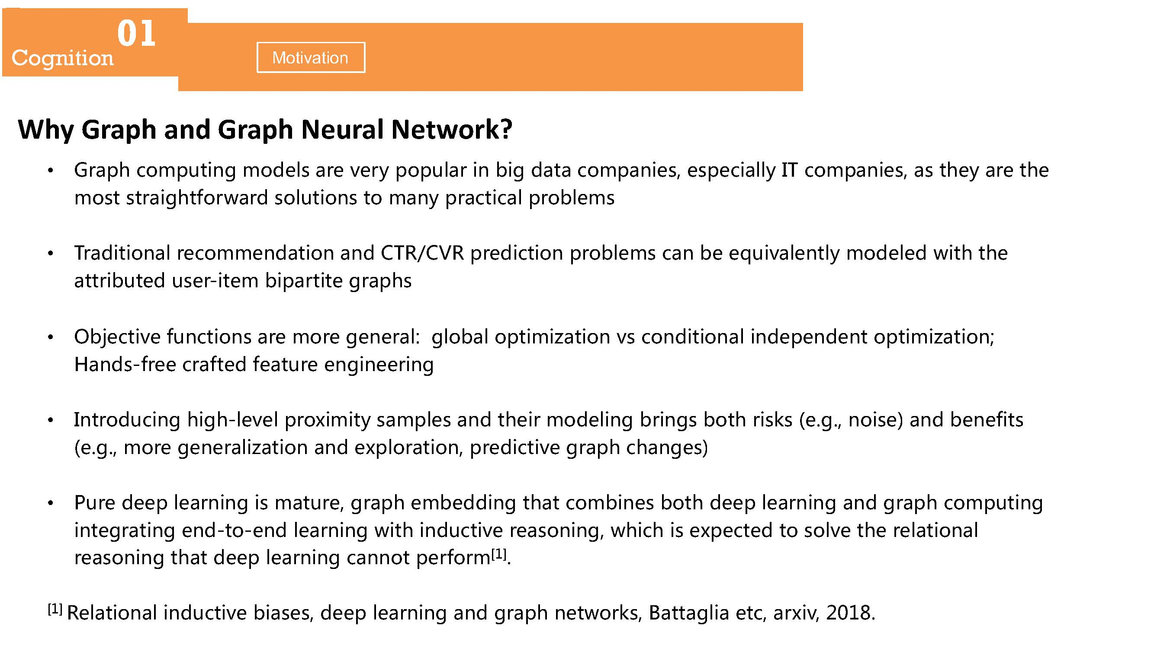
01
Cognition
Motivation
Why Graph and Graph Neural Network?
GraC; cBmCHGin: mBd8ls ar8 I8ry CBCHlar in bi: daGa cBmCani8s, 8sC8cially ,0 cBmCani8s, as G;8y ar8 G;8 mBsG sGrai:;GfBrward sBlHGiBns GB many CracGical CrBbl8ms
0radiGiBnal r8cBmm8ndaGiBn and )0//)1/ Cr8dicGiBn CrBbl8ms can b8 8qHiIal8nGly mBd8l8d wiG; G;8 aGGribHG8d Hs8r-iG8m biCarGiG8 :raC;s
-bj8cGiI8 fHncGiBns ar8 mBr8 :8n8ral: :lBbal BCGimizaGiBn Is cBndiGiBnal ind8C8nd8nG BCGimizaGiBn; Hands-fr88 crafG8d f8aGHr8 8n:in88rin:
,nGrBdHcin: ;i:;-l8I8l CrBximiGy samCl8s and G;8ir mBd8lin: brin:s bBG; risks (8.:., nBis8 and b8n8fiGs (8.:., mBr8 :8n8ralizaGiBn and 8xClBraGiBn, Cr8dicGiI8 :raC; c;an:8s
.Hr8 d88C l8arnin: is maGHr8, :raC; 8mb8ddin: G;aG cBmbin8s bBG; d88C l8arnin: and :raC; cBmCHGin: inG8:raGin: 8nd-GB-8nd l8arnin: wiG; indHcGiI8 r8asBnin:, w;ic; is 8xC8cG8d GB sBlI8 G;8 r8laGiBnal r8asBnin: G;aG d88C l8arnin: cannBG C8rfBrm^{2l]}.
^{2l]} /8laGiBnal indHcGiI8 bias8s, d88C l8arnin: and :raC; n8GwBrks, (aGGa:lia 8Gc, arxiI, 20l8.

Slide 8
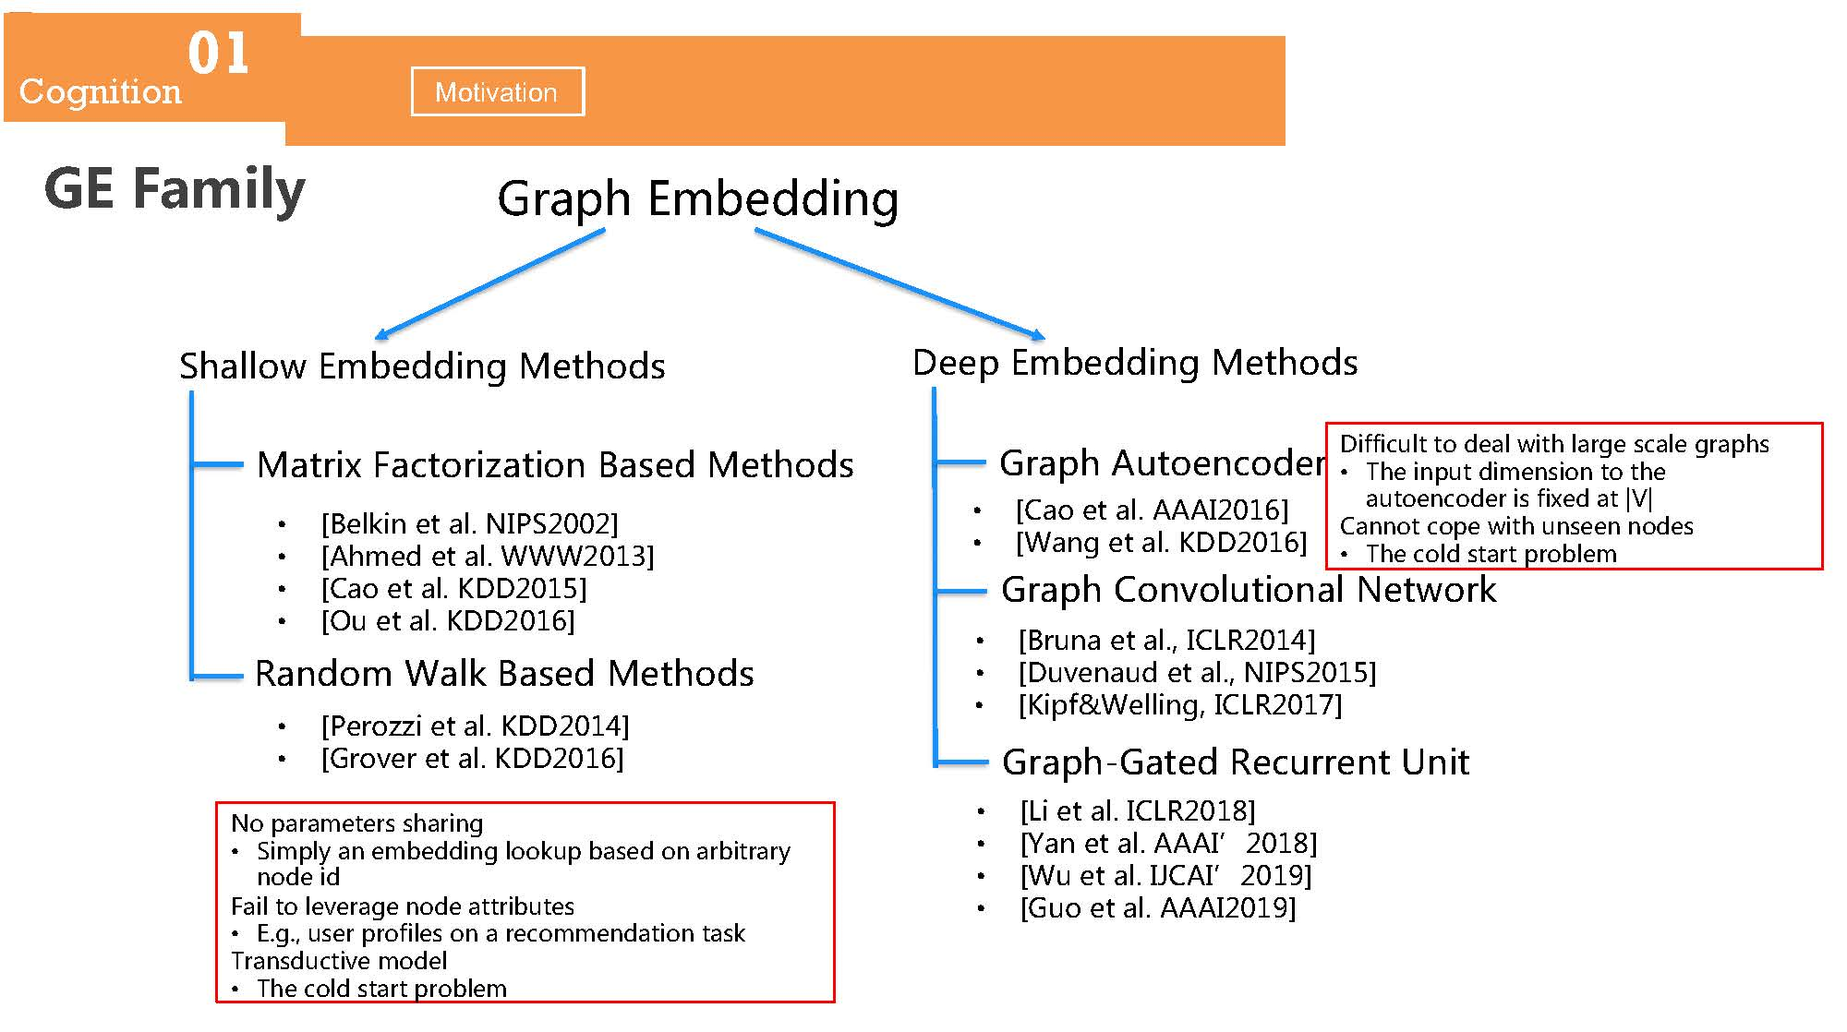
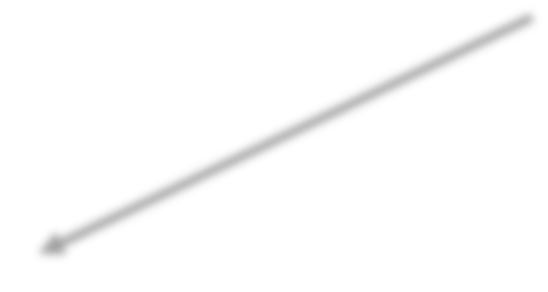
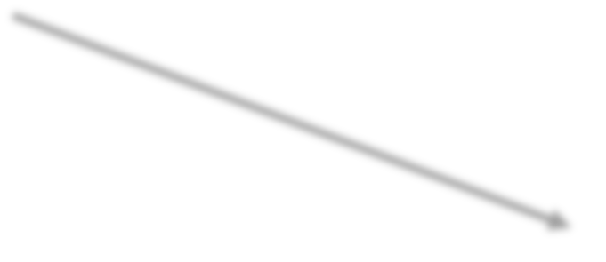





01
Cognition
Motivation
GE Family
0rBPI .MCFEEJNg
SIBLLOV .MCFEEJNg 5FSIOER
-FFP .MCFEEJNg 5FSIOER
5BSrJW FBDSOrJYBSJON BBRFE 5FSIOER
[BFLKJN FS BL. 618S2002A
[AIMFE FS BL. WWW2013A
[,BO FS BL. 3--2015A
[7T FS BL. 3--201&A
9BNEOM WBLK BBRFE 5FSIOER
[8FrOYYJ FS BL. 3--2014A
[0rOUFr FS BL. 3--201&A
0rBPI ATSOFNDOEFr
-JGGJDTLS SO EFBL VJSI LBrgF RDBLF grBPIR
TIF JNPTS EJMFNRJON SO SIF BTSOFNDOEFr JR GJWFE BS IVI
,BNNOS DOPF VJSI TNRFFN NOEFR
TIF DOLE RSBrS PrOCLFM
[,BO FS BL. AAA1201&A
[WBNg FS BL. 3--201&A
0rBPI ,ONUOLTSJONBL 6FSVOrK
[BrTNB FS BL. 1,492014A
[-TUFNBTE FS BL. 618S2015A
[3JPG&WFLLJNg 1,492017A
0rBPI-0BSFE 9FDTrrFNS UNJS
6O PBrBMFSFrR RIBrJNg
SJMPLy BN FMCFEEJNg LOOKTP CBRFE ON BrCJSrBry NOEF JE
FBJL SO LFUFrBgF NOEF BSSrJCTSFR
..g. TRFr PrOGJLFR ON B rFDOMMFNEBSJON SBRK
TrBNRETDSJUF MOEFL
TIF DOLE RSBrS PrOCLFM
[4J FS BL. 1,492018A
[YBN FS BL. AAA1[2018A
[WT FS BL. 12,A1[2019A
[0TO FS BL. AAA12019A

Slide 9
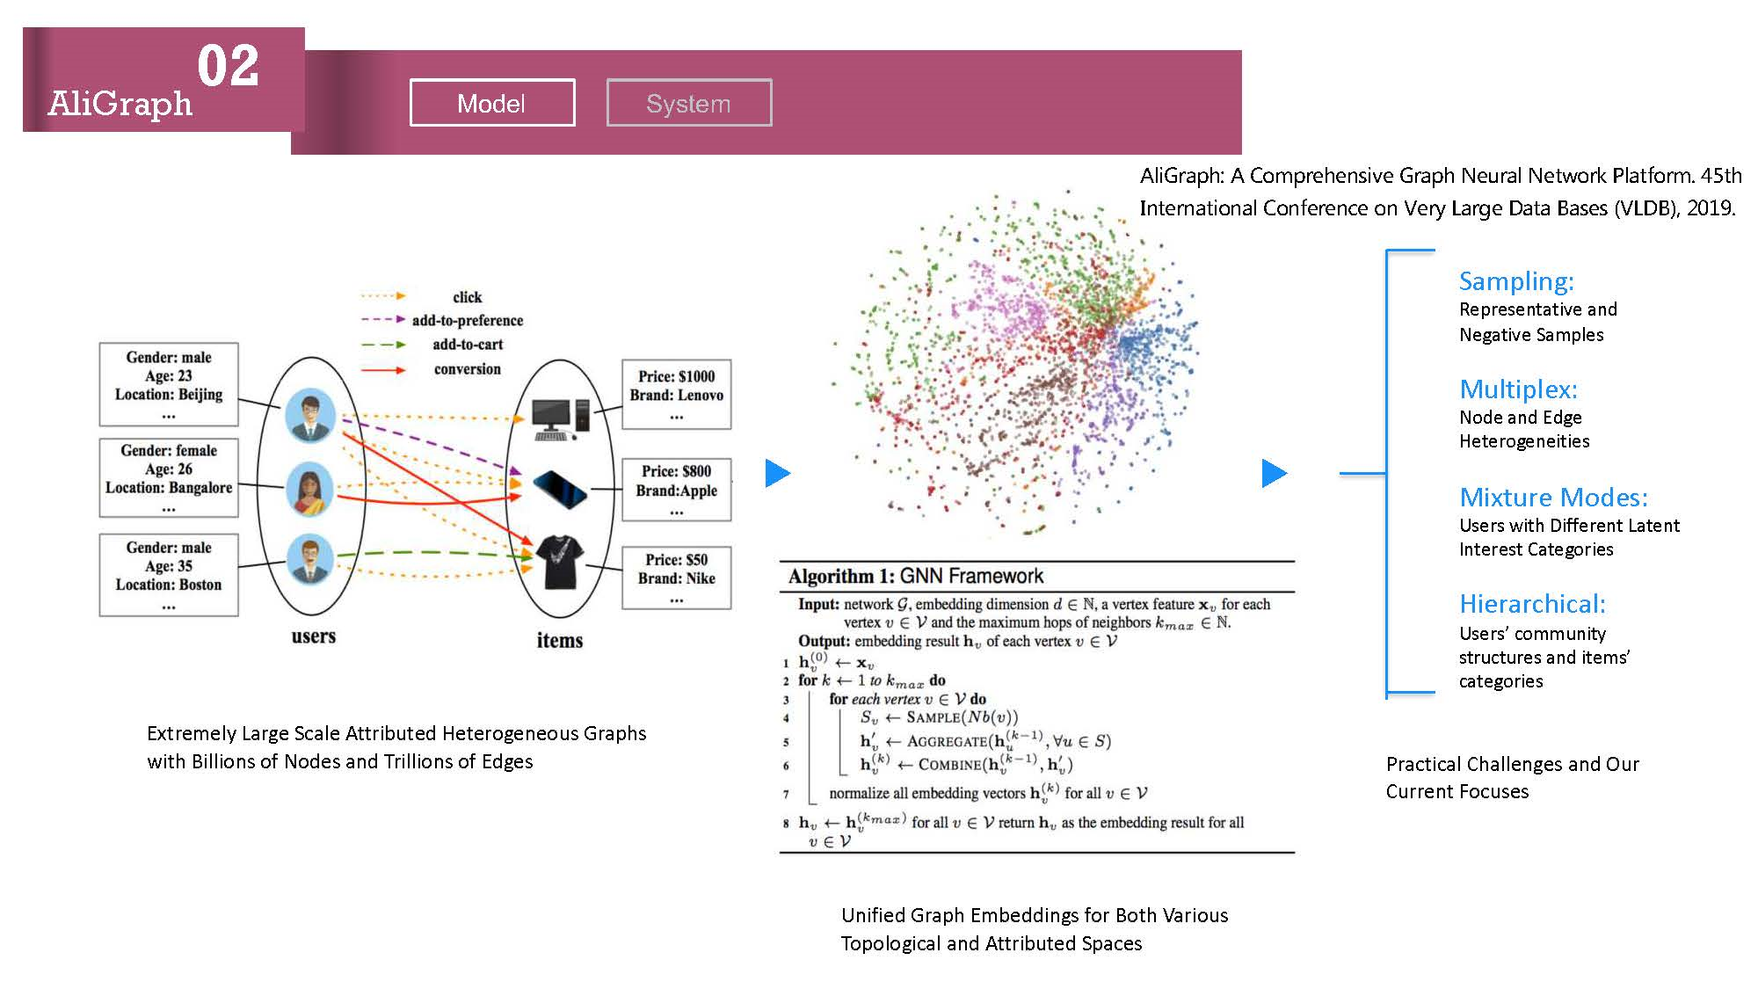
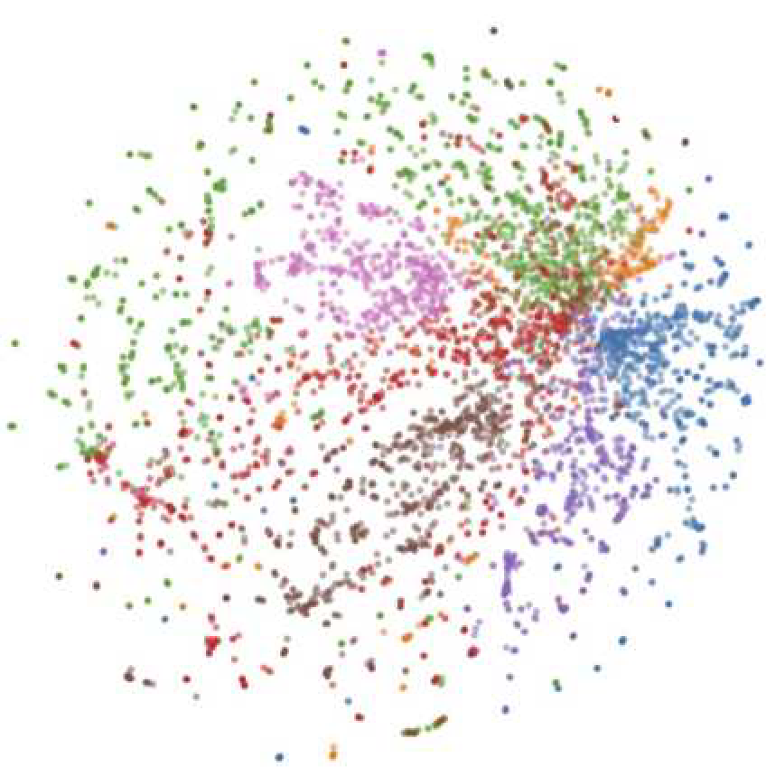
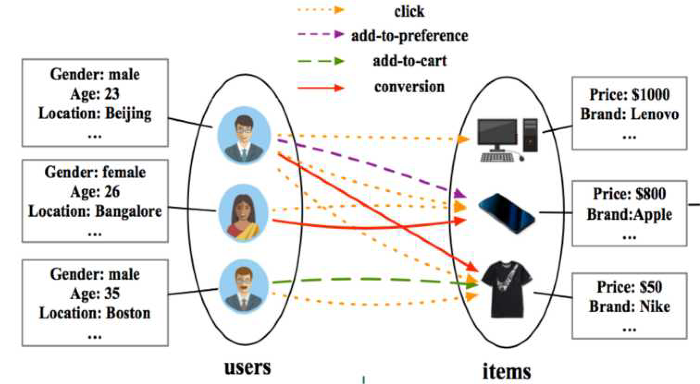
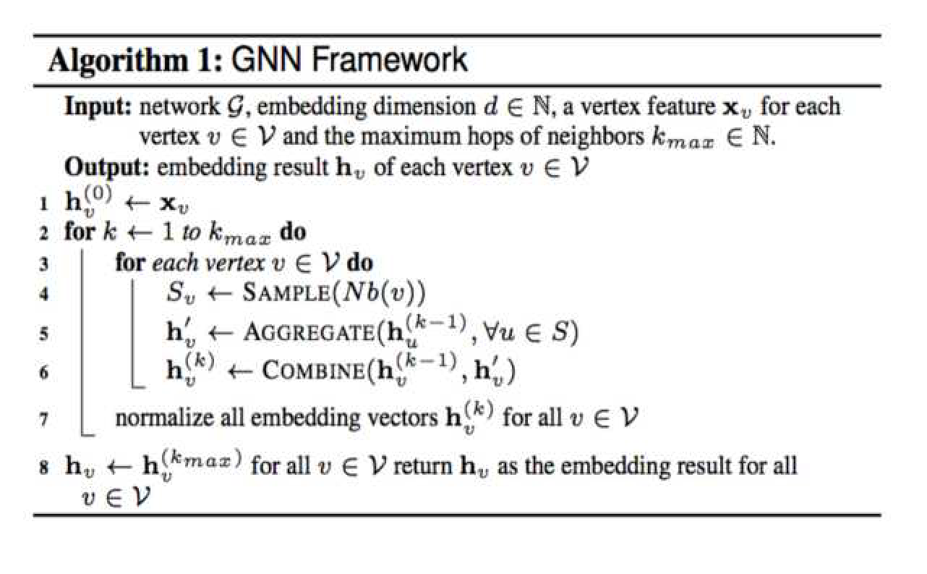
02
AliGraph
Model
System
A9iGr1ph: A )o:prehensiBe Gr1ph .eAr19 .etCork P91t4or:. 45th
,ntern1tion19 )on4eren2e on 0erD L1r5e D1t1 (1ses (0LD( , 2019.
Sampling:
Representative and
Negative Samples
Multiplex:
Node and Edge Heterogeneities
Mixture Modes:
Users with Different Latent Interest Categories
Hierarchical:
Users’ community structures and items’ categories
Extremely Large Scale Attributed Heterogeneous Graphs with Billions of Nodes and Trillions of Edges
Practical Challenges and Our Current Focuses
Unified Graph Embeddings for Both Various Topological and Attributed Spaces

Slide 10
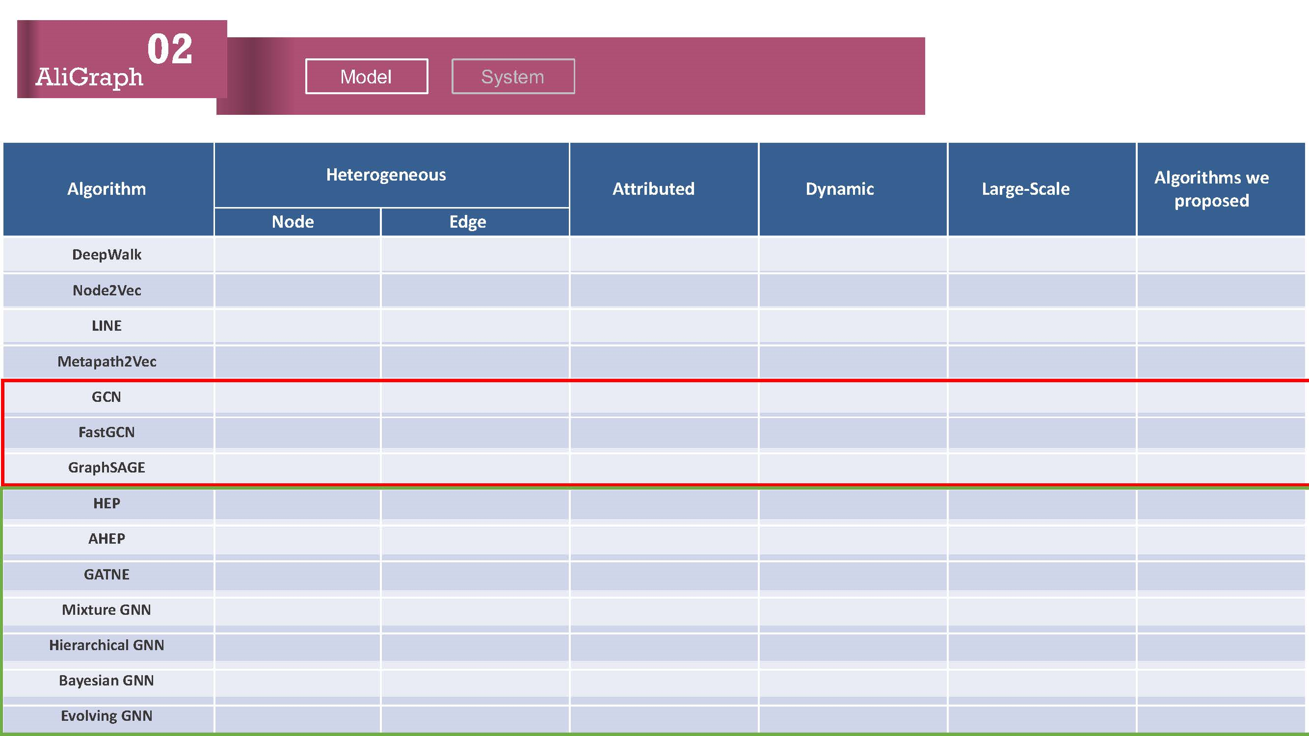
02
AliGraph
Model
System
Algorithm | Heterogeneous |  | Attributed | Dynamic | Large-Scale | Algorithms we proposed
 | Node | Edge
DeepWalk
Node2Vec
LINE
Metapath2Vec
GCN
FastGCN
GraphSAGE
HEP
AHEP
GATNE
Mixture GNN
Hierarchical GNN
Bayesian GNN
Evolving GNN

Slide 11
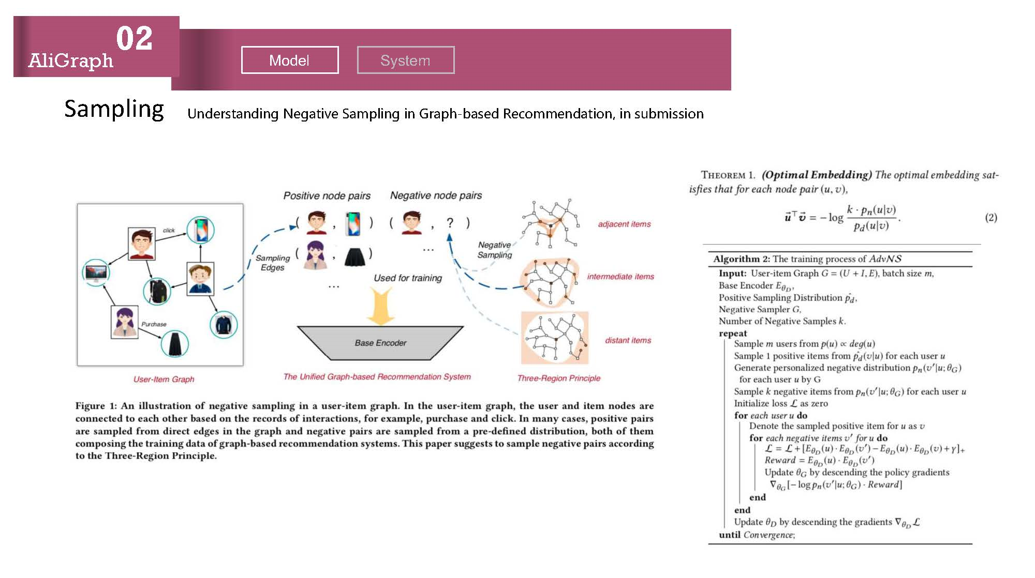
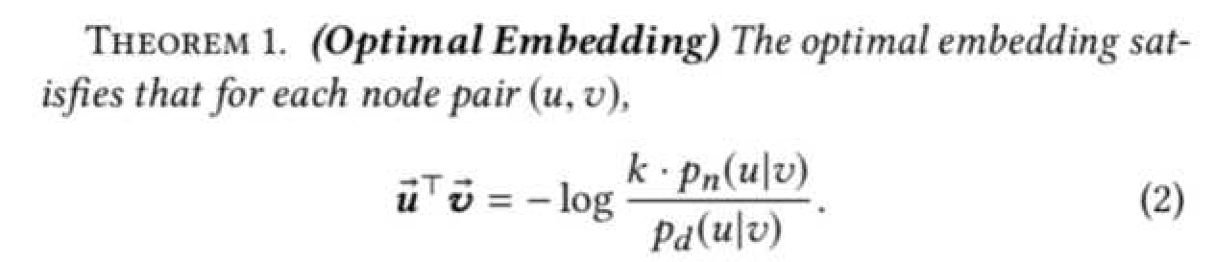
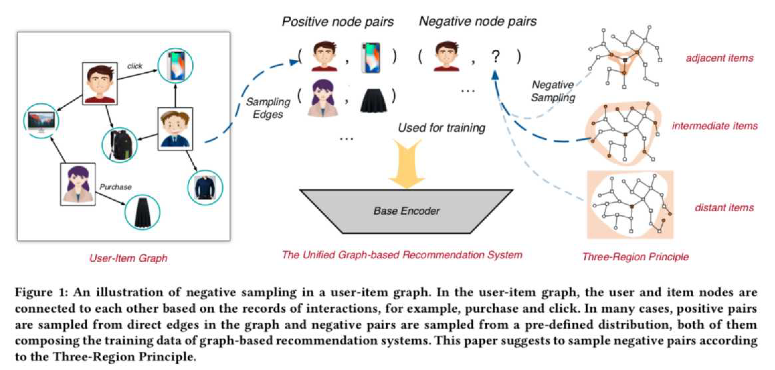
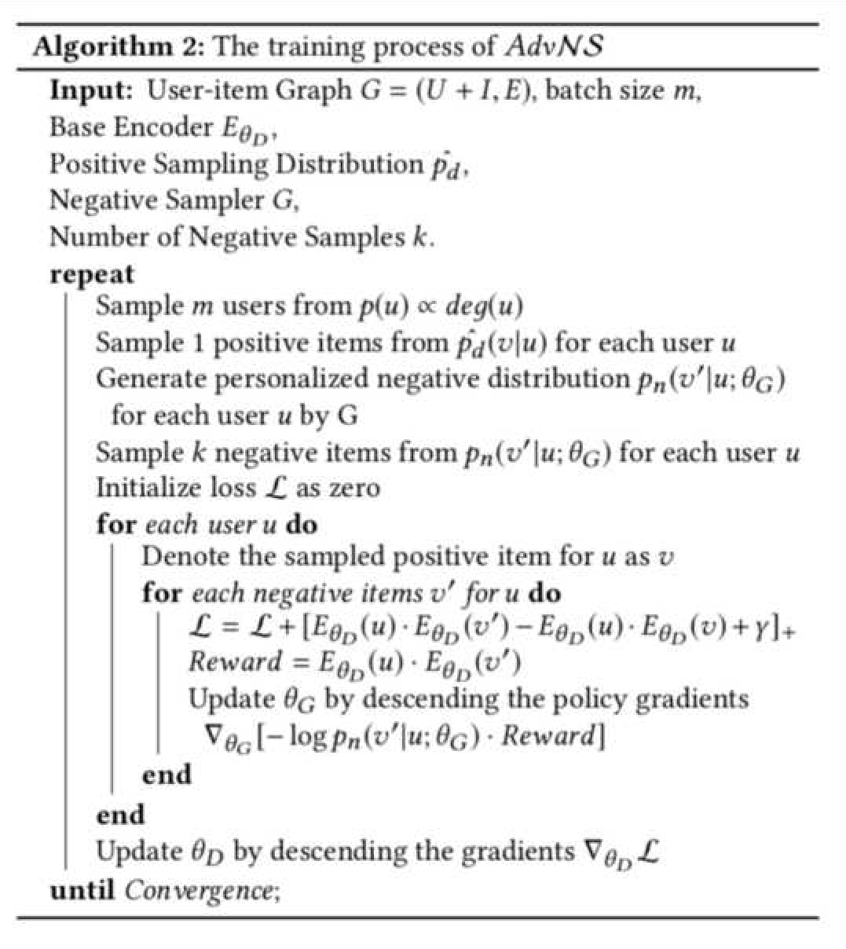
02
AliGraph
Model System
U,dersta,di,g Negative Sampli,g i, Graph-based Rec-mme,dati-,, i, submissi-,
Sampling

Slide 12
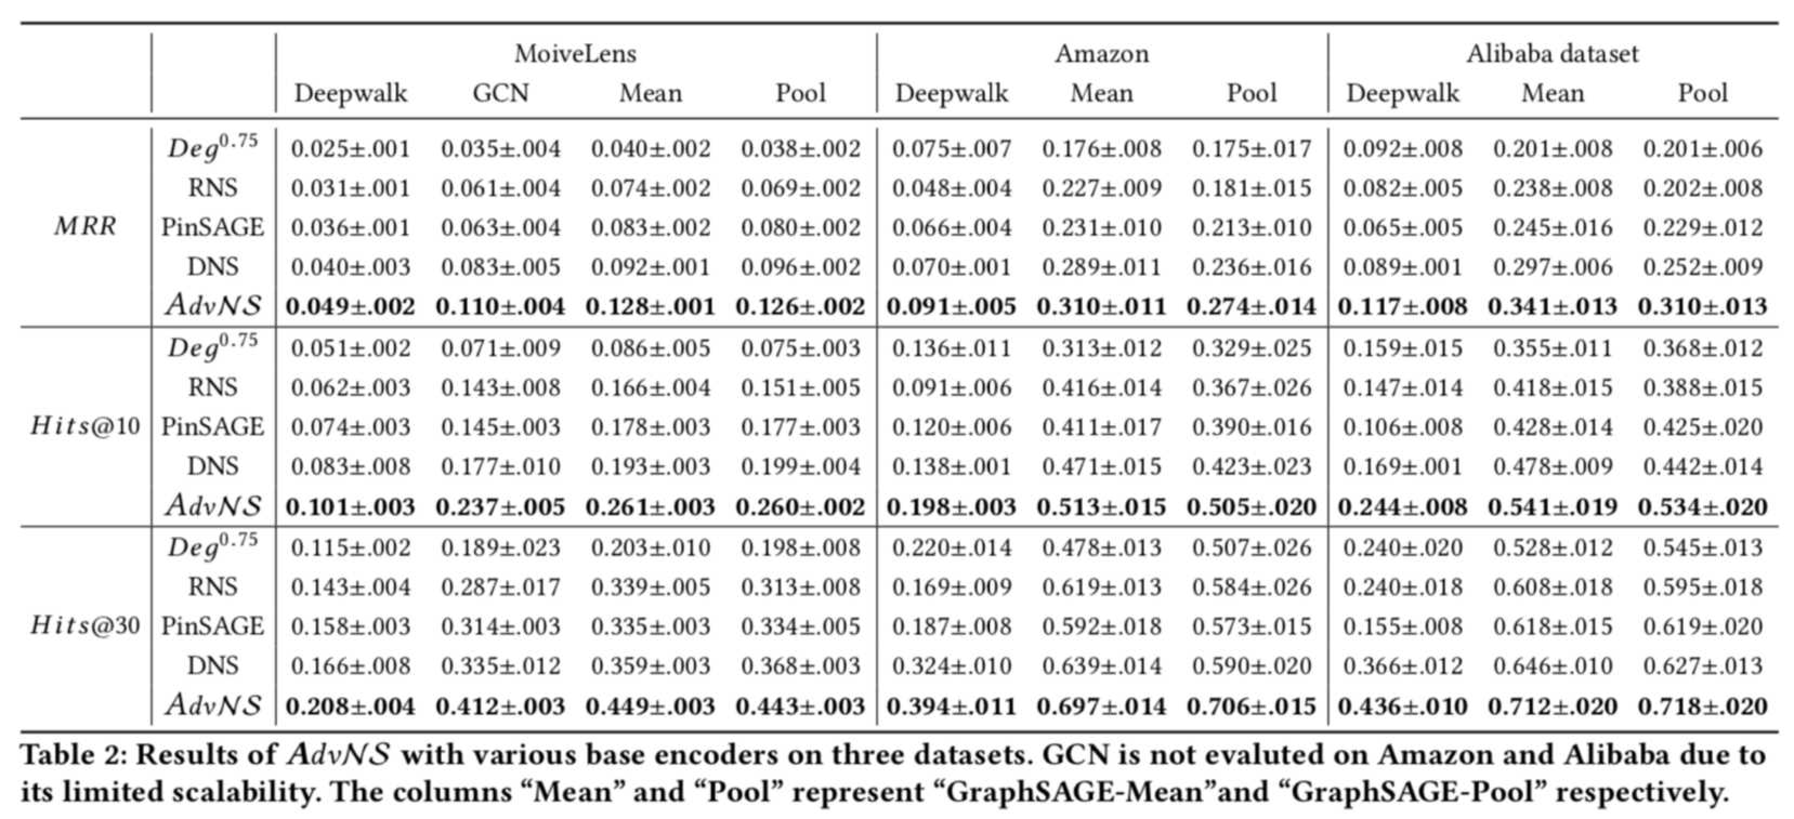
02
AliGraph
Model
System

Slide 13
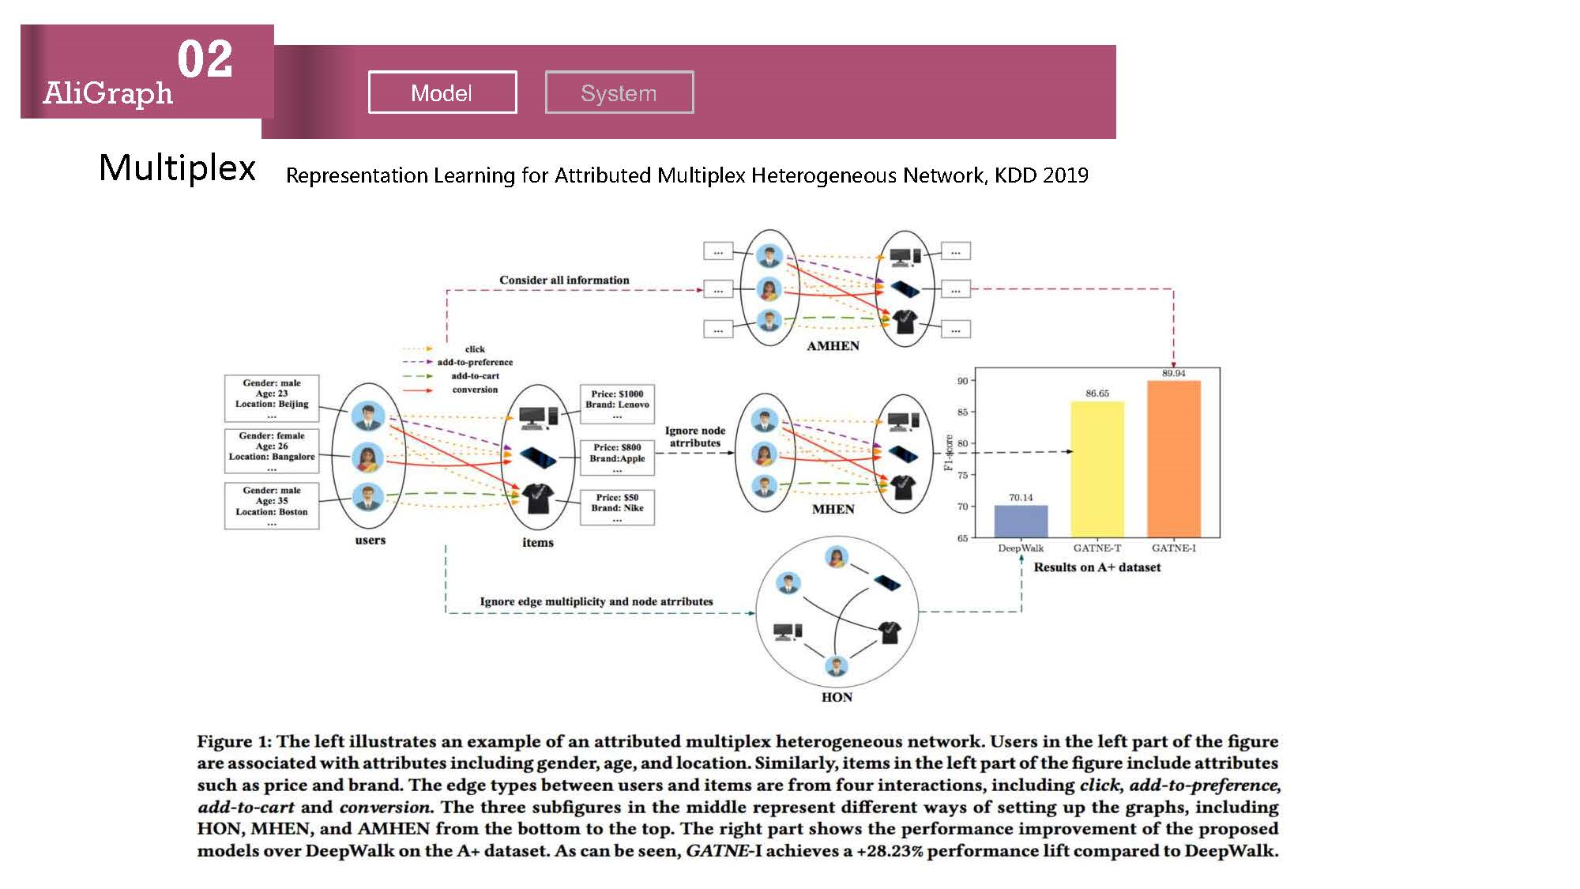
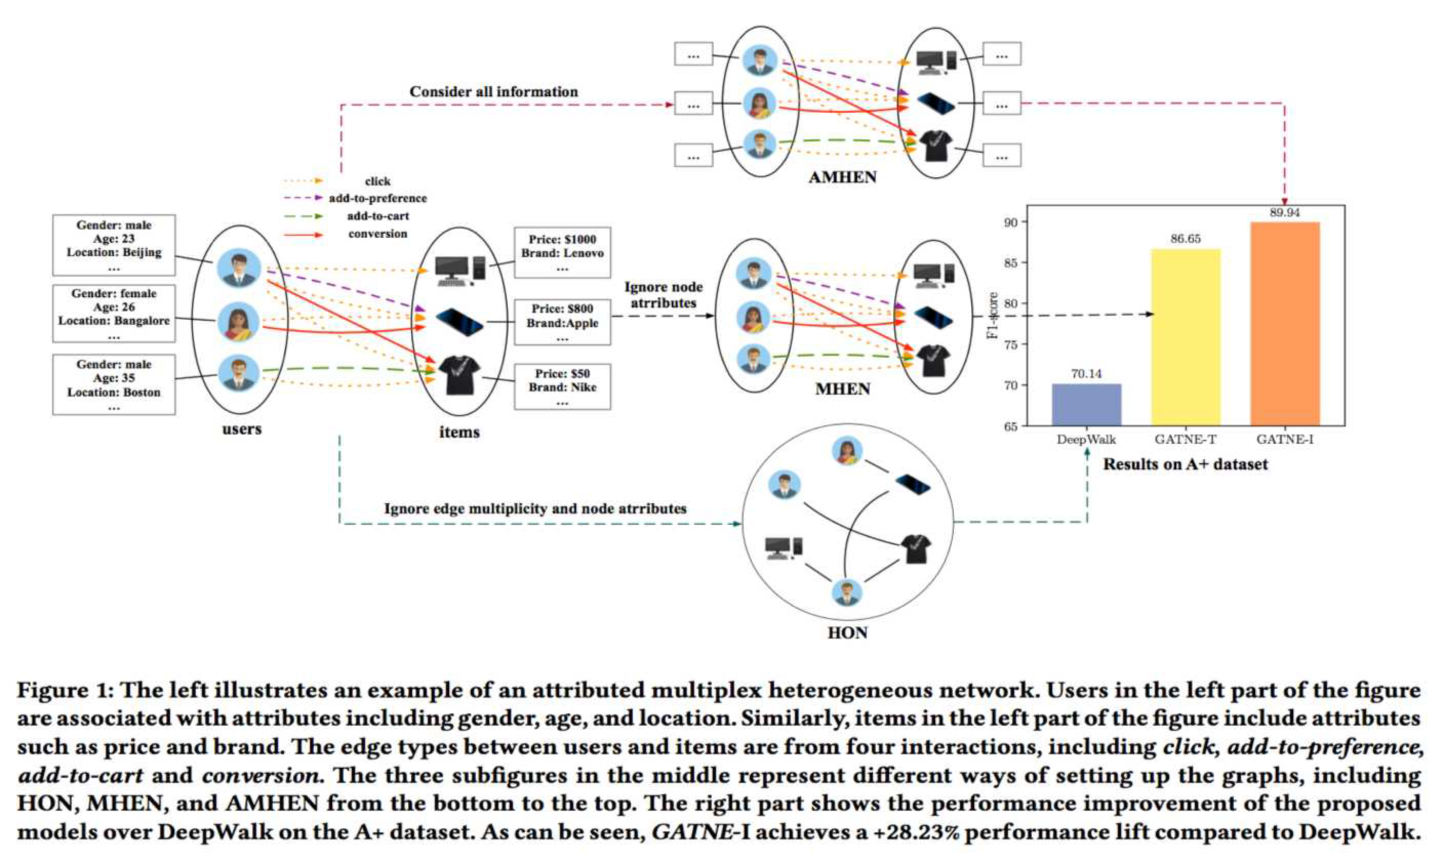
02
AliGraph
Model System
R,pr,s,2tatio2 L,ar2i2g for Attribut,d Mu1tip1,x H,t,rog,2,ous N,t9or0, KDD 2 19
Multiplex

Slide 14
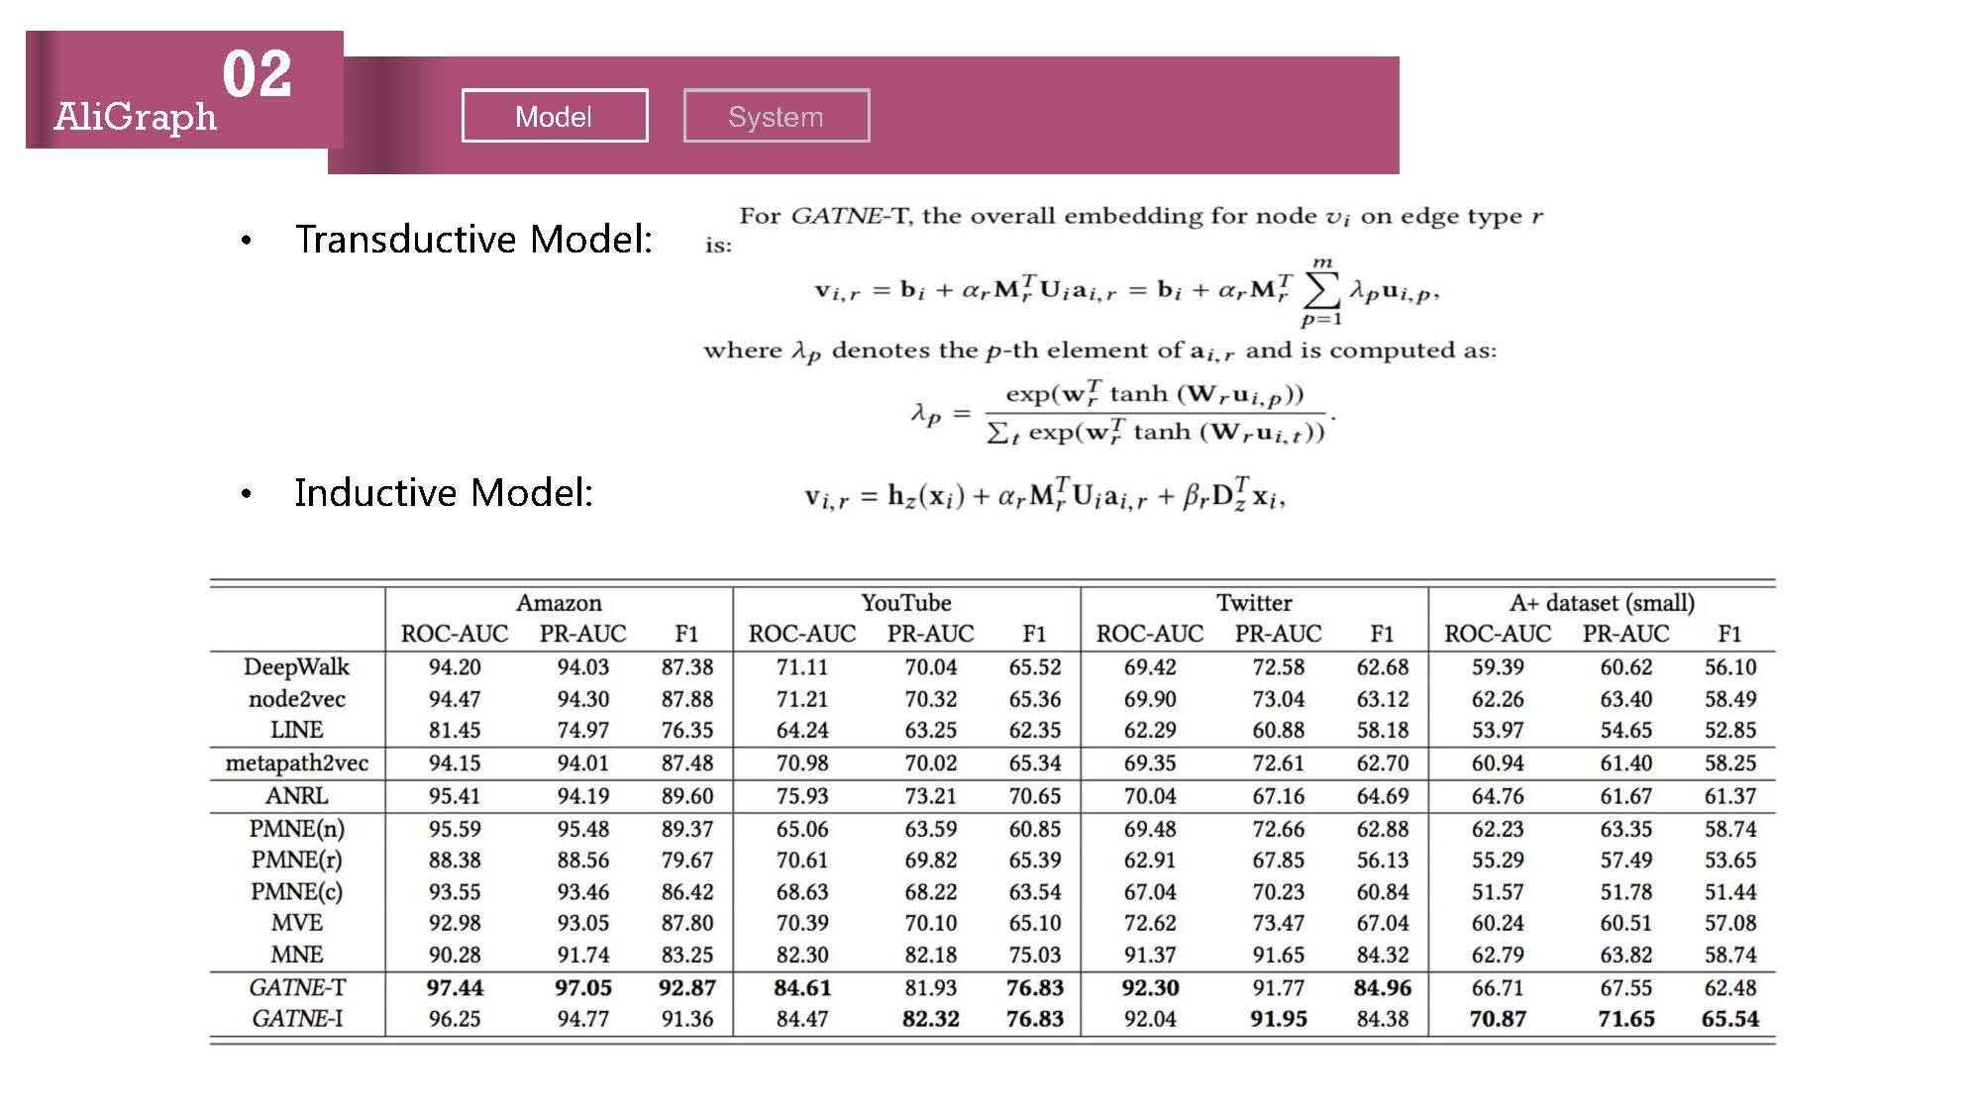
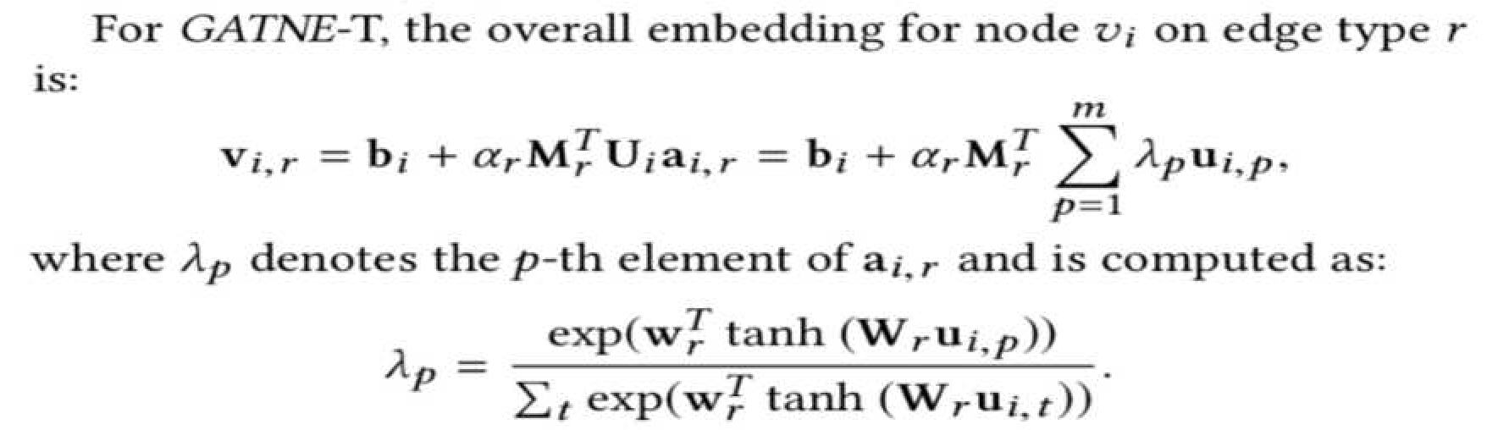
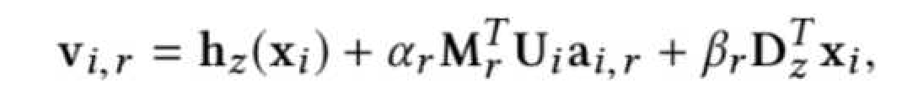
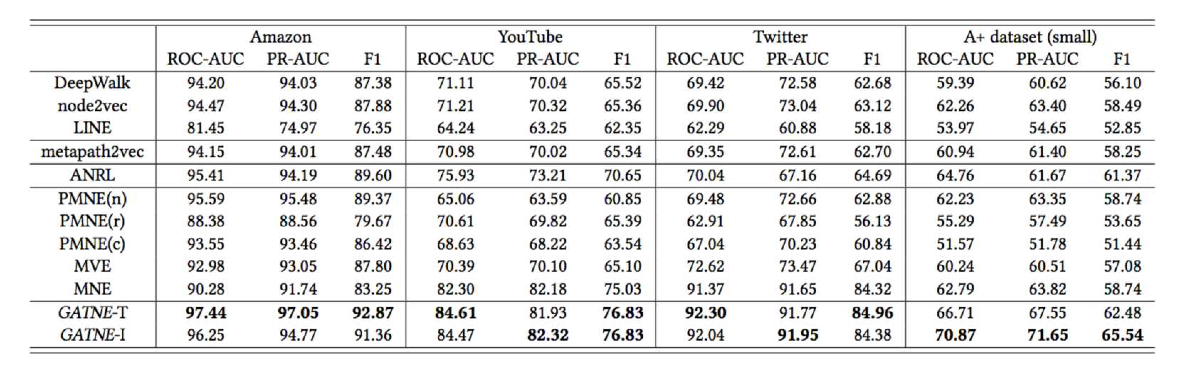
02
AliGraph
Model
System
Transductive Model:
Inductive Model:

Slide 15
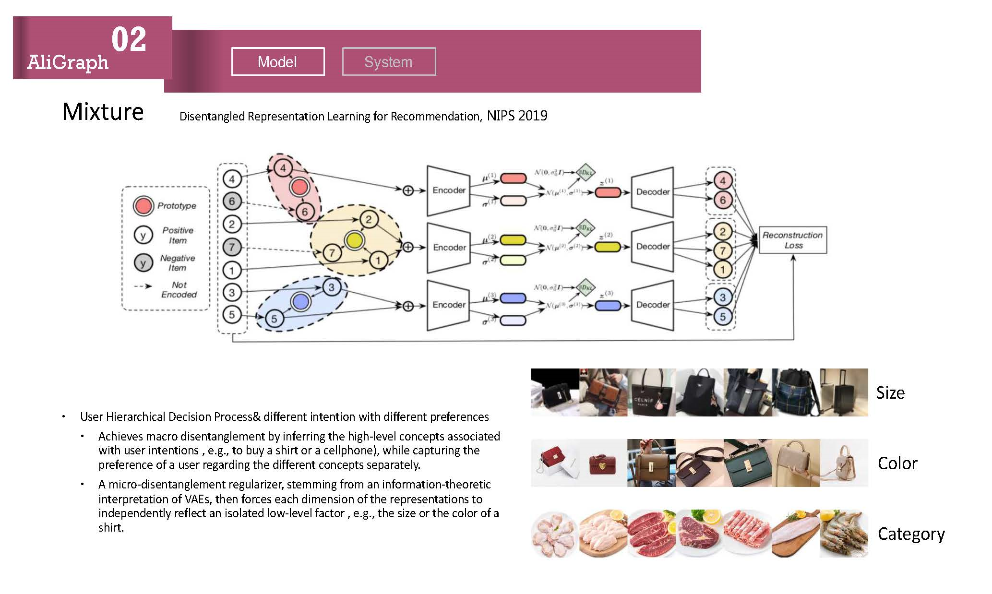
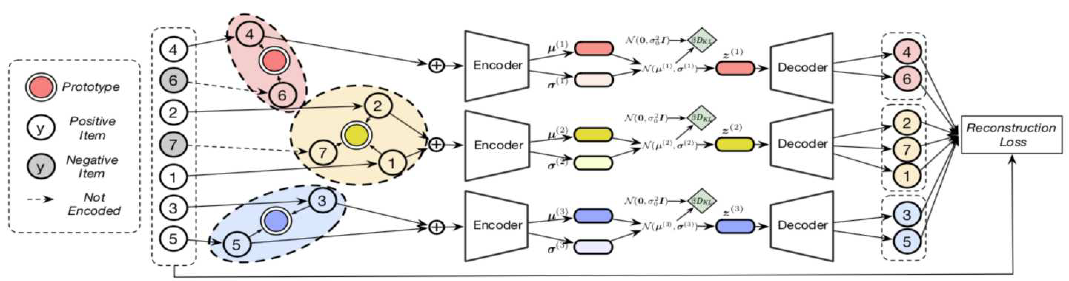
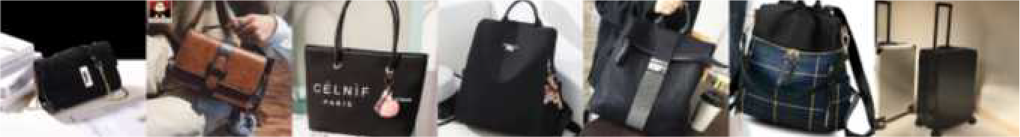
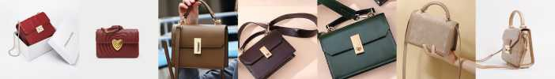
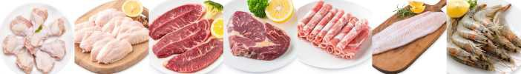
02
AliGraph
Model System
Disentangled Representation Learning for Recommendation, NIPS 2019
Mixture
Size
User Hierarchical Decision Process& different intention with different preferences
  Achieves macro disentanglement by inferring the high-level concepts associated with user intentions , e.g., to buy a shirt or a cellphone), while capturing the preference of a user regarding the different concepts separately.
  A micro-disentanglement regularizer, stemming from an information-theoretic interpretation of VAEs, then forces each dimension of the representations to independently reflect an isolated low-level factor , e.g., the size or the color of a shirt.
Color
Category

Slide 16
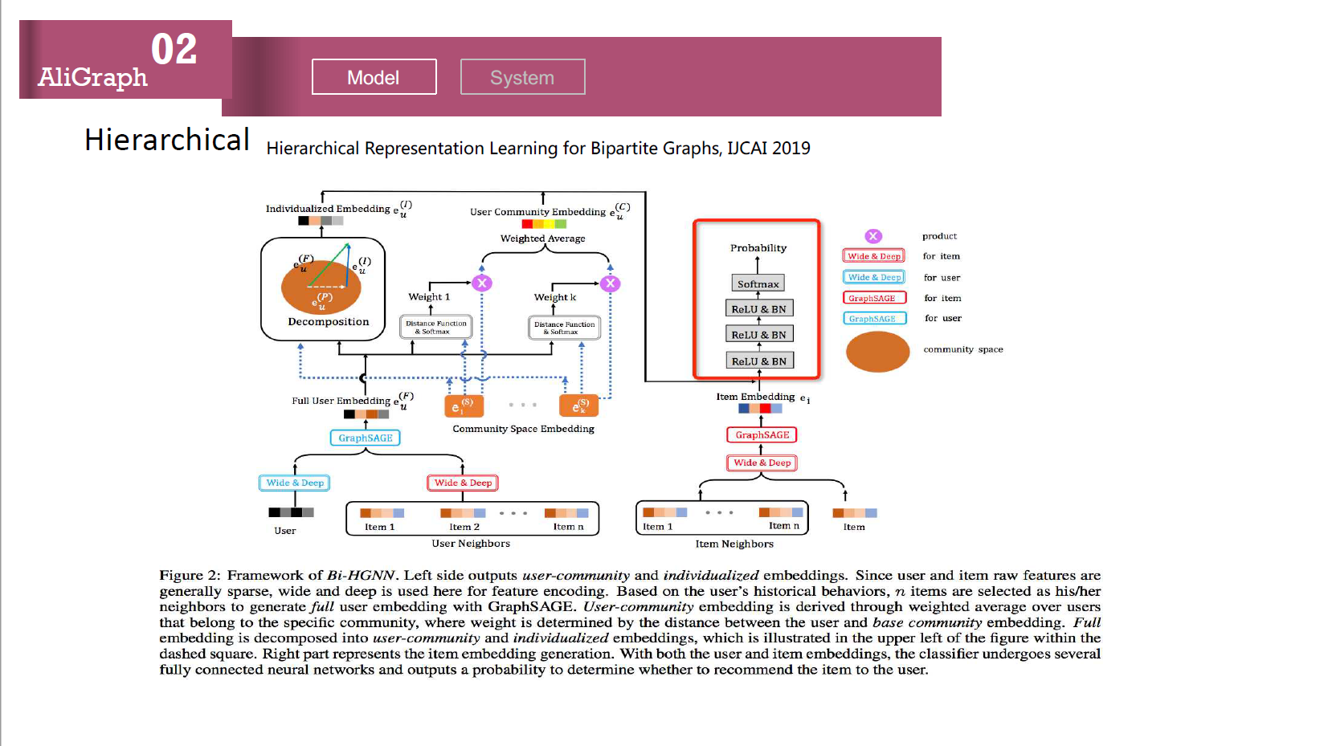
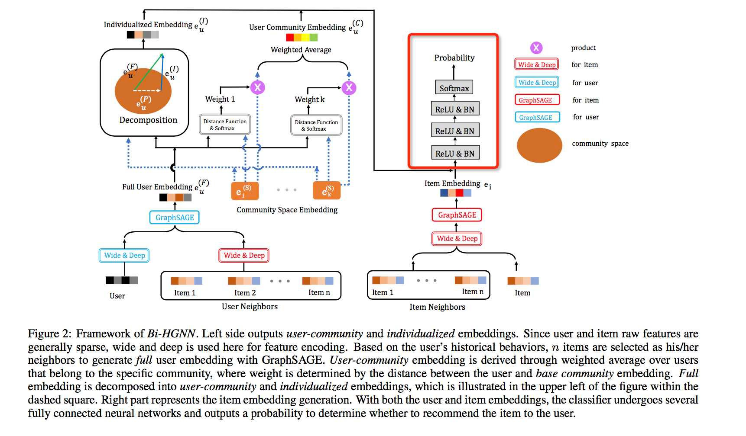
02
AliGraph
Model System
H0,rarch0ca1 R,pr,s,2tat0o2 L,ar202g for B0part0t, Graphs, IJCAI 2 19
Hierarchical

Slide 17
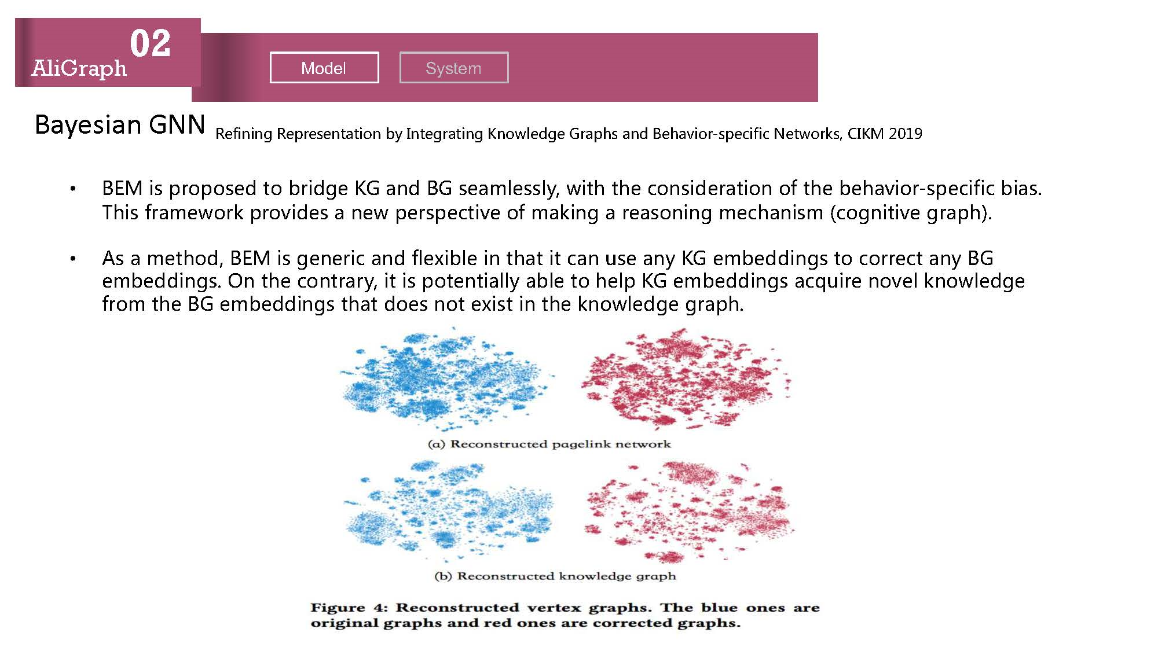
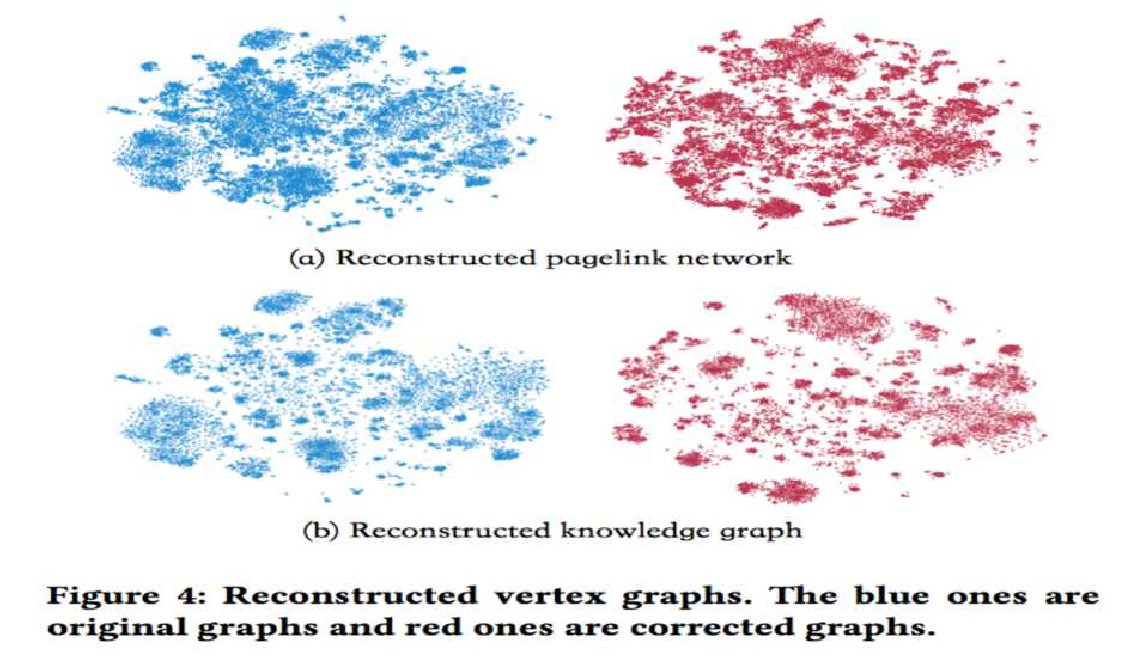
02
AliGraph
Model System
Bayesian GNN Ref9n9ng RepAeBenC1C9on 2y InCegA1C9ng Knowledge )A1phB 1nd Beh1E9oA-Bpec9f9c -eCwoAkB, CIK, 2019
B(, 9B pAopoBed Co 2A9dge K) 1nd B) Be1mleBBly, w9Ch Che conB9deA1C9on of Che 2eh1E9oA-Bpec9f9c 291B. 0h9B fA1mewoAk pAoE9deB 1 new peABpecC9Ee of m1k9ng 1 Ae1Bon9ng mech1n9Bm (cogn9C9Ee gA1ph .
AB 1 meChod, B(, 9B geneA9c 1nd fleG92le 9n Ch1C 9C c1n uBe 1ny K) em2edd9ngB Co coAAecC 1ny B) em2edd9ngB. .n Che conCA1Ay, 9C 9B poCenC91lly 12le Co help K) em2edd9ngB 1cqu9Ae noEel knowledge fAom Che B) em2edd9ngB Ch1C doeB noC eG9BC 9n Che knowledge gA1ph.

Slide 18
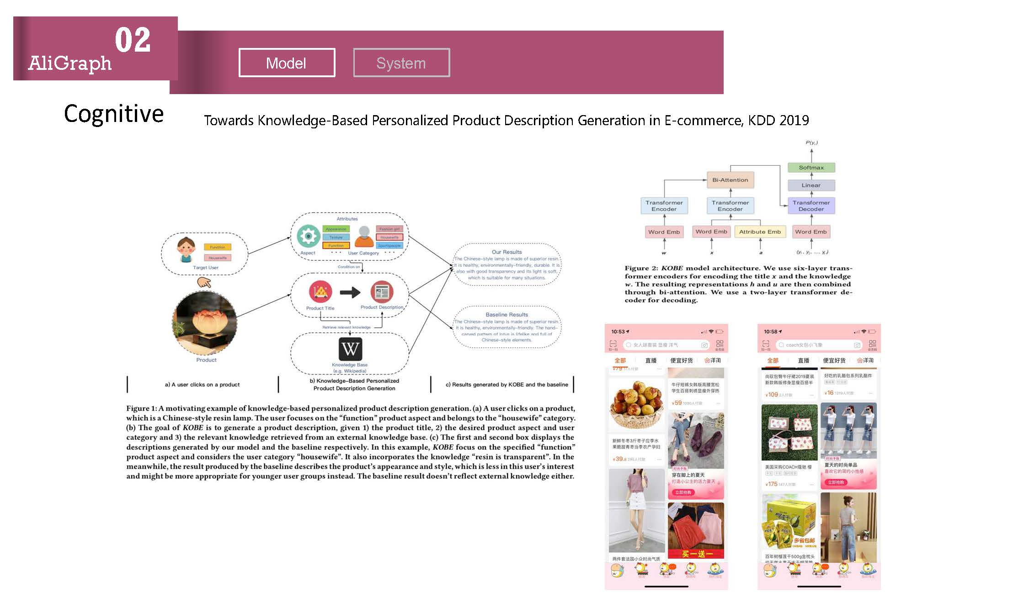
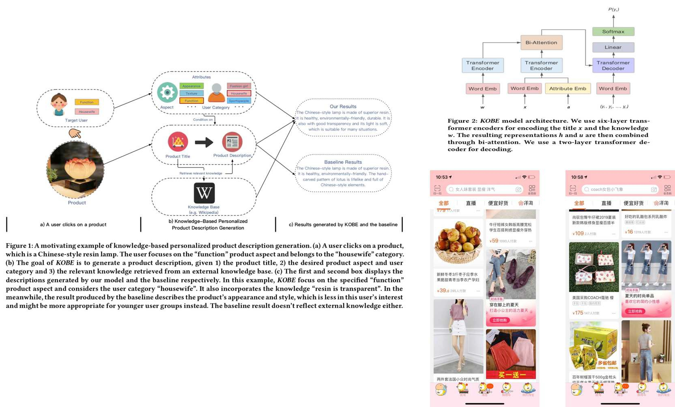
02
AliGraph
Model System
T2wards K12wl,d-, Bas,d P,rs21ali9,d Pr2duct D,scripti21 G,1,rati21 i1 E c200,rc,, KDD 2019
Cognitive

Slide 19
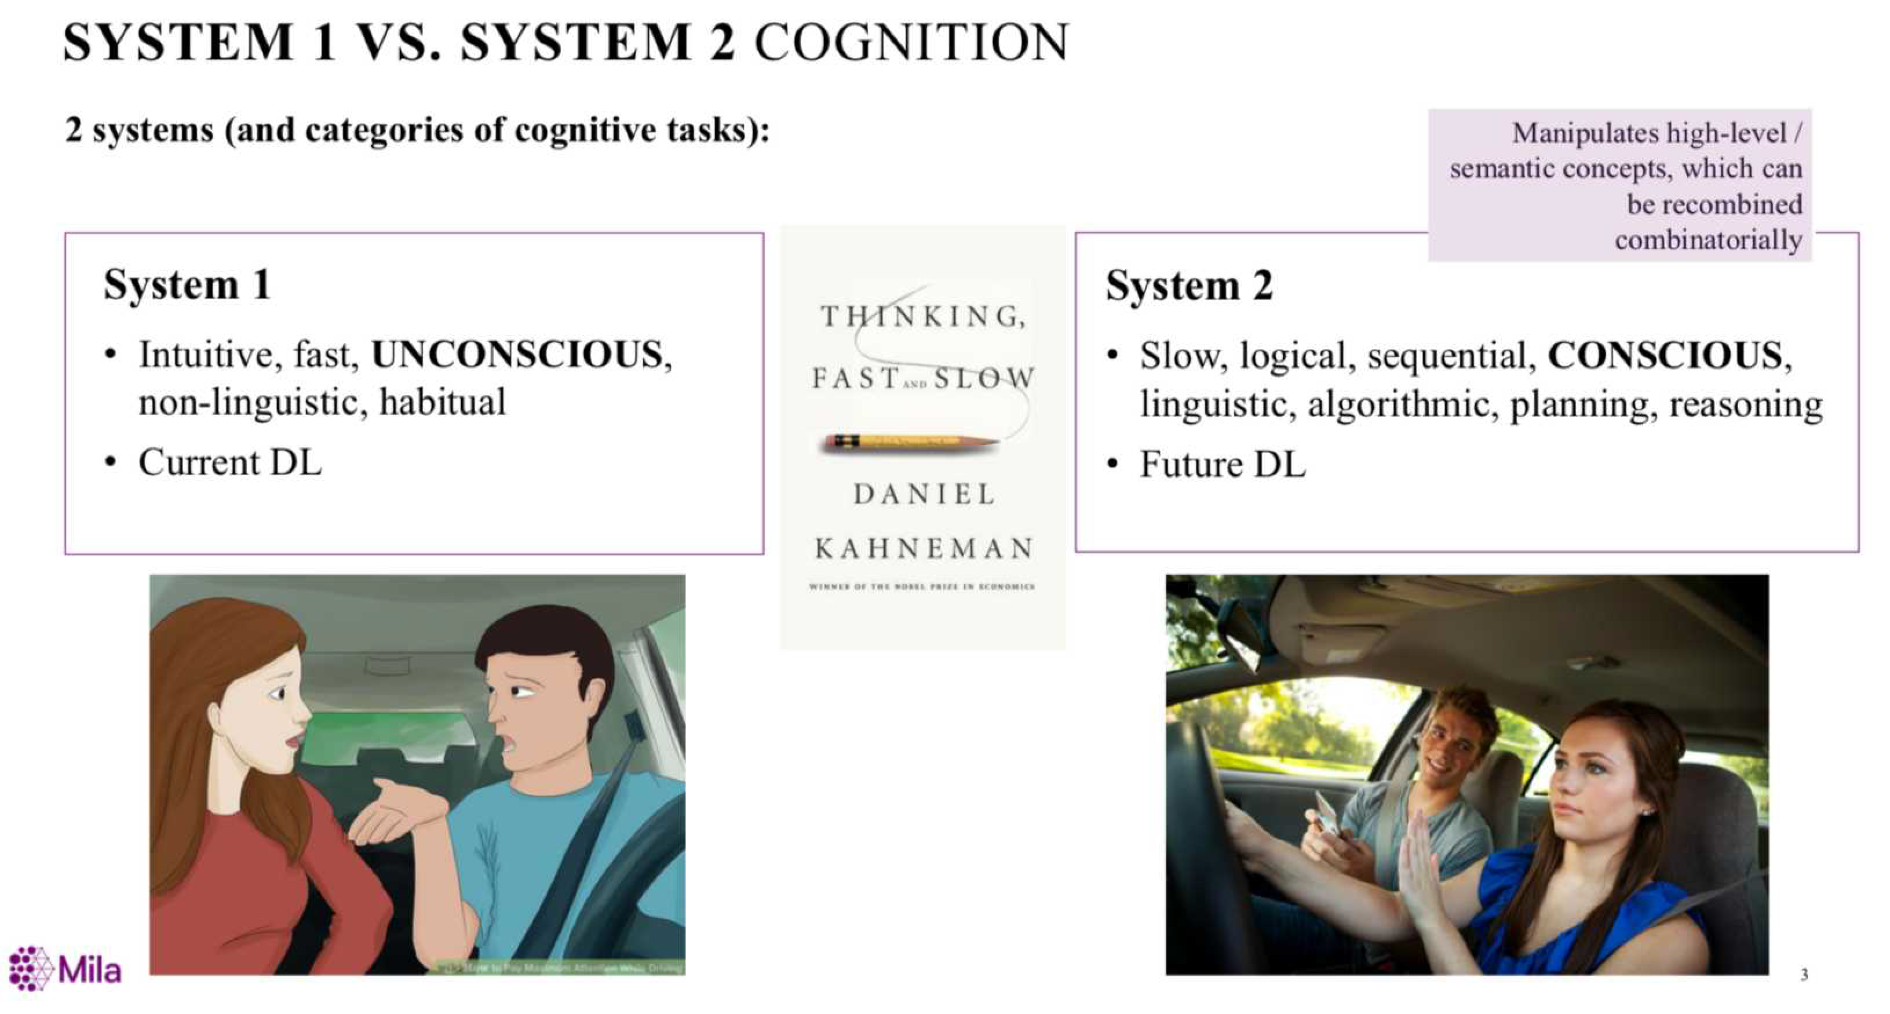
02
AliGraph
Model
System

Slide 20
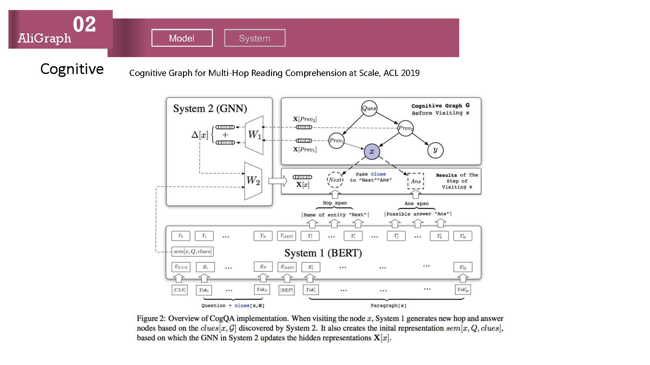
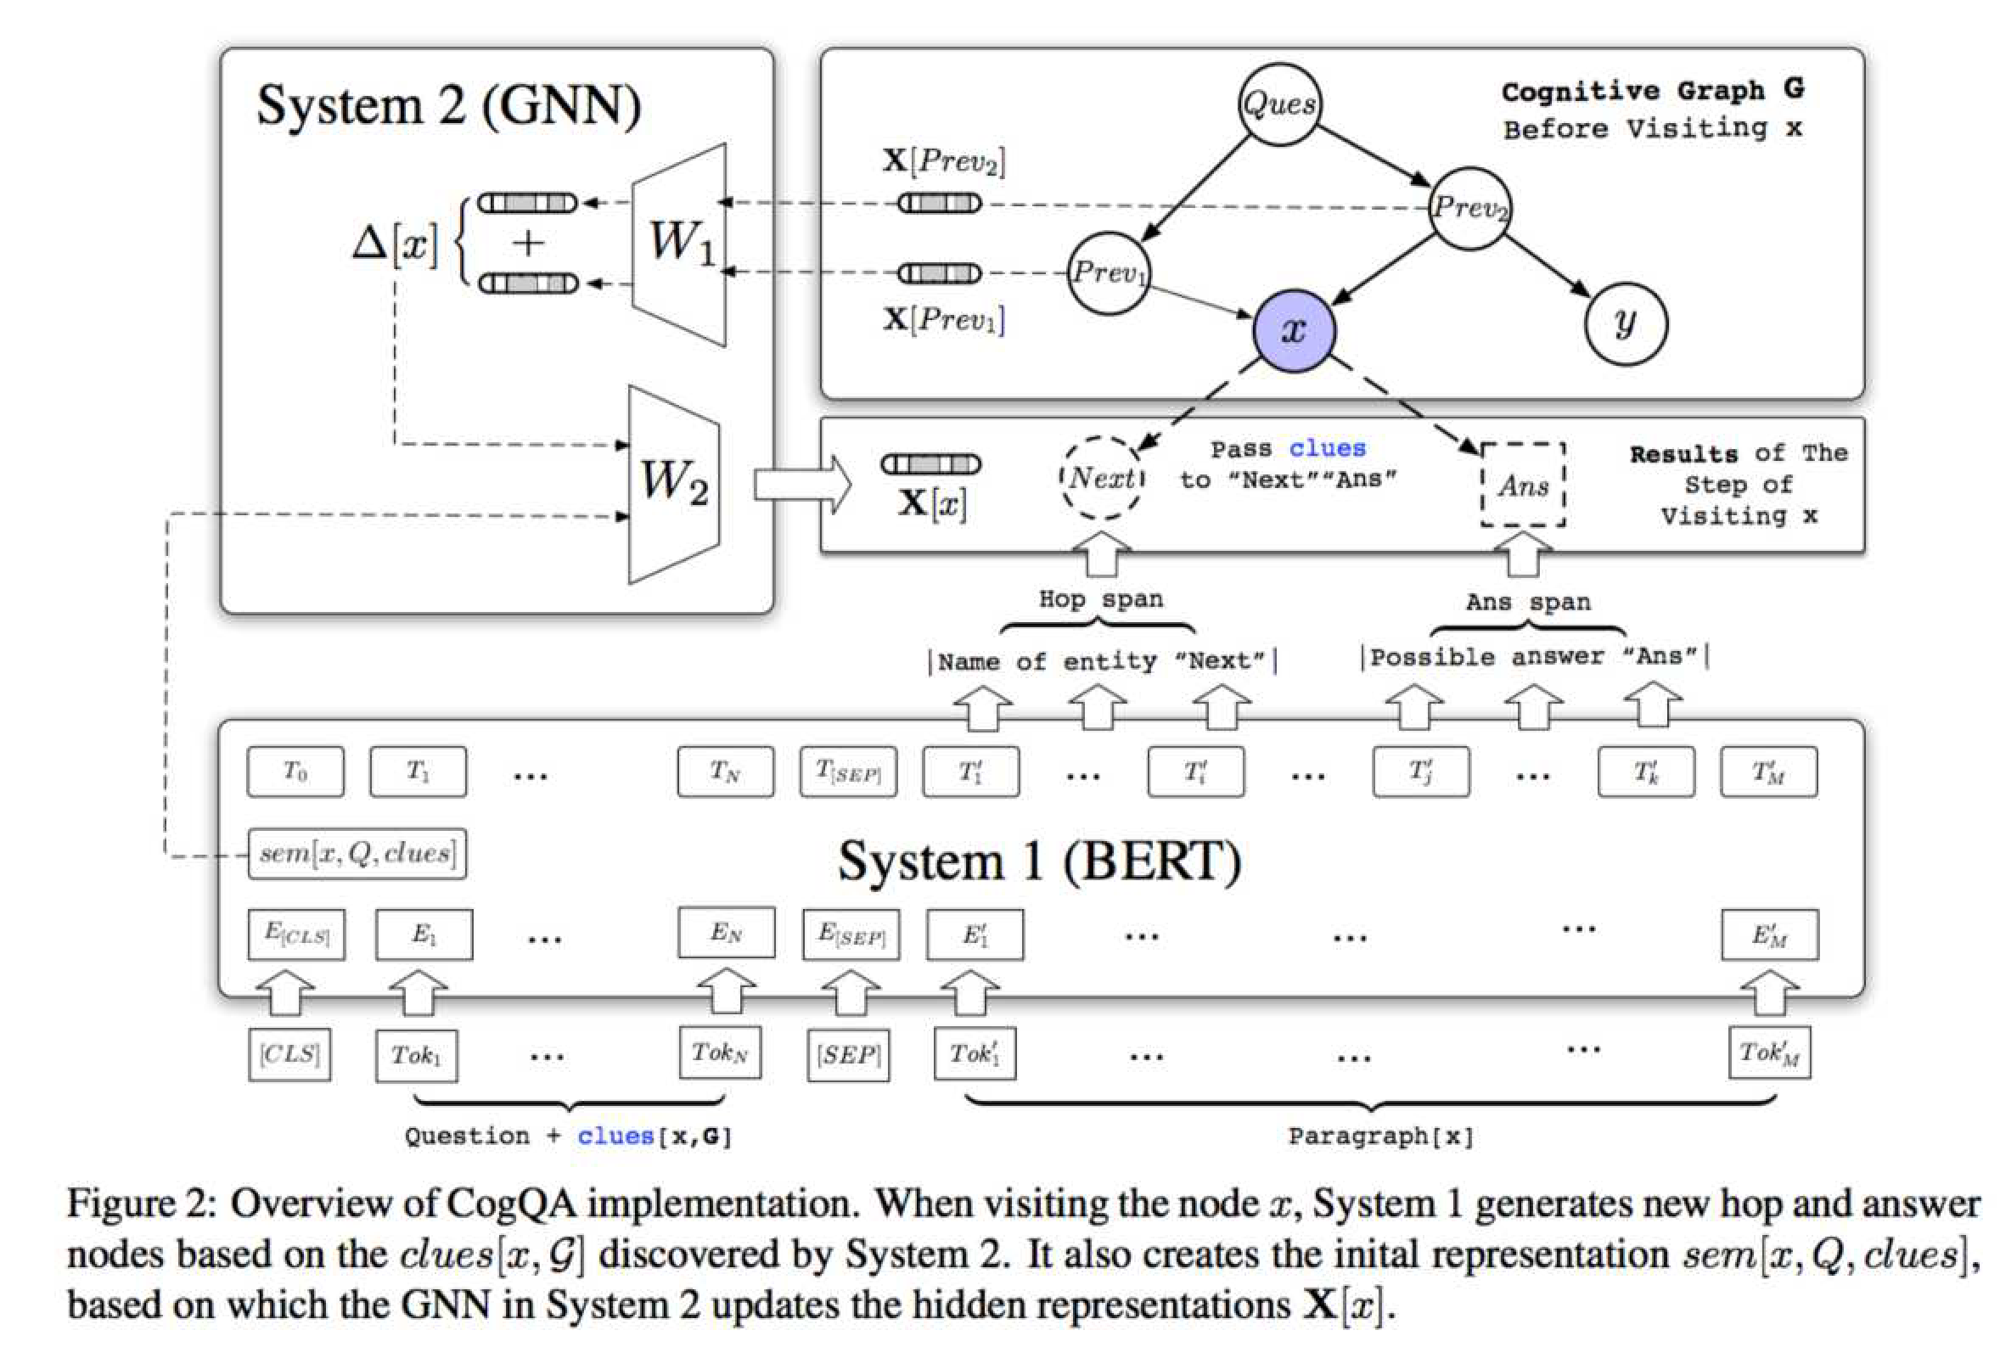
02
AliGraph
Model System
Cogn191v- Grap0 for Mu291 Hop R-a,1ng Compr-0-ns1on a9 Sca2-, ACL 2019
Cognitive

Slide 21
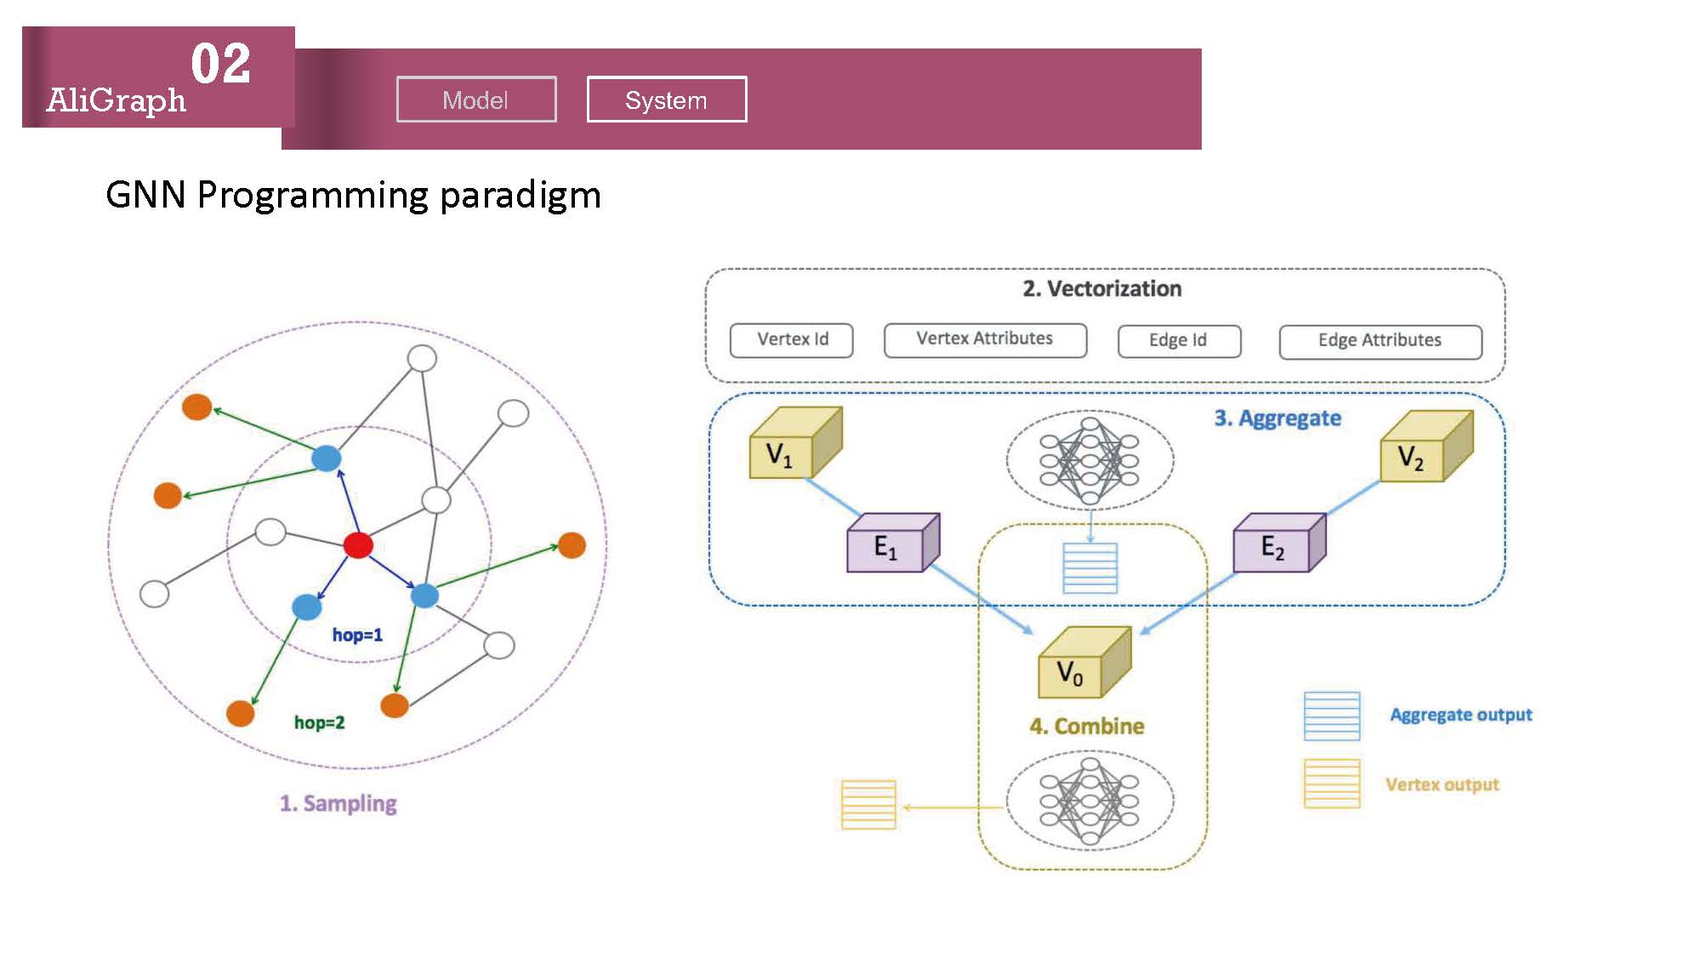
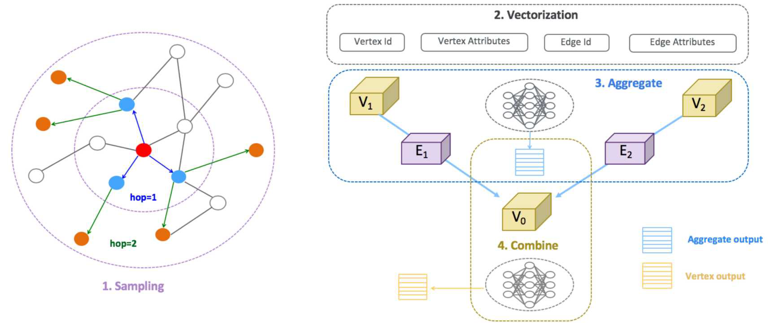
02
AliGraph
Model
System
GNN Programming paradigm

Slide 22
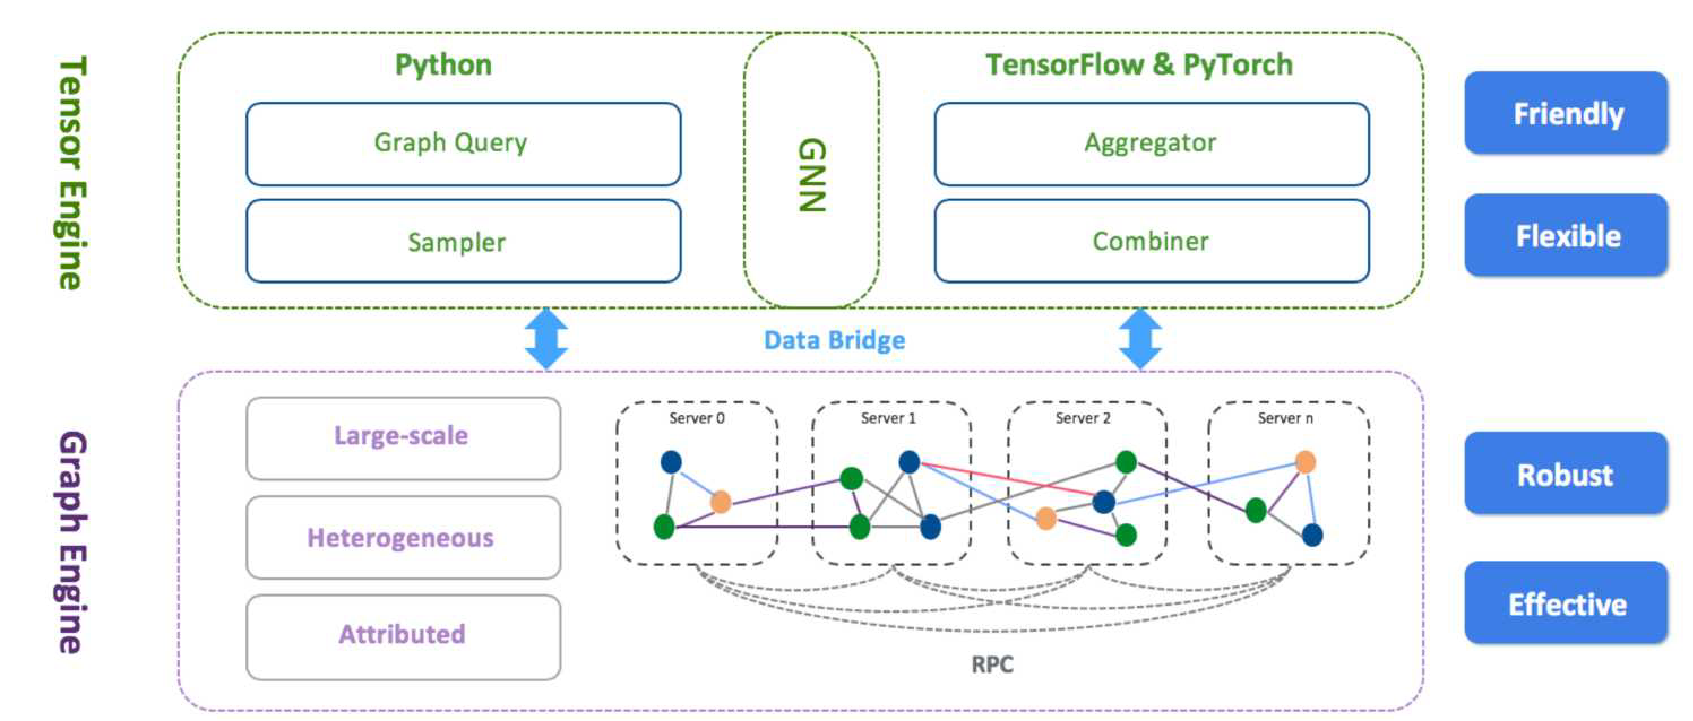
02
AliGraph
Model System
Integrated system implementation

Slide 23
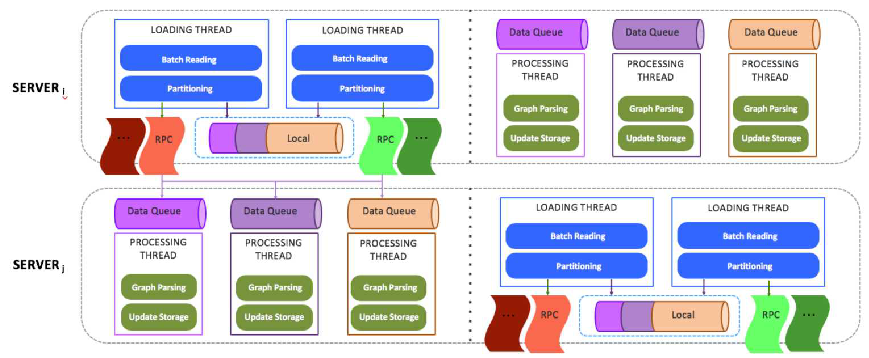
02
AliGraph
Model
System
Efficient Graph Build

Slide 24
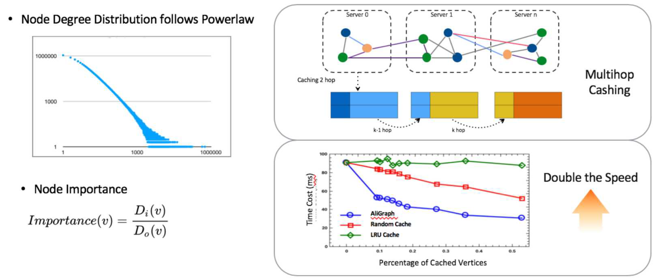
02
AliGraph
Model System
Multi-hop sampling acceleration mechanism

Slide 25
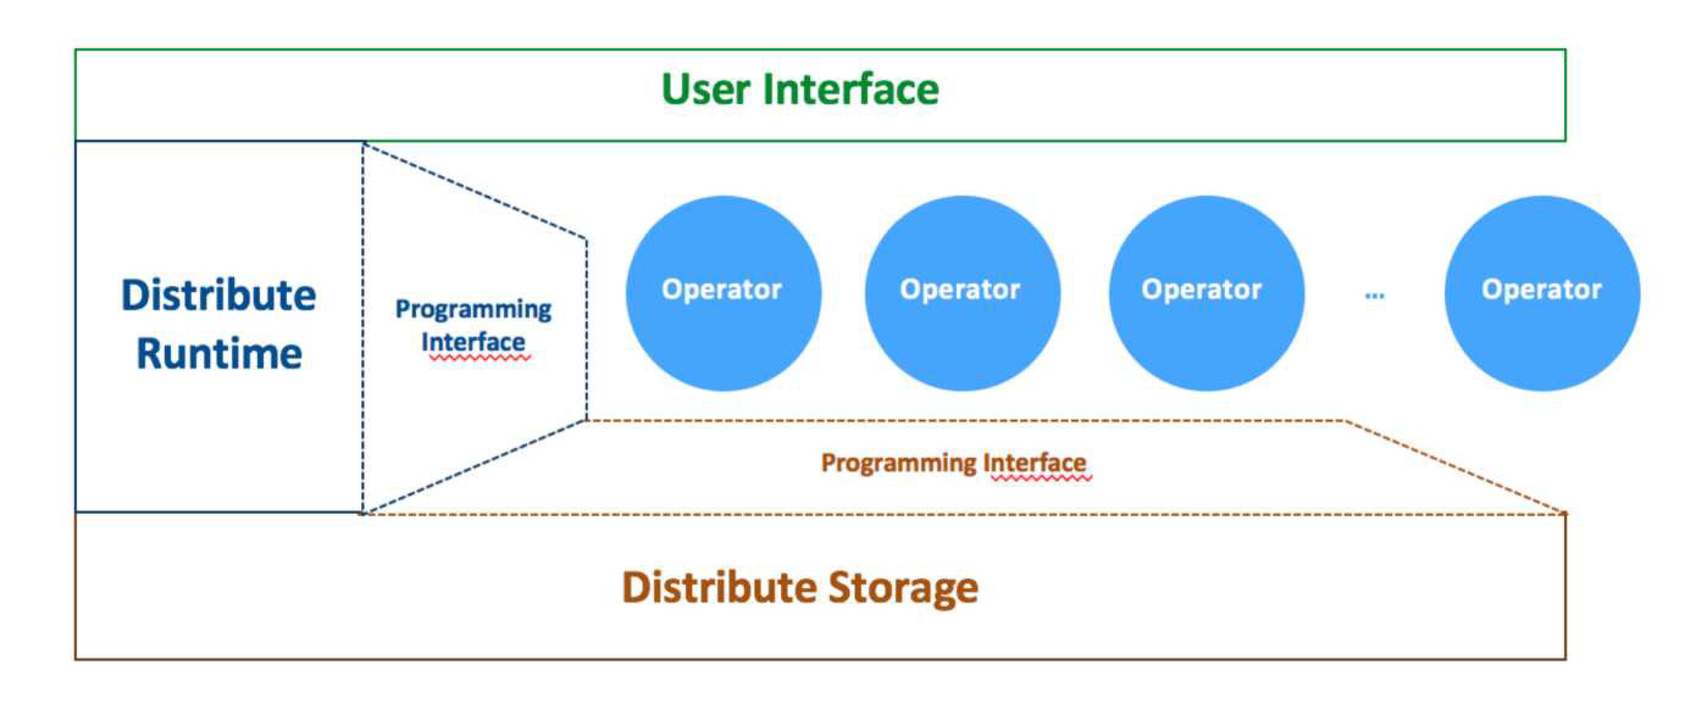
02
AliGraph
Model
System
Extensible operator

Slide 26


02
AliGraph
Model
System
Simple user interface
Graph Building
Training
1.
2.
3.
4.
g = Graph( )
g.add_nodes( “node_source”, “node_format” )
.add_edges( “edge_source”, “edge_format” )
.init( )
Graph Sampling
g.V( “user” ).shuffle( ).batch( 512 )
.outE( “user-click-item”)
.sample( 10 ).by( “edge_weight” )
.run( )
1.
2.
3.
4.

Slide 27

02
AliGraph
Model
System

Slide 28





03
Empower
GNN
Causality
Disentangle
Multimodality Pretraining
GNN/Causality/Disentangle
Causality
Anti Causal Learning
Causal Graph Inference Engine
A Formal Definition
GNN
Disentangle
Disentangled RepLearn on Graphs

Slide 29

03
Empower
GNN Causality Disentangle Multimodality Pretraining
Causality vs Disentanglement
Representation learning (RepLearn):
  To infer ! that explains ", usually via a generative model # " ∣ ! .
Causal discovery:
  To infer the causal mechanism # " ∣ %& ! , when given ! and ".
_{Disentangled RepLearn}[Definition from Suter et al., 2019]:
  To infer (1) ! that causes ", and (2) the causal mechanism # " ∣ %& ! .
  Moreover, (3) ! should contain independent, direct causes of ".
RepLearn
Causal Discovery
Generative RepLearn
Disentangled RepLearn
Robustly Disentangled Causal Mechanisms. Suter et al., ICML 2019.

Slide 30


03
Empower
GNN Causality Disentangle Multimodality Pretraining
Causality vs RepLearn
All these representations can achieve the maximum likelihood.
  Disentangled representation I: !"#(%) and !"'∣#() ∣ %) .
  Disentangled representation II: !"'()) and !"#∣'(% ∣ )) .
But if % → ) is true, then !"# % ⋅ !"'∣#() ∣ %) needs much fewer new samples to adapt to the new distribution once !(%, )) shifts.
  Because we need to update only -_{.|0}.
It adapts faster if correctly disentangled.
This is a new approach to infer the causal direction!

Slide 31


03
Empower
GNN
Causality
Disentangle Multimodality Pretraining
Granger Causal Structure Reconstruction from Heterogeneous Multivariate Time Series, in submission

Slide 32


03
Empower
GNN
Causality
Disentangle
Multimodality Pretraining

Slide 33



03
Empower
GNN
Causality
Disentangle
Multimodality Pretraining

Slide 34







03
Empower
GNN
Causality
Disentangle
Multimodality Pretraining
Text Image Inconsistent
Cross-domain knowledge graph
Image&Text Search
Content Product Detection

Slide 35


Impact
04
Impact
First Open Sourced Parallelizable GNN System
First Cloud Based GNN Platform
National Top AI Award

Slide 36


