Slide 1
Commonsense Knowledge and Language Generation
Minlie Huang (黄民烈)
CS Department, Tsinghua University
aihuang@tsinghua.edu.cn
http://coai.cs.tsinghua.edu.cn/hml

Slide 2
Knowledge
Knowledge is a familiarity, awareness, or understanding of someone or something, such as facts, information, descriptions, or skills, which is acquired through experience or education by perceiving, discovering, or learning.
Knowledge can refer to a theoretical or practical understanding of a subject
Plato(柏拉图): justified, true, believed
Francis Bacon: Knowledge is Power

Slide 3
Knowledge Types
World facts
Commonsense knowledge
Model knowledge (prior distribution, knowledge distillation, knowledge transfer)

Slide 4
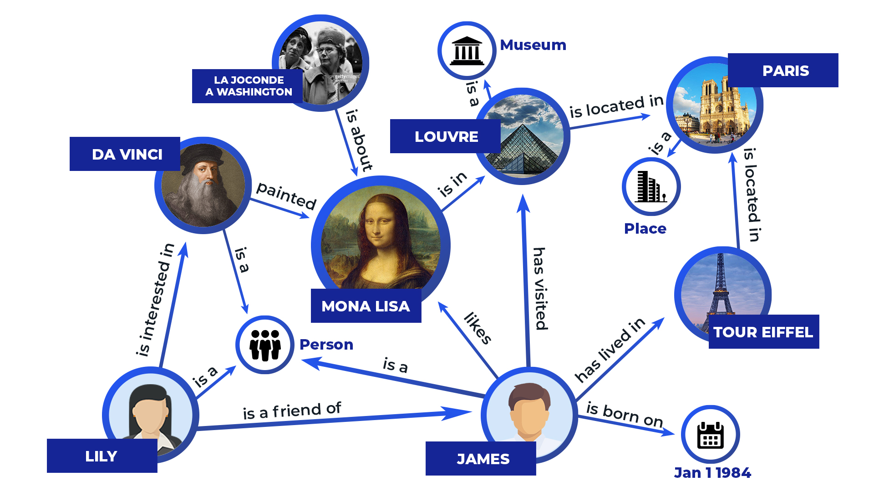
Knowledge – world facts
Knowledge graph by Google on May 16, 2012
70 billion facts (Oct. 2016); support search, Google Assistant, Google Home
Knowledge triples (head entity, relation, tail entity)
(DA Vinci, painted, Mona Lisa)
(Mona Lisa, is in, Louvre)
(Louvre, locatedIn, Paris)

Slide 5
Knowledge – commonsense
Commonsense knowledge consists of facts about the everyday world, that all humans are expected to know. (Wikipedia)
  Lemons are sour
  Tree has leaves
  Dog has four legs
Commonsense knowledge bases
  ConceptNet
  Cyc
  Open Mind Common Sense

Slide 6
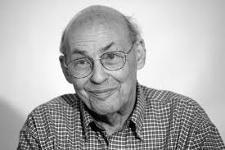
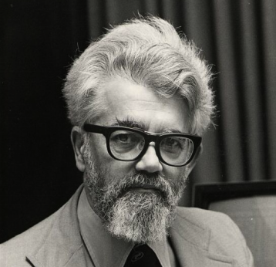
Commonsense Knowledge
Marvin Minsky, 1969
John McCarthy, 1971
In 1959, John McCarthy came to MIT
from Dartmouth, and we started the MIT Artificial Intelligence Project. We agreed that the most critical problem was of how minds do common-sense reasoning.

Slide 7
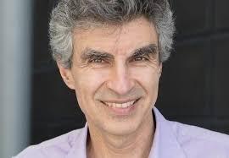
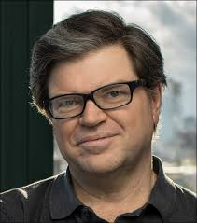
Commonsense Knowledge
…So the vision I have is that a big missing piece in our current machine learning systems is what people call common sense.
Yoshua Bengio, 2018
Most of the systems, you show them images with other types of objects or unusual situations they've never seen and they will say complete garbage about it. They don't have common sense.
Yann Lecun, 2018

Slide 8
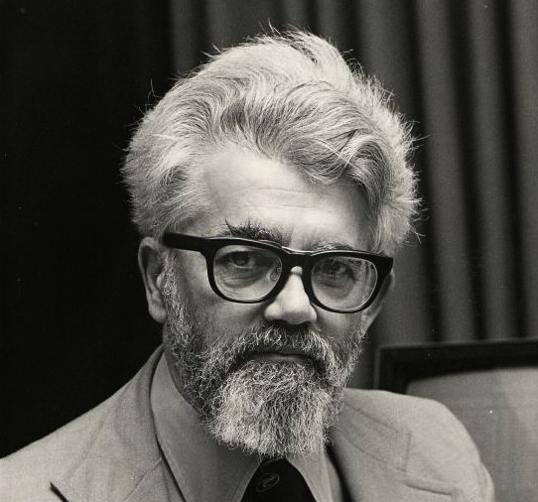
Commonsense Knowledge
A program has common sense if it automatically deduces for itself a sufﬁciently wide class of immediate consequences of anything it is told and what it already knows.
– McCarthy (1959)

Slide 9
Knowledge– commonsense
Winograd Schema Challenge: An alternative to Turing Test (fooling human judges vs. testing machine’s intelligence)
A Winograd schema is a pair of sentences that contain an ambiguity which requires world knowledge or reasoning to resolve it.
  The city councilmen refused the demonstrators a permit because they [feared/advocated] violence.
  ---Who [feared/advocated] violence?
  The trophy doesn’t fit in the suitcase because it is too [big/small].
  ---What is too [big/small]?

Slide 10
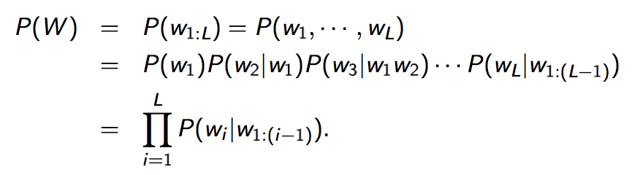
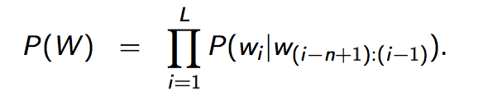
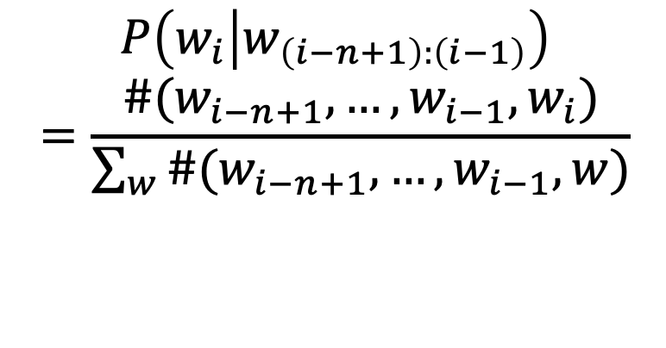
Statistical Language Models
A statistical language model is a probability distribution over word sequences.
A sequence W consists of L words (eg: I like deep learning):
N-gram language model
$$P\left(w_{i} | w_{\left(i−n+1\right):\left(i−1\right)}\right)$$
$$=\frac{\#(w_{i−n+1},…,w_{i−1},w_{i})}{\sum_{w}{\#(w_{i−n+1},…,w_{i−1},w)}}$$
Notes:
In traditional SLM, it is impossible to consider all the history of arbitrary lengths;
Thus, we have n-gram LM for approximation: each time, we just look ahead at most n-1 tokens;
This will make computation more feasible and efficient;
How can we get the conditional probs?
We simply count how many times the phrases occur in a large corpus;
And do normalization to make a legal distribution.

Slide 11
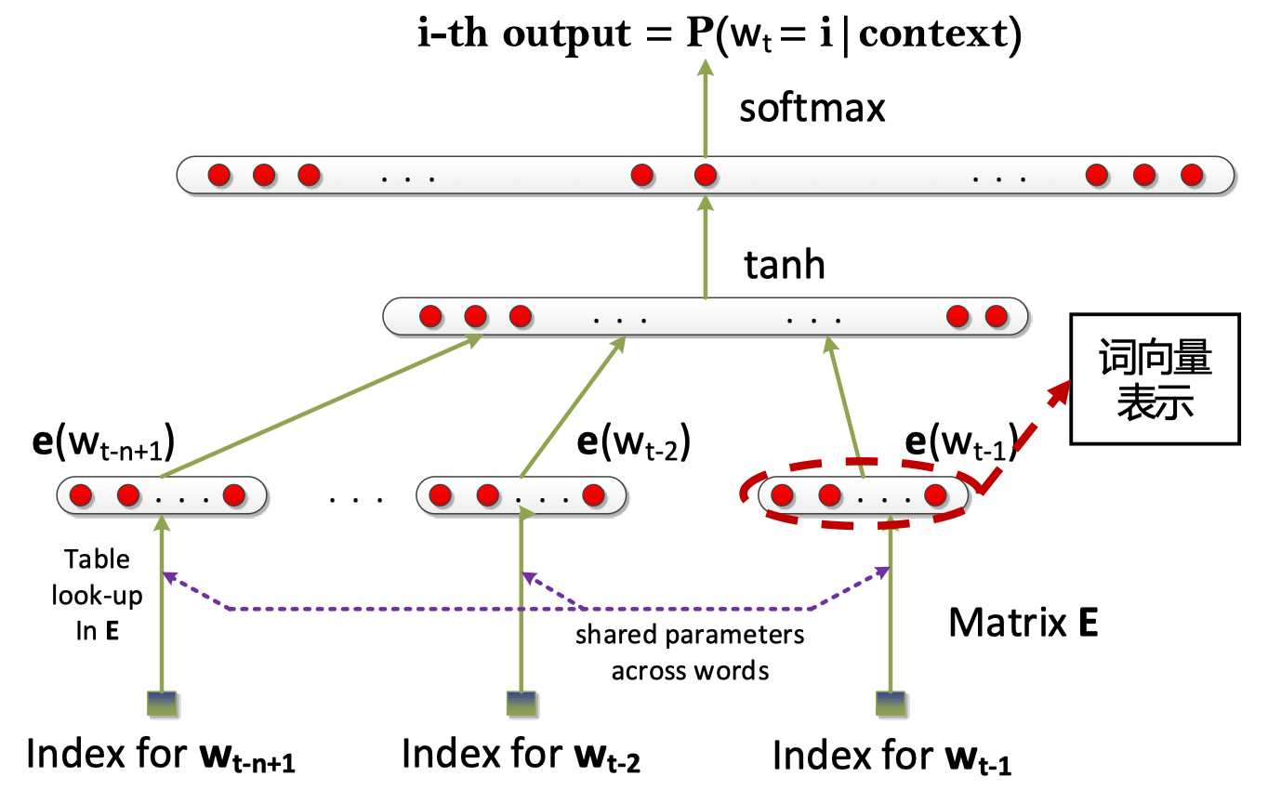
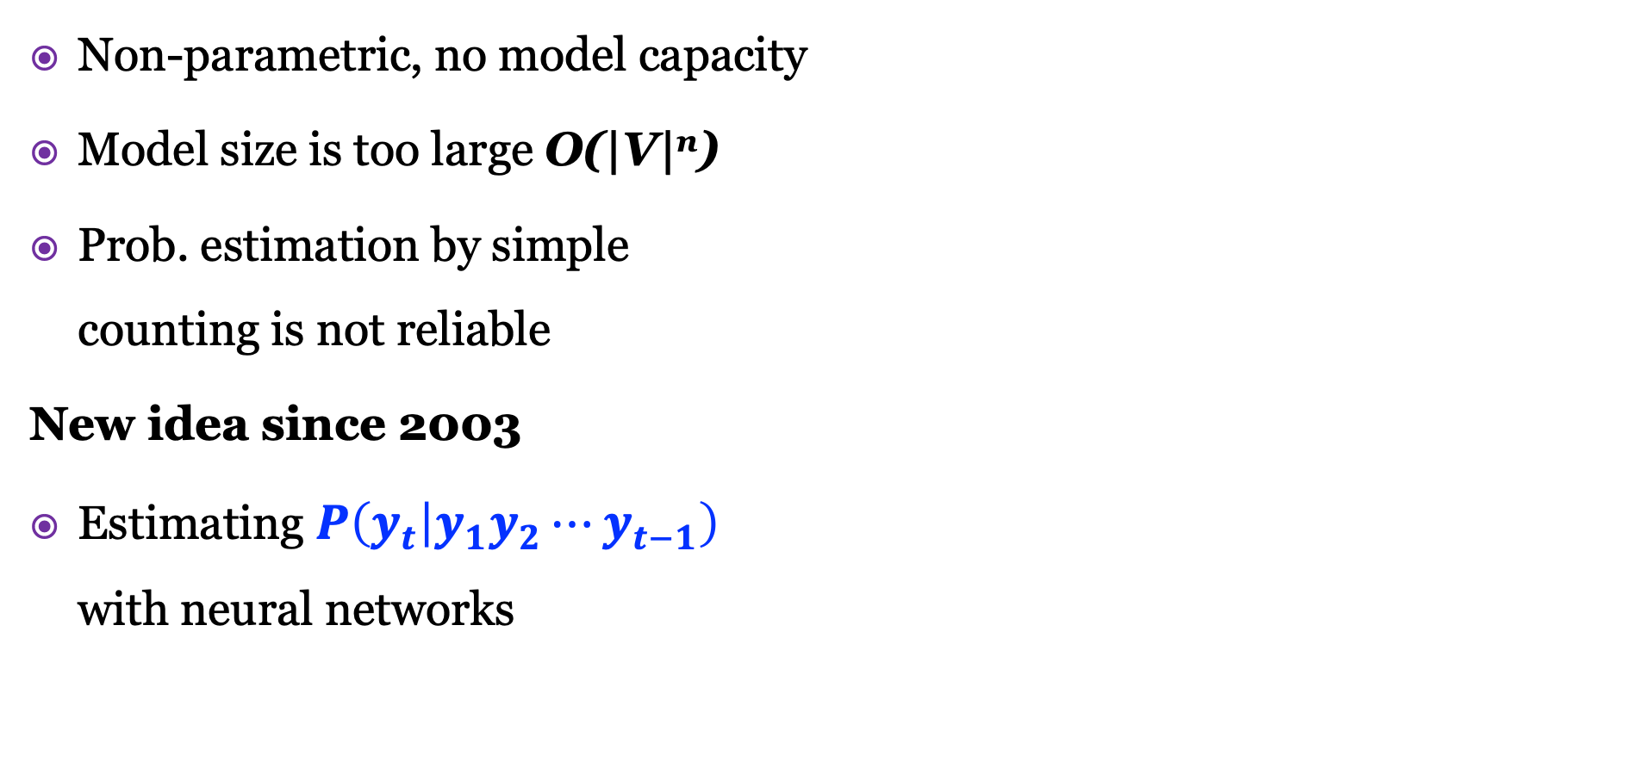
Neural Language Models
Non-parametric, no model capacity
Model size is too large O(|V|^{n})
Prob. estimation by simple
counting is not reliable
New idea since 2003
Estimating $P\left(y_{t} | y_{1}y_{2}⋯y_{t−1}\right)$
with neural networks
Word
vector
Bengio, Y., Ducharme, R., Vincent, P., & Jauvin, C. (2003). A neural probabilistic language model. Journal of machine learning research, 3(Feb), 1137-1155.
Notes:
Is proportional to the n power of the vocab size

Slide 12
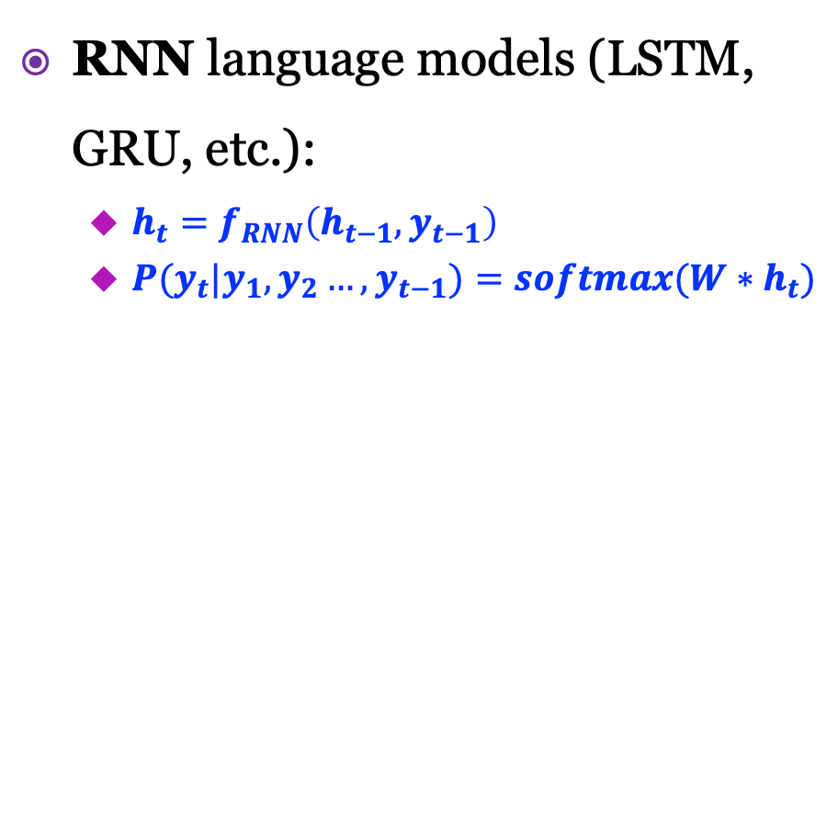
Neural Language Models
RNN language models (LSTM, GRU, etc.):
  $h_{t}=f_{RNN}\left(h_{t−1},y_{t−1}\right)$
  ${P(y}_{t}|{y_{1},y_{2}…,y}_{t−1})=softmax(W∗h_{t})$
Transformer language models
  Multi-head self-attention
  Deep structures (12-48 layers)
  Large parameters (100M~1B)
P(y_{t}|y₁y₂…y_{t-1})
y_{t+1}
P(y₁)
P(y₂|y₁)
P(y₃|y₁y₂)
y_{t-1}
linear
linear
linear
linear
linear
linear
h₁
h₂
h₃
h_{t-1}
h_{t}
h_{t+1}
Trans. Blocks
Masked-self-attention
y_{t-1}
y_{t}
y_{t+1}
y₁
y₂
y₃
Notes:
So there are two types of modern neural language models;
RNN and transformer language models.
For RNN LM, it essentially evaluate a recurrent function: h_t equals a non-linear function of h_t-1 and y_t-1
And the conditional prob is a softmax function of the multiplication of W and h_t
Transformer LM is very much different from RNN models;
It used multi-head self att; it is very deep structure, with large parameters (the smallest, the largest)

Slide 13
Problems to be Answered
RNN language model has commonsense/factual knowledge?
GPT language model has commonsense/factual knowledge?

Slide 14
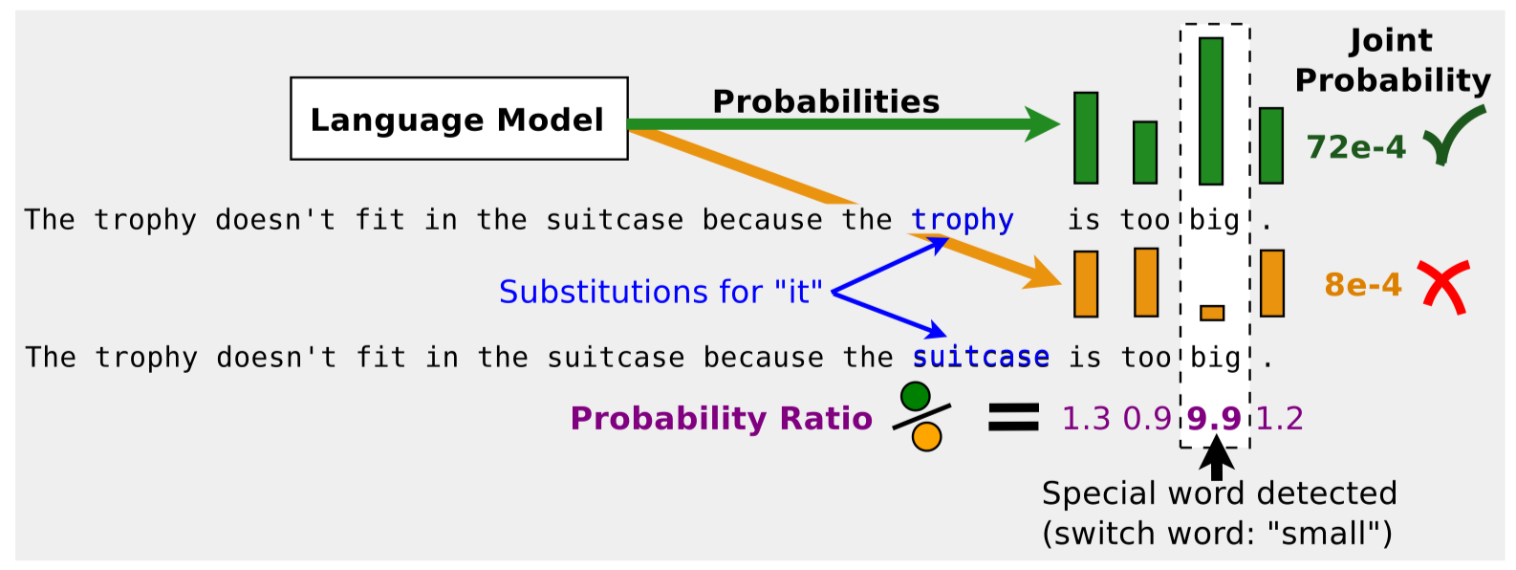
RNN language models have commonsense?
The trophy doesn’t fit in the suitcase because it is too big/small.
What is too big/small?
Trieu H. Trinh and Quoc V. Le. 2019. Do language models have common sense?

Slide 15
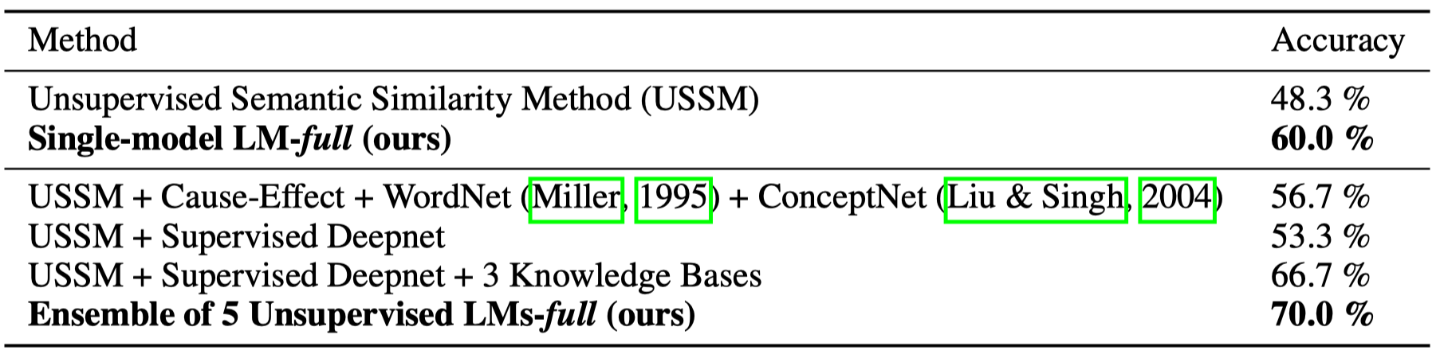
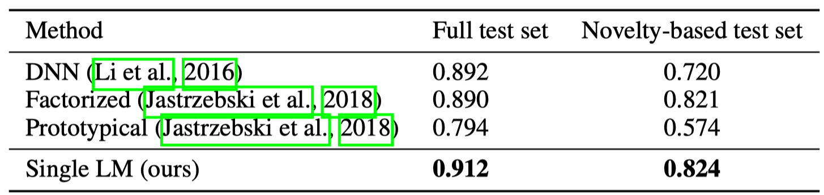
RNN language models have commonsense?
PDP-60 Winograd Schema Challenge
Classifying fact and non-fact triples from ConceptNet, fine-tuned LM with classification loss
Notes:
第二个模型，用ConceptNet的triple进行fine tune

Slide 16
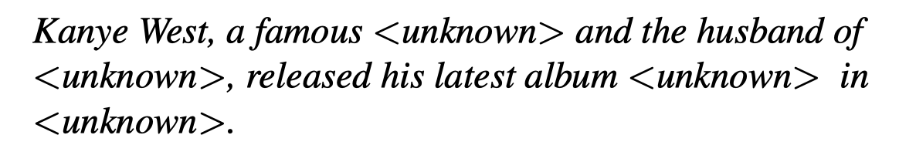
RNN LMs have factual knowledge?
“A core purpose of language is to communicate knowledge.”
“Traditional language models are good at capturing statistical co-occurrences of entities as long as they are observed frequently in the corpus.”
However, for rare entities,
Yoshua Bengio
Ahn et al. A Neural Knowledge Language Model. Arxiv 2016

Slide 17
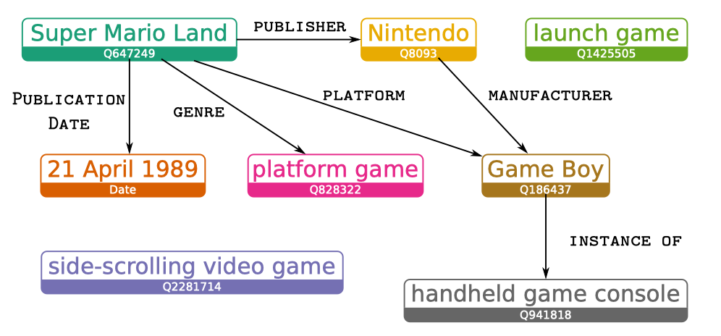
RNN LMs have factual knowledge?
WikiText-2 example
Logan IV et al. claimed:
Can memorize facts observed during training to some degree
Do not generalize to rare/unseen entities
Easily generate UNKNOWN tokens
[Super Mario Land] is a [1989] [side-scrolling]
[platform video game] developed and
published by [Nintendo] as a [launch title]
for their [Game Boy] [handheld game console].
Play station?
Logan IV et al. ACL 2019. Barack’s Wife Hillary: Using Knowledge Graphs for Fact-Aware Language Modeling

Slide 18
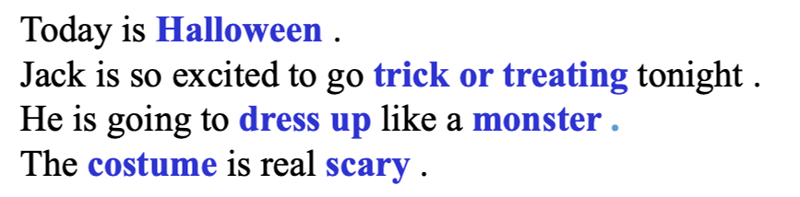
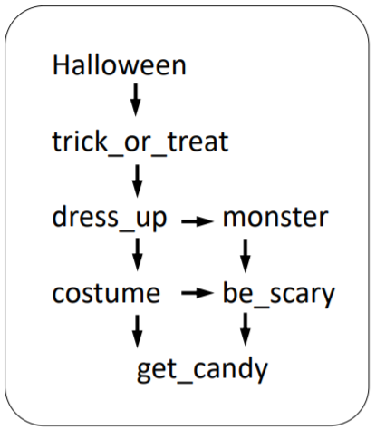
Commonsense Story Ending Generation
Story Context:
Story Ending:
Most likely
He hopes to get a lot of candy .
He gets no candy at all.
Least likely
He sleeps all the night.
Jian Guan, Yansen Wang, Minlie Huang. Story Ending Generation with Incremental Encoding and Commonsense Knowledge. AAAI 2019
Notes:
捕获文章逻辑信息的重要两个部分：发掘原文中的逻辑信息，从外部知识库中获取信息。
上：例文，蓝色和紫色分别代表原文和生成结局中的events和entities
左下：常识信息中各个实体间的关系
右下：context clues，各个事件以及实体在文中的出现顺序

Slide 19
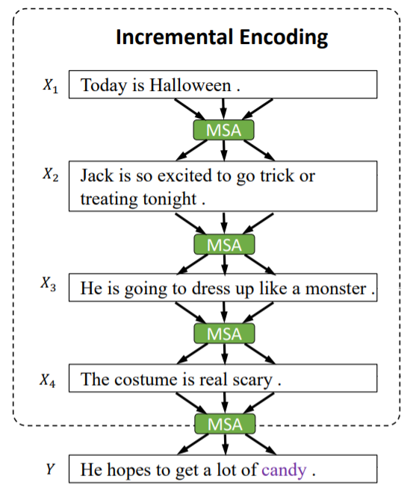
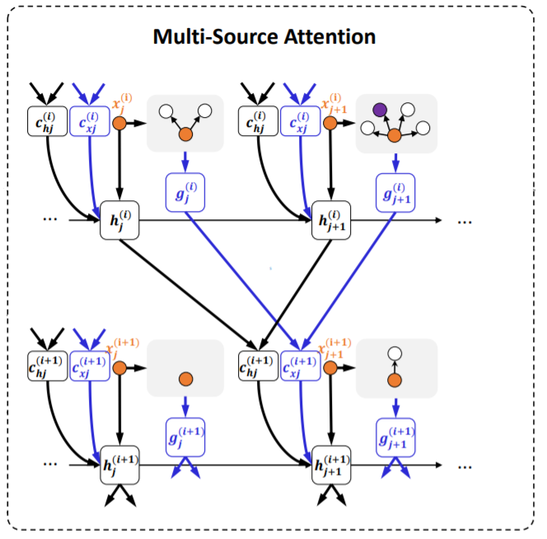
Commonsense Story Ending Generation
Incremental Encoding
Multi-Source Attention
Notes:
MSA: multi-source attention, 可以从上文中计算与当前编码的句子相关的部分，以及从知识库中获取信息
亮点在于在故事编码的过程中利用attention传递逻辑信息，在每一个时刻得到当前时刻的context clue，最终在解码的时候使用这个context clue预测正确的event和entity

Slide 20
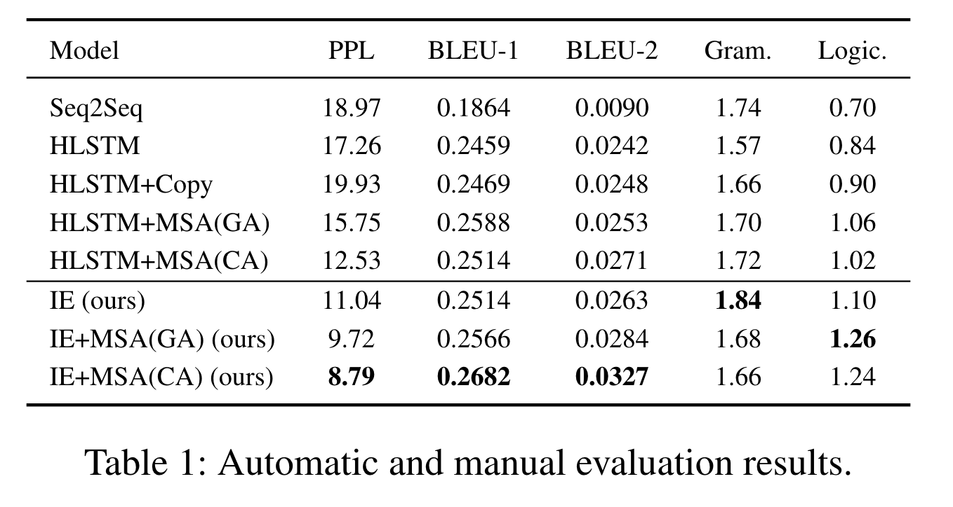
Commonsense Story Ending Generation
Scoring Gram. & Logic. with 0, 1, 2 (max)
Notes:
MSA: multi-source attention, 可以从上文中计算与当前编码的句子相关的部分，以及从知识库中获取信息
亮点在于在故事编码的过程中利用attention传递逻辑信息，在每一个时刻得到当前时刻的context clue，最终在解码的时候使用这个context clue预测正确的event和entity

Slide 21
Commonsense Story Ending Generation
Context 1:
Taj has never drank an espresso drink.
He ordered one while out with his friends.
The shot of espresso tasted terrible to him.
Taj found that he couldn't stop talking or moving.
Generated Ending 1:
He decided to never drink again.
Jian Guan, Yansen Wang, Minlie Huang. Story Ending Generation with Incremental Encoding and Commonsense Knowledge. AAAI 2019
Notes:
两个例子，蓝色和紫色的是文中表示逻辑的事件

Slide 22
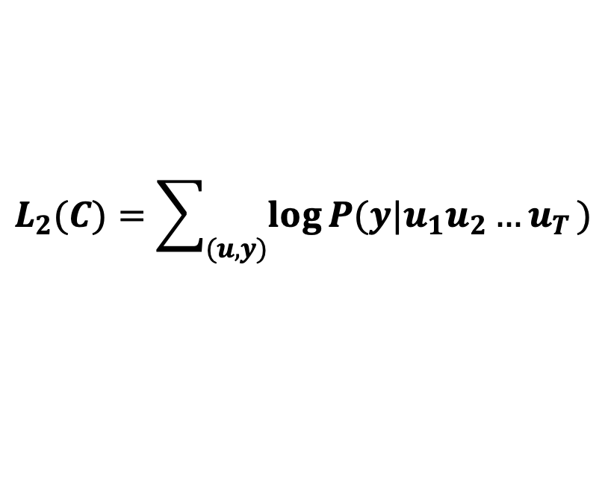
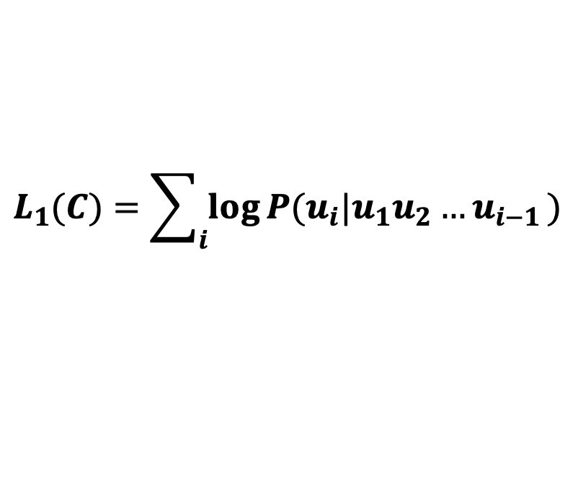

General pretraining model (GPT)
  Transformer block (multi-head masked self-attention, layer norm., feed forward)
  Pre-training : language generation loss
  Finetuning: task-specific classification loss
  Very large & deep networks: 12-48 blocks, 100M~1B params
Generation loss
Classification loss
Transformer Block
$$H_{t}^{l}$$
Layer Norm
Language-generation loss
Feed Forward
×12~48
$$L_{1}(C)=\sum_{i}{\log{P(u_{i}|u_{1}u_{2}{…u}_{i−1})}}$$
Layer Norm
Task-specific classification loss
Masked Self Attention
$$L_{2}(C)=\sum_{(u,y)}{\log{P(y|u_{1}u_{2}{…u}_{T})}}$$
Token&Positional Embedding

Slide 23
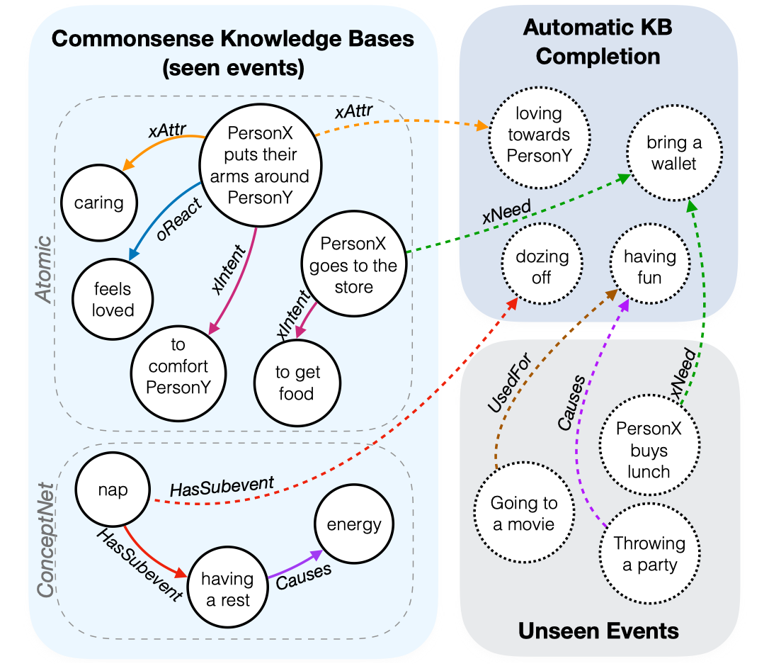
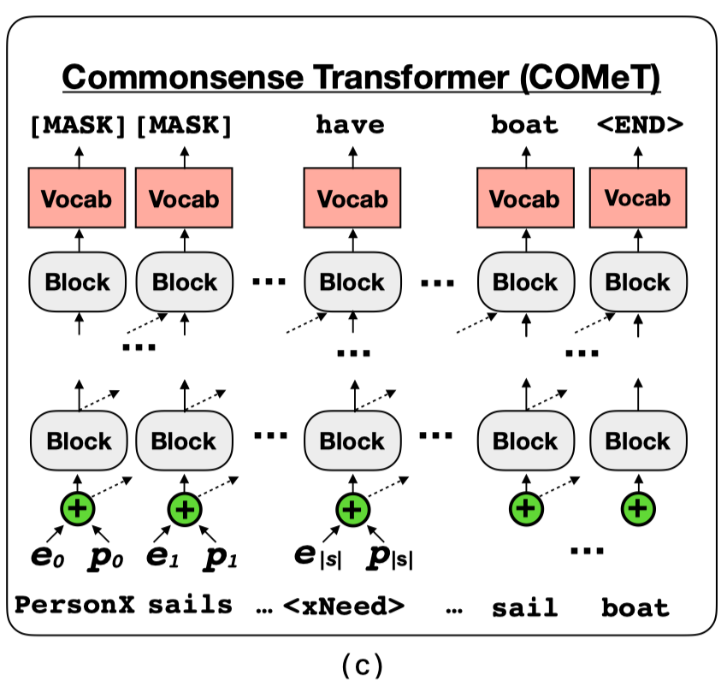
GPT has commonsense?
Bosselute et al. 2019. COMET : Commonsense Transformers for Automatic Knowledge Graph Construction.

Slide 24
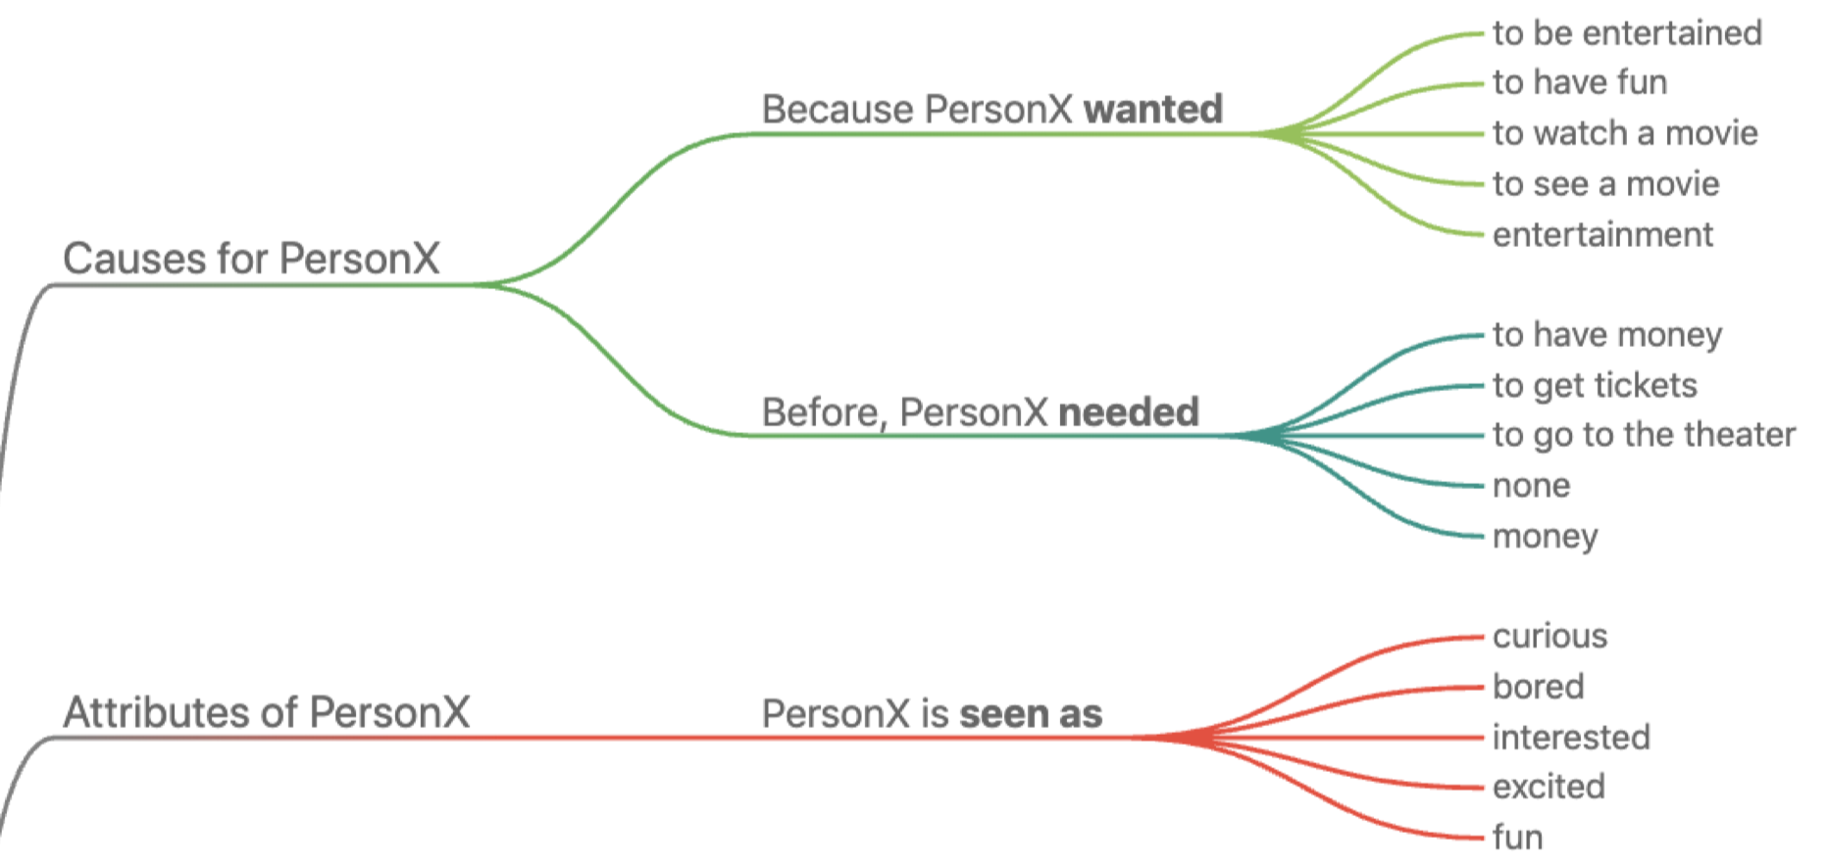
GPT has commonsense?
Input: Eric wants to see a movie

Slide 25
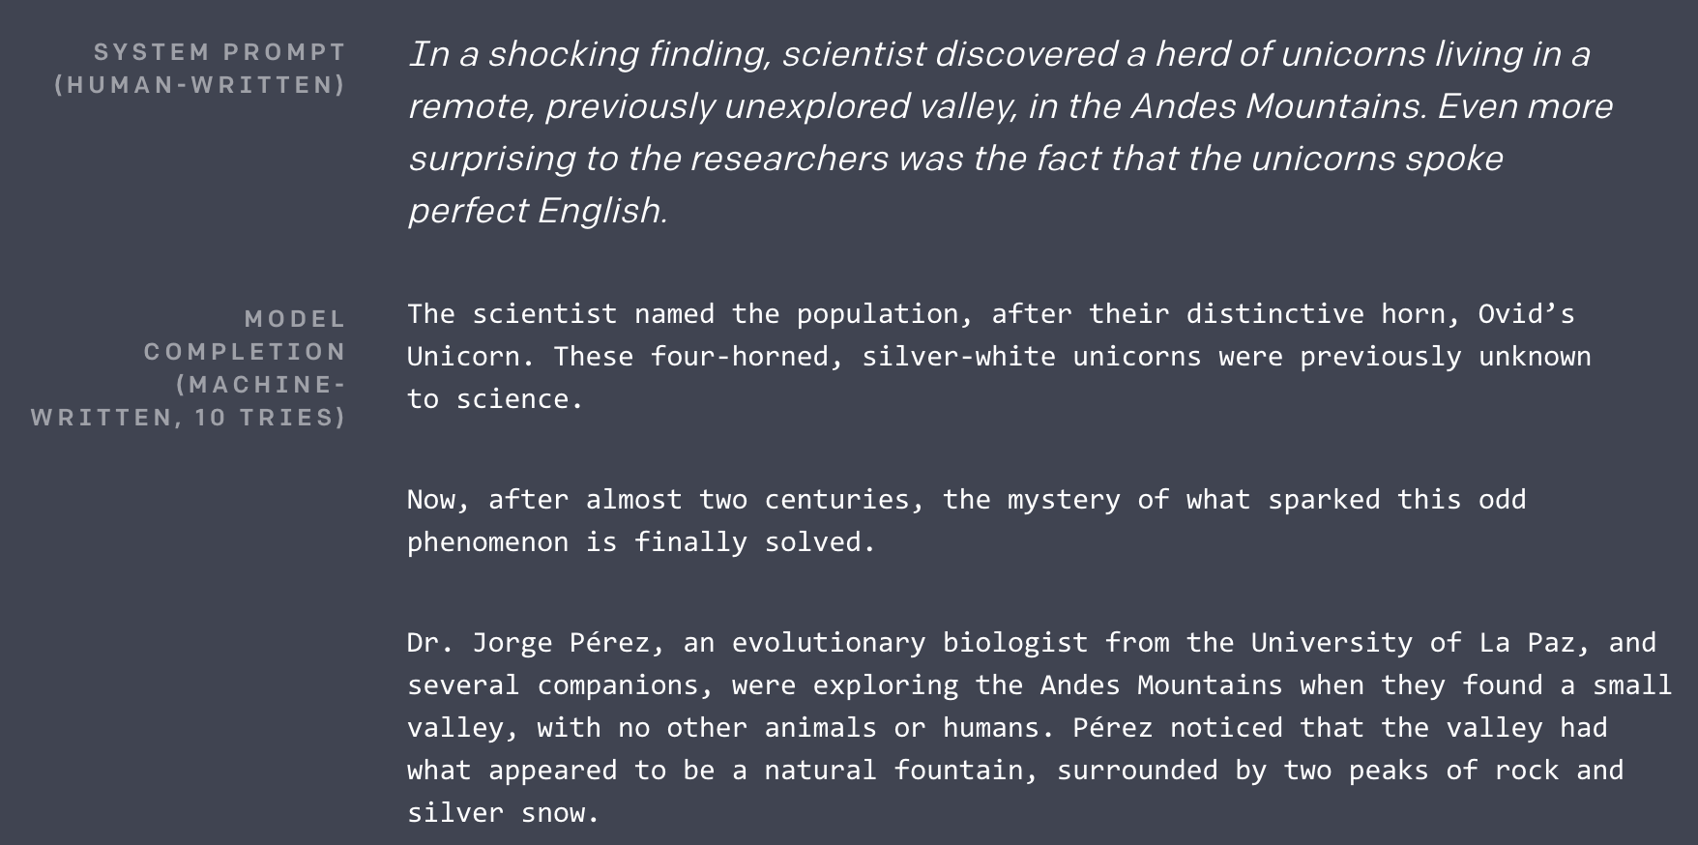
Story Generation with GPT2
From https://openai.com/blog/better-language-models/
The scientist named the population, after their distinctive horn, Ovid’s Unicorn. These four-horned, silver-white unicorns were previously unknown to science.

Slide 26
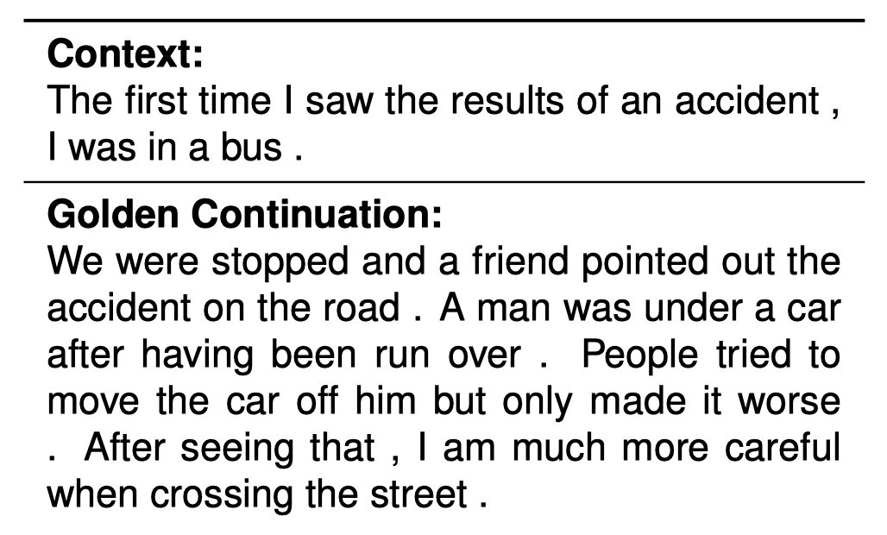
Commonsense Story Generation
An example from ROCStories (human-written)
How do humans write common
sense stories?
Notes:
任务设定：给定一句话的开头，生成后面的完整故事

Slide 27
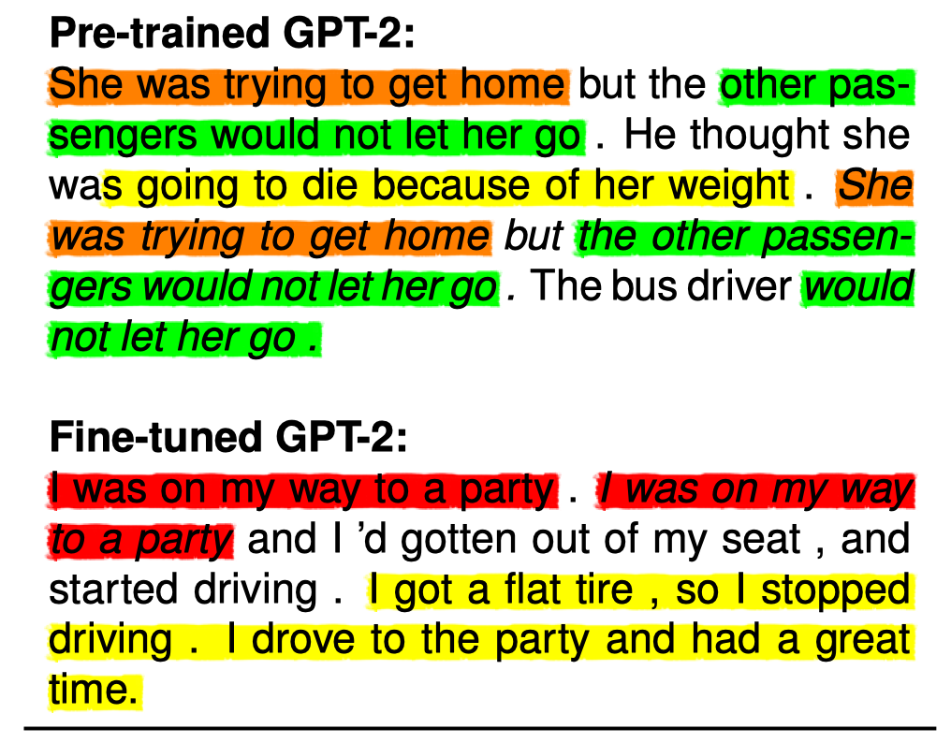
Commonsense Story Generation
Two major issues:
Repetition
Semantic or logic conflicts
Notes:
橙色、绿色和红色：成对的重复
黄色：逻辑因果冲突

Slide 28
Commonsense Story Generation
Context:
the first time i saw the results of an accident , i was in a bus .
Story:
we were stopped and a friend pointed out the accident on the road .
a man was under a car after having been run over .
people tried to move the car off him but only made it worse .
after seeing that , i am much more careful when crossing the street .
stop
car
CapableOf
AtLocation
street
HasLastSubevent
CapableOf
IsA
AtLocation
bus
AtLocation
run
move
AtLocation
Cause
xEffect
UsedFor
road
accident
Cause
cross street
xAttr
CapableOf
From ConceptNet and ATOMIC
HasSubevent
move car
xAttr
careful
people

Slide 29




Training with knowledge resources
Generation loss
Classification loss
Knowledge Base
(c)
$$𝓛_{ST}$$
Transformer Block
Transformer
$$H_{t}^{l}$$
True&Fake Stories
Layer Norm
(b)
$$𝓛_{KG}$$
Feed Forward
×12
bus is a car.
bus is at street.
cross street causes accident.
PersonX cross street. PersonX should be careful.
……
Transformer
Commonsense Knowledge
Layer Norm
(a)
$$𝓛_{GPT}$$
Masked Self Attention
Transformer
Large-Scale Corpus
Token&Positional Embedding
Jian Guan, Fei Huang, Xiaoyan Zhu, Minlie Huang. A Knowledge-Enhanced Pretraining Model for Commonsense Story Generation. TACL 2020.
Notes:
我们的工作：用知识库中常识三元组来训练模型（bus is a car）
加上多任务损失：让模型辨别一个好的故事和差的故事。
差的故事------自动构造方式：1）把原来故事的中一句话随机替换为其它故事中的一句；
2）把原来故事的句子顺序随机打乱；
3）随机把原来故事中一句话重复

Slide 30
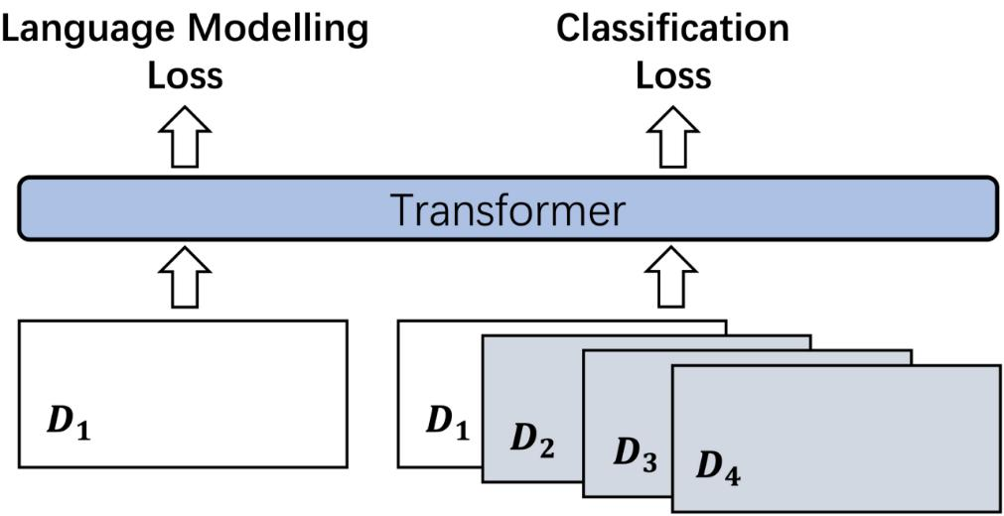
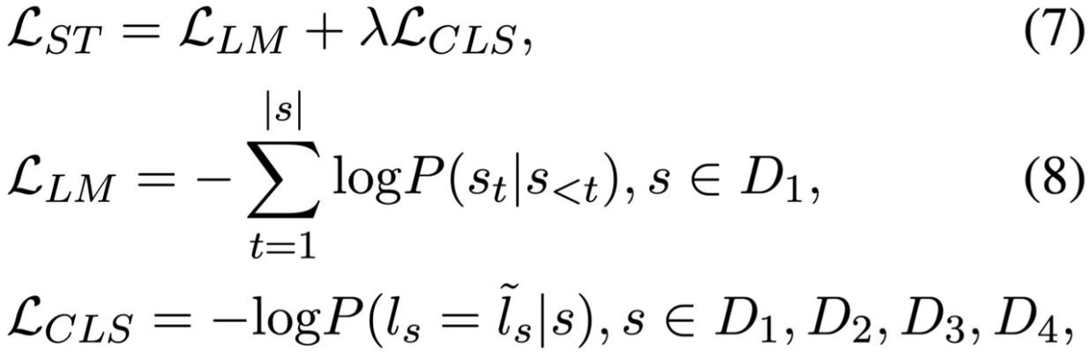

Training with classification loss
(c)
$$𝓛_{ST}$$
Transformer
True&Fake Stories
(b)
$$𝓛_{KG}$$
Transformer
True stories
True & fake stories
Commonsense Knowledge
(a)
$$𝓛_{GPT}$$
Transformer
Large-Scale Corpus

Slide 31
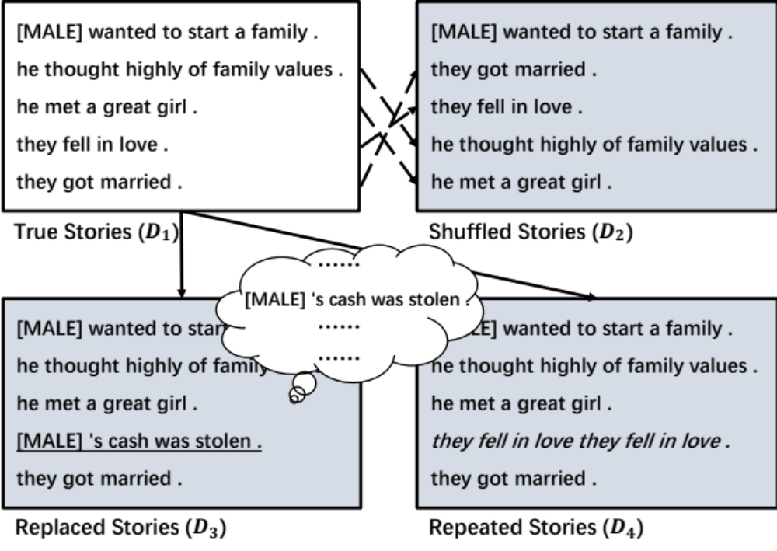
Training with classification loss
(c)
$$𝓛_{ST}$$
Transformer
True&Fake Stories
(b)
$$𝓛_{KG}$$
Transformer
Commonsense Knowledge
(a)
$$𝓛_{GPT}$$
Transformer
Large-Scale Corpus

Slide 32
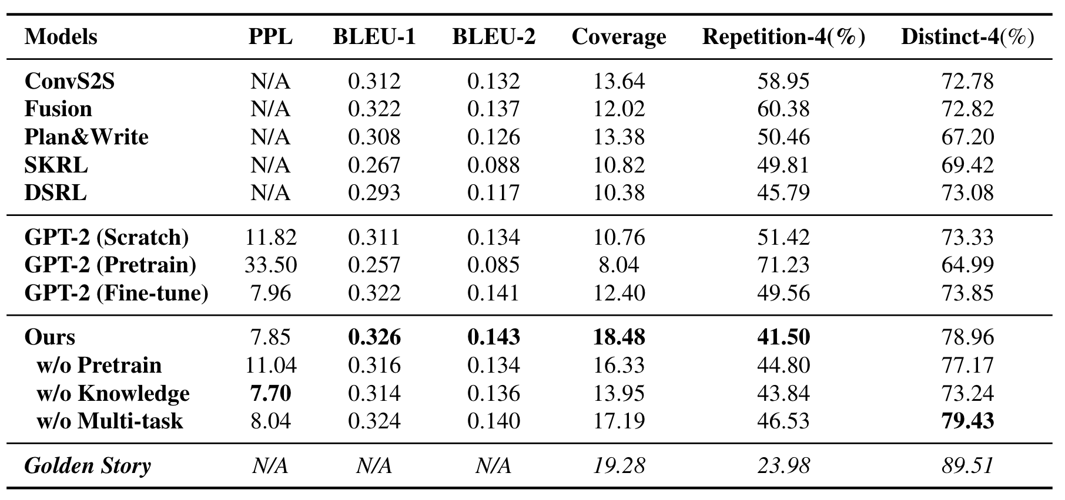
Results – automatic evaluation
Notes:
we calculated the coverage score as the average number of commonsense
triples matched in each generated story, which re-
quires both the head and tail entities/events ap-
pears in the same story.
Repetition-4: the proportion of stories that repeat at least one 4-gram.
Distinct-4: measure the proportion of unique 4-grams over all the generated 4-grams.

Slide 33
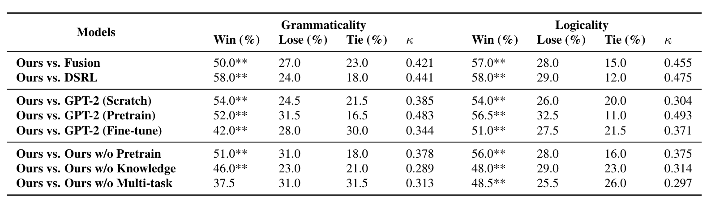
Results – better logic
Pair-wise manual evaluation

Slide 34
Results
Context: [MALE] studied politics in college .
Ours: [MALE] decided to run for president . [MALE] was nervous to win the election . [MALE] ran a very successful campaign . [MALE] was elected to president .
GPT (Fine-tuned): he got a job as a reporter . he interviewed for a news story . he interviewed for a local news station . [MALE] eventually got an interview in a local news station .
Fusion (Fan et al., 2018): he began to run out of community college . [MALE] started to become a reporter . [MALE] became a successful reporter . [MALE] became very successful .
Try Demo: http://coai.cs.tsinghua.edu.cn/static/CommonsenseStoryGen/
Notes:
GPT（Scratch）：不使用预训练的参数，直接在ROCstories 故事集合上训练；
GPT-pretrain：直接用预训练的模型 生成故事
GPT-finetune:基于预训练模型，在ROCstories上 fine tune
Fusion: facebook的故事生成模型

Slide 35
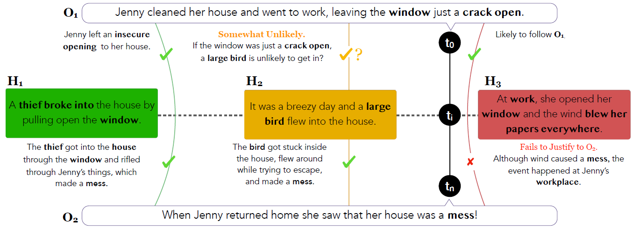
New Trends: Generative CS Reasoning
Bhagavatula et al 2020. Abductive Commonsense Reasoning

Slide 36
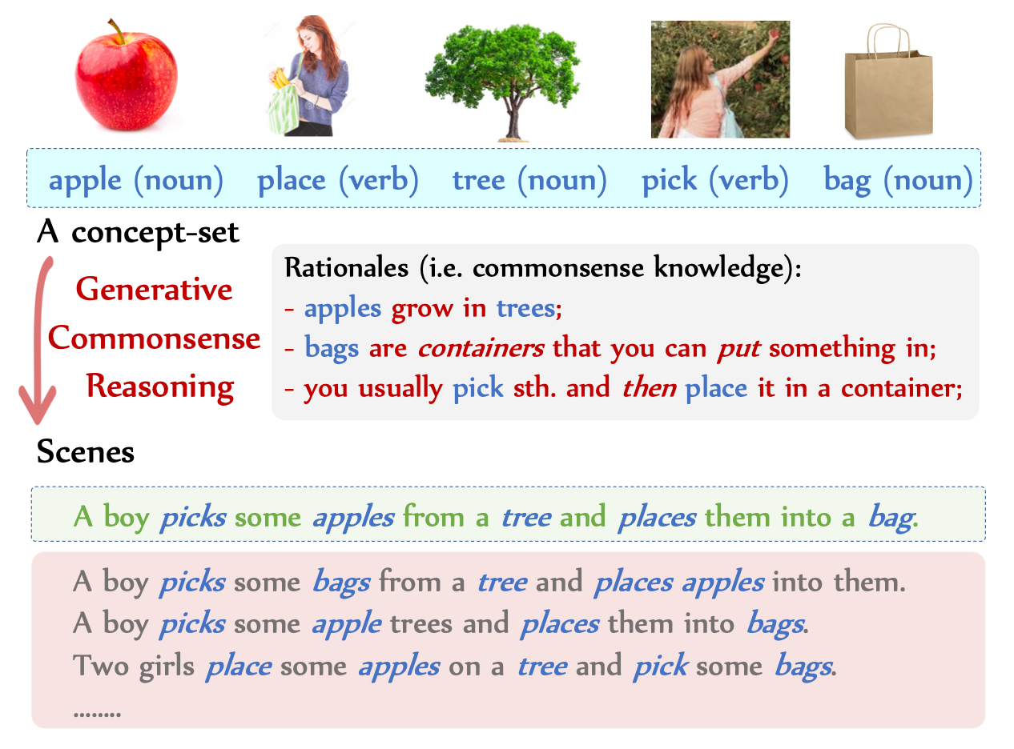
New Trends: Generative CS Reasoning
Lin et al. 2019. CommonGen: A Constrained Text Generation Dataset Towards Generative Commonsense Reasoning

Slide 37
Summary
Commonsense reasoning in question answering, reading comprehension, language inference
Commonsense in language generation (dialog/story generation)
Generative commonsense reasoning

Slide 38
Recent papers from CoAI group
Hao Zhou, Tom Yang, Minlie Huang, Haizhou Zhao, Jingfang Xu, Xiaoyan Zhu. Commonsense Knowledge Aware Conversation Generation with Graph Attention. IJCAI-ECAI 2018, Stockholm, Sweden. [IJCAI2018 Distinguished Paper]
Jian Guan, Yansen Wang, Minlie Huang. Story Ending Generation with Incremental Encoding and Commonsense Knowledge. AAAI 2019, Honolulu, Hawaii, USA
Jian Guan, Fei Huang, Zhihao Zhao, Minlie Huang. A Knowledge-Enhanced Pretraining Model for Commonsense Story Generation. TACL 2020

Slide 39
Thanks for Your Attention
Contact:
  Minlie Huang, Tsinghua University
  aihuang@tsinghua.edu.cn
  http://coai.cs.tsinghua.edu.cn/hml
  http://coai.cs.tsinghua.edu.cn/dialtk

