Slide 1
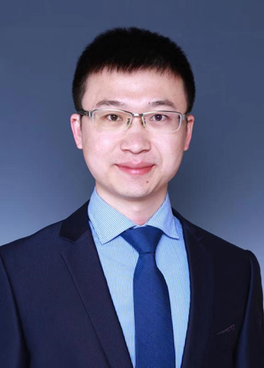
黄高
清华大学自动化系助理教授

Slide 2
Deep Convolutional Architectures
Gao Huang (黄高)
Assistant Professor
Department of Automation, Tsinghua University

Slide 3
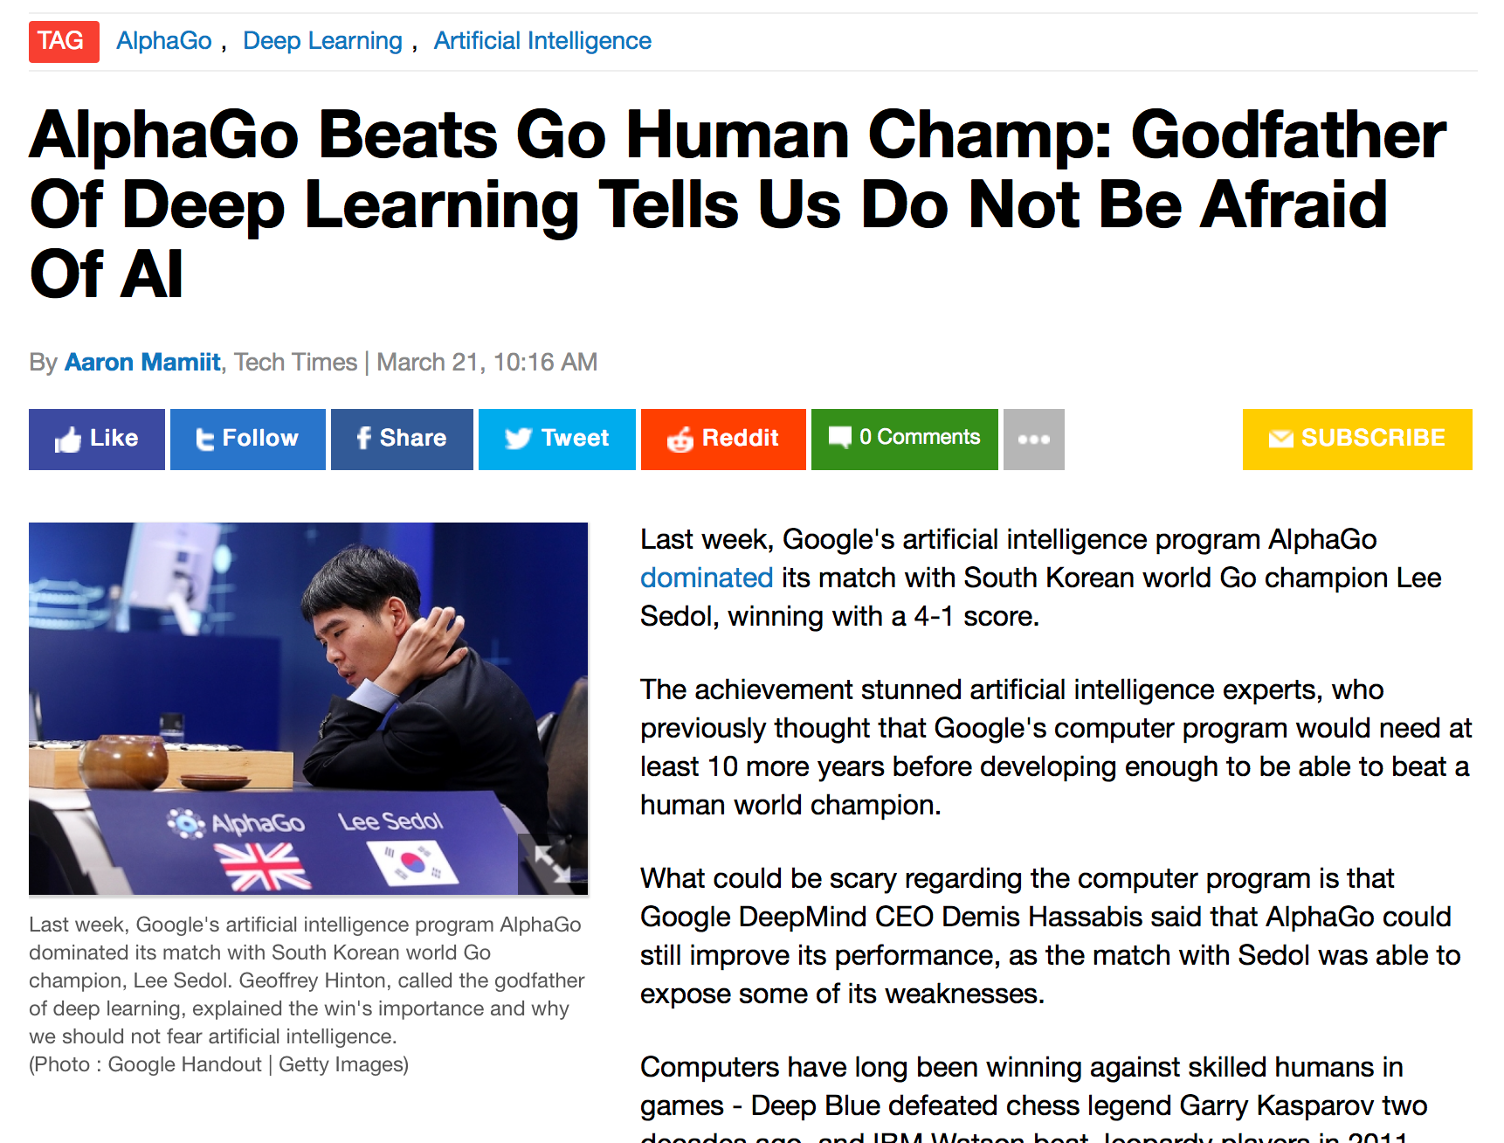
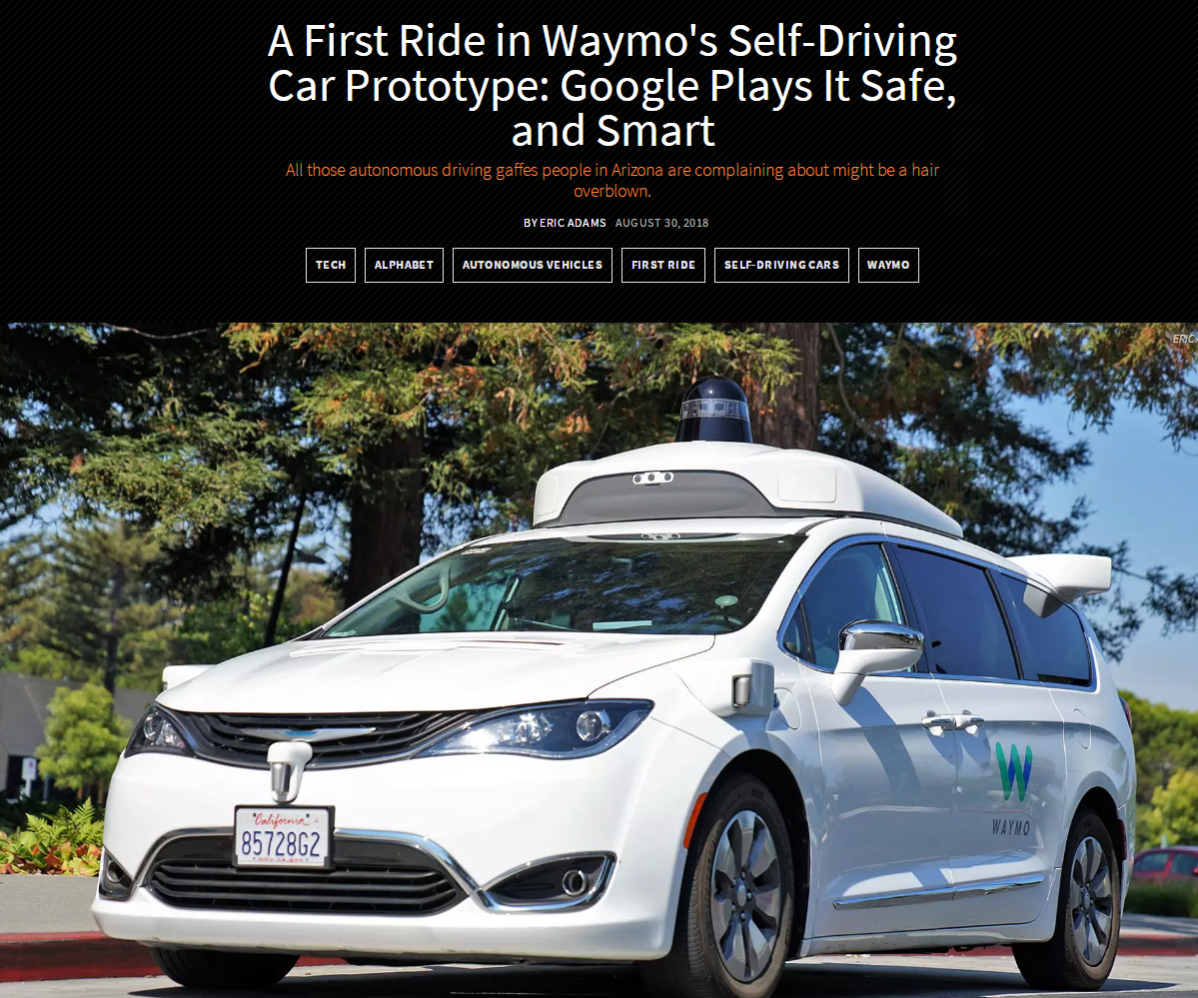
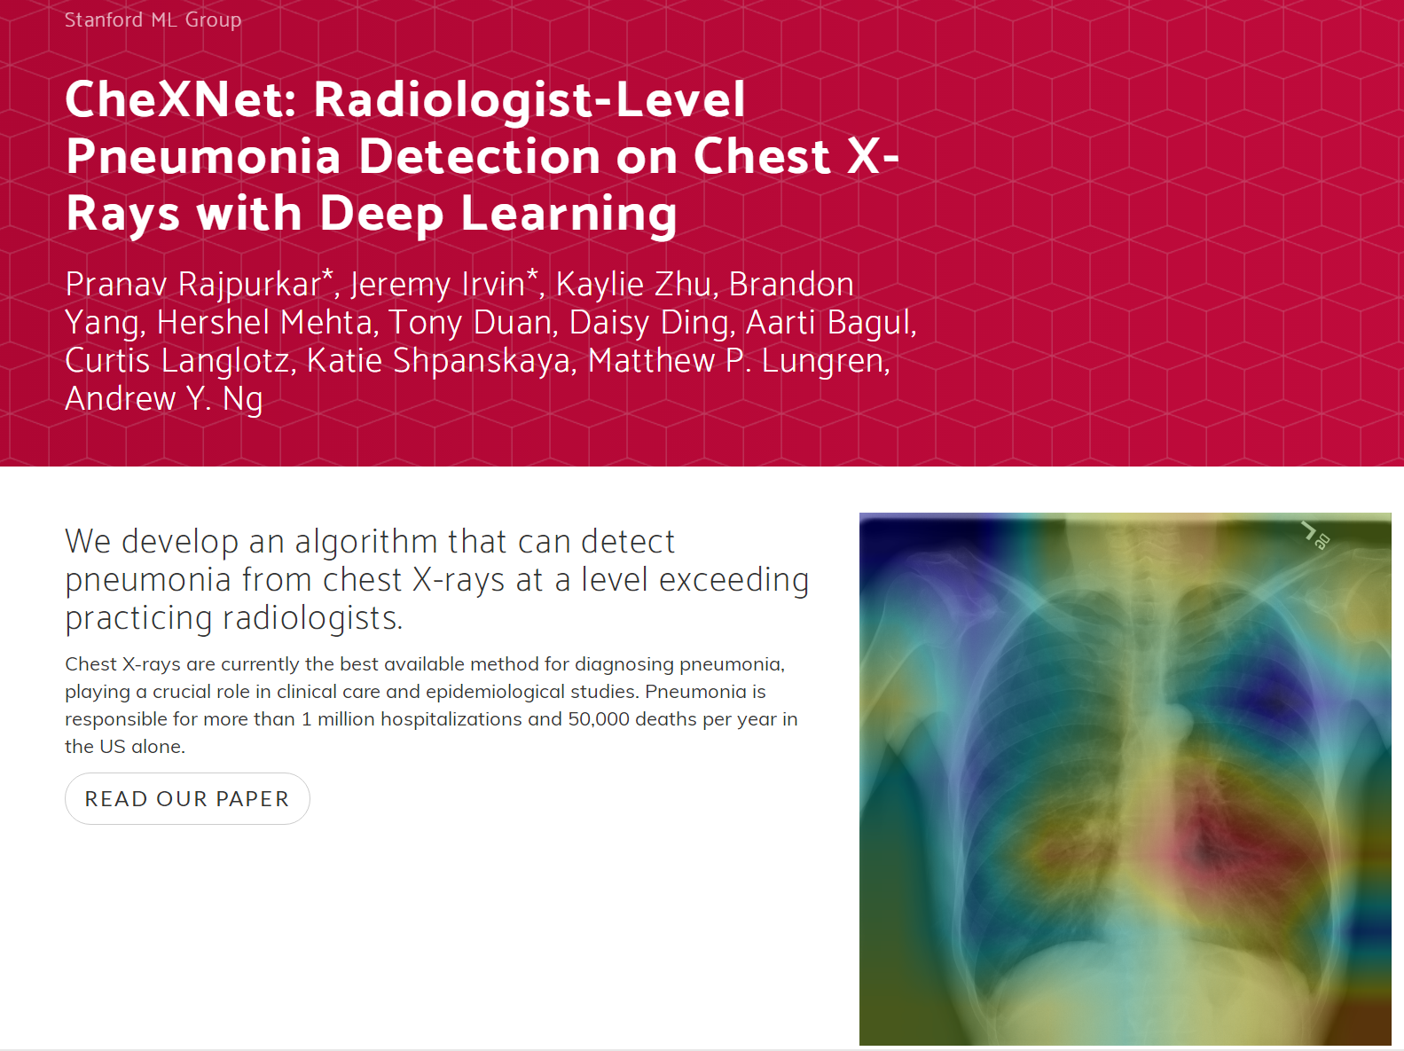
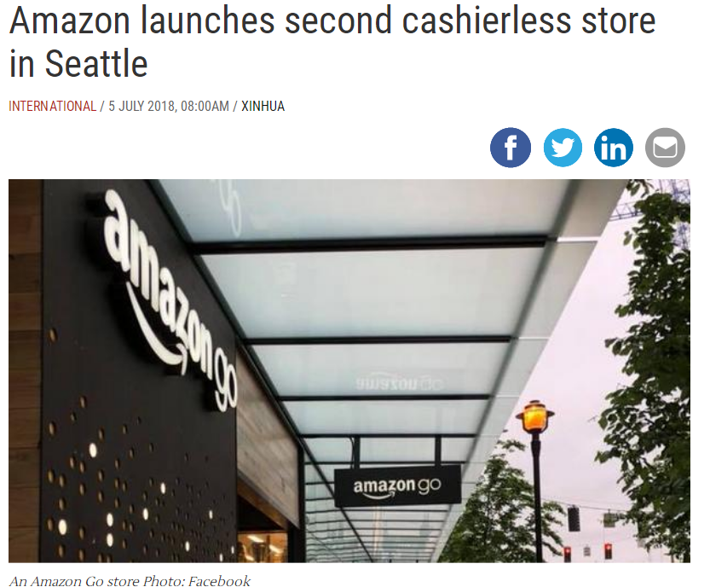
  deep learning

Slide 4
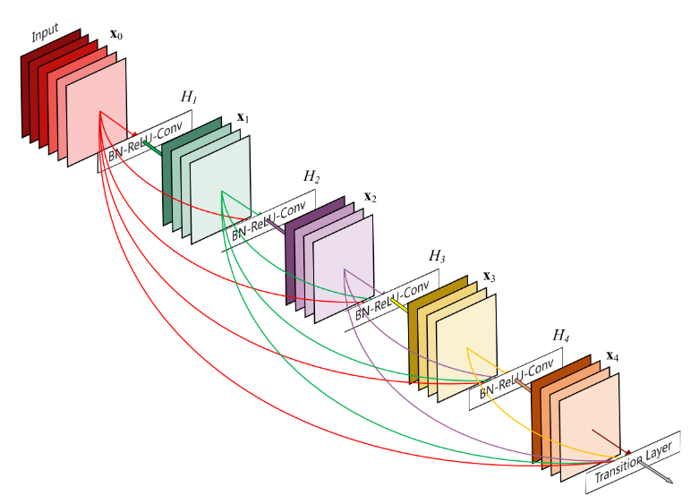
Convolutional networks
LeNet
AlexNet
Inception
DenseNet
VGG
ResNet

Slide 5
Advances in neural architecture design
Highway Networks
FractalNet
ResNet
DenseNet
ResNeXt
Dual Path Network
…
Light-weighted models
MobileNet (V1, V2, V3)
CondenseNet
ShuffleNet (V1, V2)
SENet
…
2012-2015
Fast developing stage
High diversity
2015-2017
Mature stage
Starting to converge
2017-Present
Prosperous stage
Very high diversity
AlexNet
ZF-Net
DSN
NIN
VGG
GoogleNet
…
Neural Arch. Search
NASNet
DARTS
AmoebaNet
…
Dynamic models
MSDNet
Block-Drop
BrachyNet
…

Slide 6
Advances in neural architecture design
2012-2015
Fast developing stage
High diversity
2015-2017
Mature stage
Starting to converge
2017-Present
Prosperous stage
Very high diversity
AlexNet
ZF-Net
DSN
NIN
VGG
GoogleNet
…

Slide 7
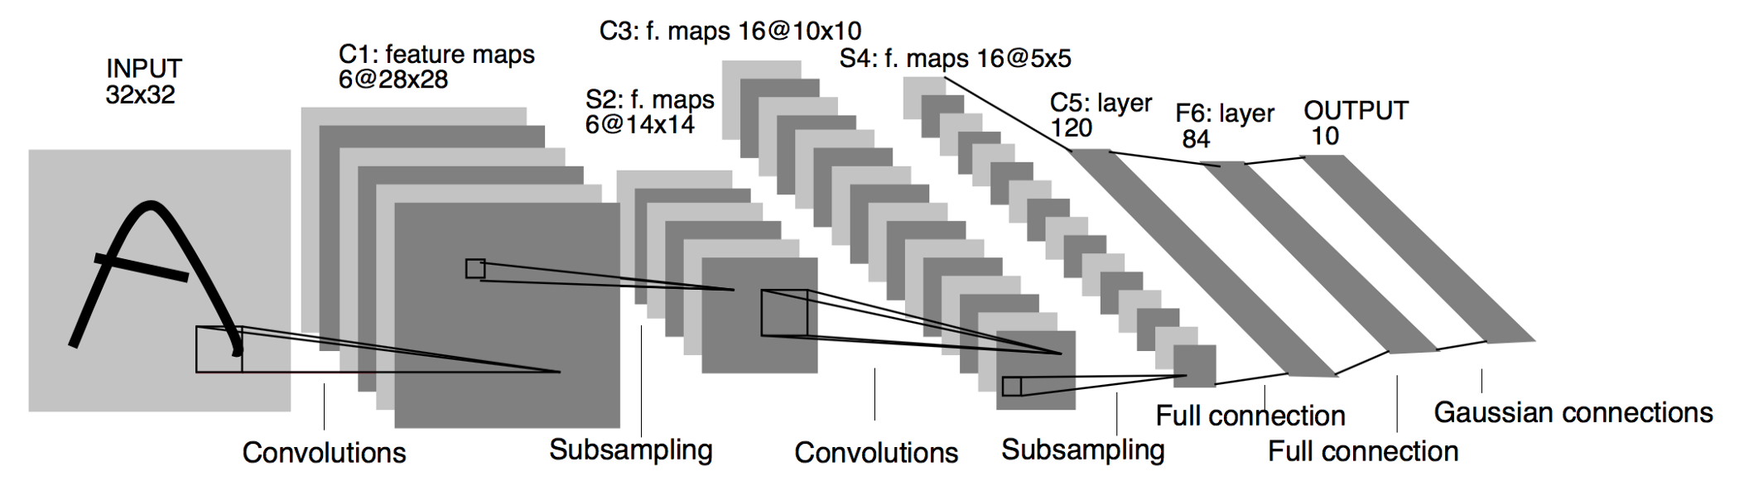
LeNet [LeCun et al. 1998]
Main Ideas:
Convolution, local receptive fields, shared weights
Spatial subsampling

Slide 8
AlexNet [Krizhevsky et al. 2012]
Main Ideas:
ReLU (Rectified Linear Unit)
Dropout
Local Response Normalization, Overlapping Pooling
Data Augmentation, Multiple GPUs

Slide 9
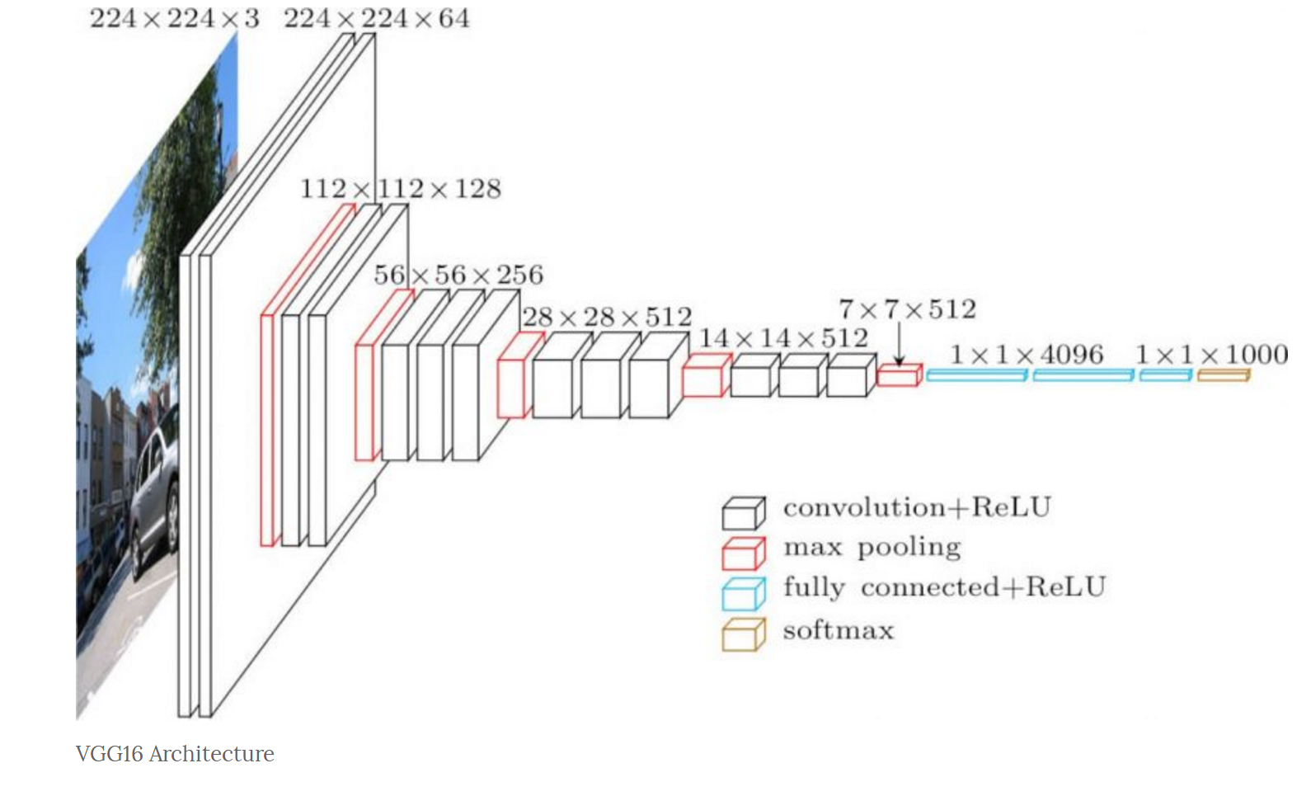
VGG [Simonyan et al, 2014]
Main Ideas:
Going deeper with wider architectures
Deploy of efficient 3x3 filters
Elegant in terms of design principle

Slide 10
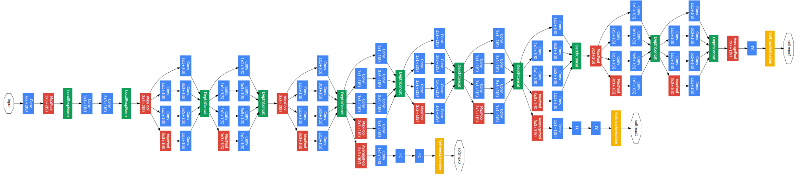
GoogleNet [Szegedy et al, 2014]
Main Ideas:
Carefully crafted design for better GPU utilization
Muiltiple intermediate classifiers
High efficient (compared to VGG)

Slide 11
Advances in neural architecture design
Highway Networks
FractalNet
ResNet
DenseNet
ResNeXt
Dual Path Network
…
Light-weighted models
MobileNet (V1, V2, V3)
CondenseNet
ShuffleNet (V1, V2)
SENet
…
2012-2015
Fast developing stage
High diversity
2015-2017
Mature stage
Starting to converge
2017-Present
Prosperous stage
Very high diversity
AlexNet
ZF-Net
DSN
NIN
VGG
GoogleNet
…
Neural Arch. Search
NASNet
DARTS
AmoebaNet
…
Dynamic models
MSDNet
Block-Drop
BrachyNet
…

Slide 12
Advances in neural architecture design
Highway Networks
FractalNet
ResNet
DenseNet
ResNeXt
Dual Path Network
…
2012-2015
Fast developing stage
High diversity
2015-2017
Mature stage
Starting to converge
2017-Present
Prosperous stage
Very high diversity

Slide 13

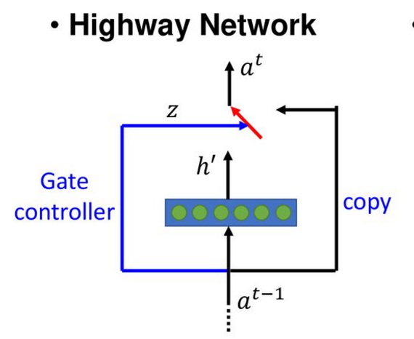

Highway networks [Srivastava et al., 2015]
Nonlinear part
Identity part
Controller

Slide 14
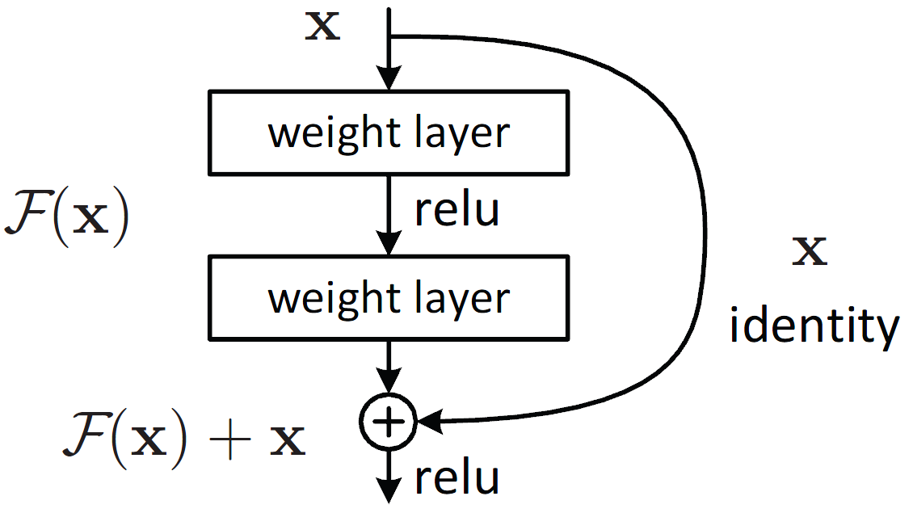
ResNet [He et al. 2016]
Main Idea:
Constant skip connection: promotes gradient propagation

Slide 15
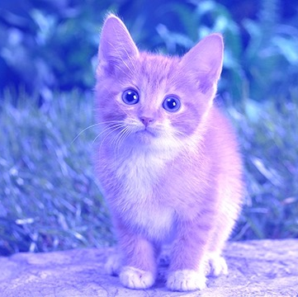
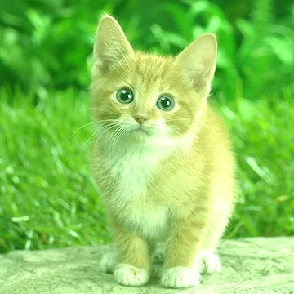
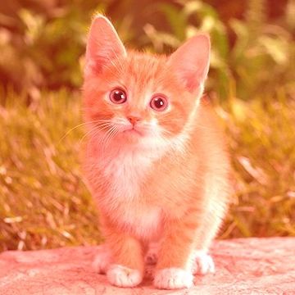
Residual network
Identity mappings promote gradient propagation.
: Element-wise addition
[He, et al, CVPR 2016]

Slide 16


Redundancy in resnet
Enforcing redundancy in deep networks helps generalization.
Redundancy wastes computation in practice!

Slide 17
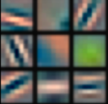
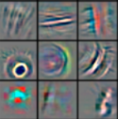
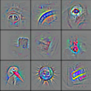
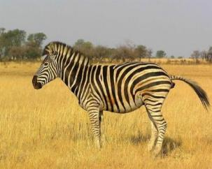
Redundancy in deep models
Low-level features
Mid-level features
High-level features
Classifier
Classifier
Input
Prediction

Slide 18



Reducing redundancy

Slide 19
Dense connectivity
C
C
C
C
: Channel-wise concatenation
C

Slide 20
Dense and slim architecture
Model | #Layers | #Parameters | Validation Error
ResNet | 18 | 11.7M | 30.43%
DenseNet | 121 | ?? | ??

Slide 21
Dense and slim architecture
More connections, less computation!
Model | #Layers | #Parameters | Validation Error
ResNet | 18 | 11.7M | 30.43%
DenseNet | 121 | 8.0M | 25.03%

Slide 22
Advantages: Strong gradient flow
Error Signal
Implicit “deep supervision”
Deeply supervised Net: [Lee, Xie, Gallagher, Zhang, Tu] (2015)

Slide 23
Results on ImageNet
ResNet-34
ResNet-34
DenseNet-121
DenseNet-121
ResNet-50
ResNet-50
DenseNet-169
DenseNet-169
ResNet-101
DenseNet-201
ResNet-101
DenseNet-201
ResNet-152
DenseNet-264
ResNet-152
DenseNet-264
DenseNet-232(k=48)
DenseNet-232(k=48)

Slide 24
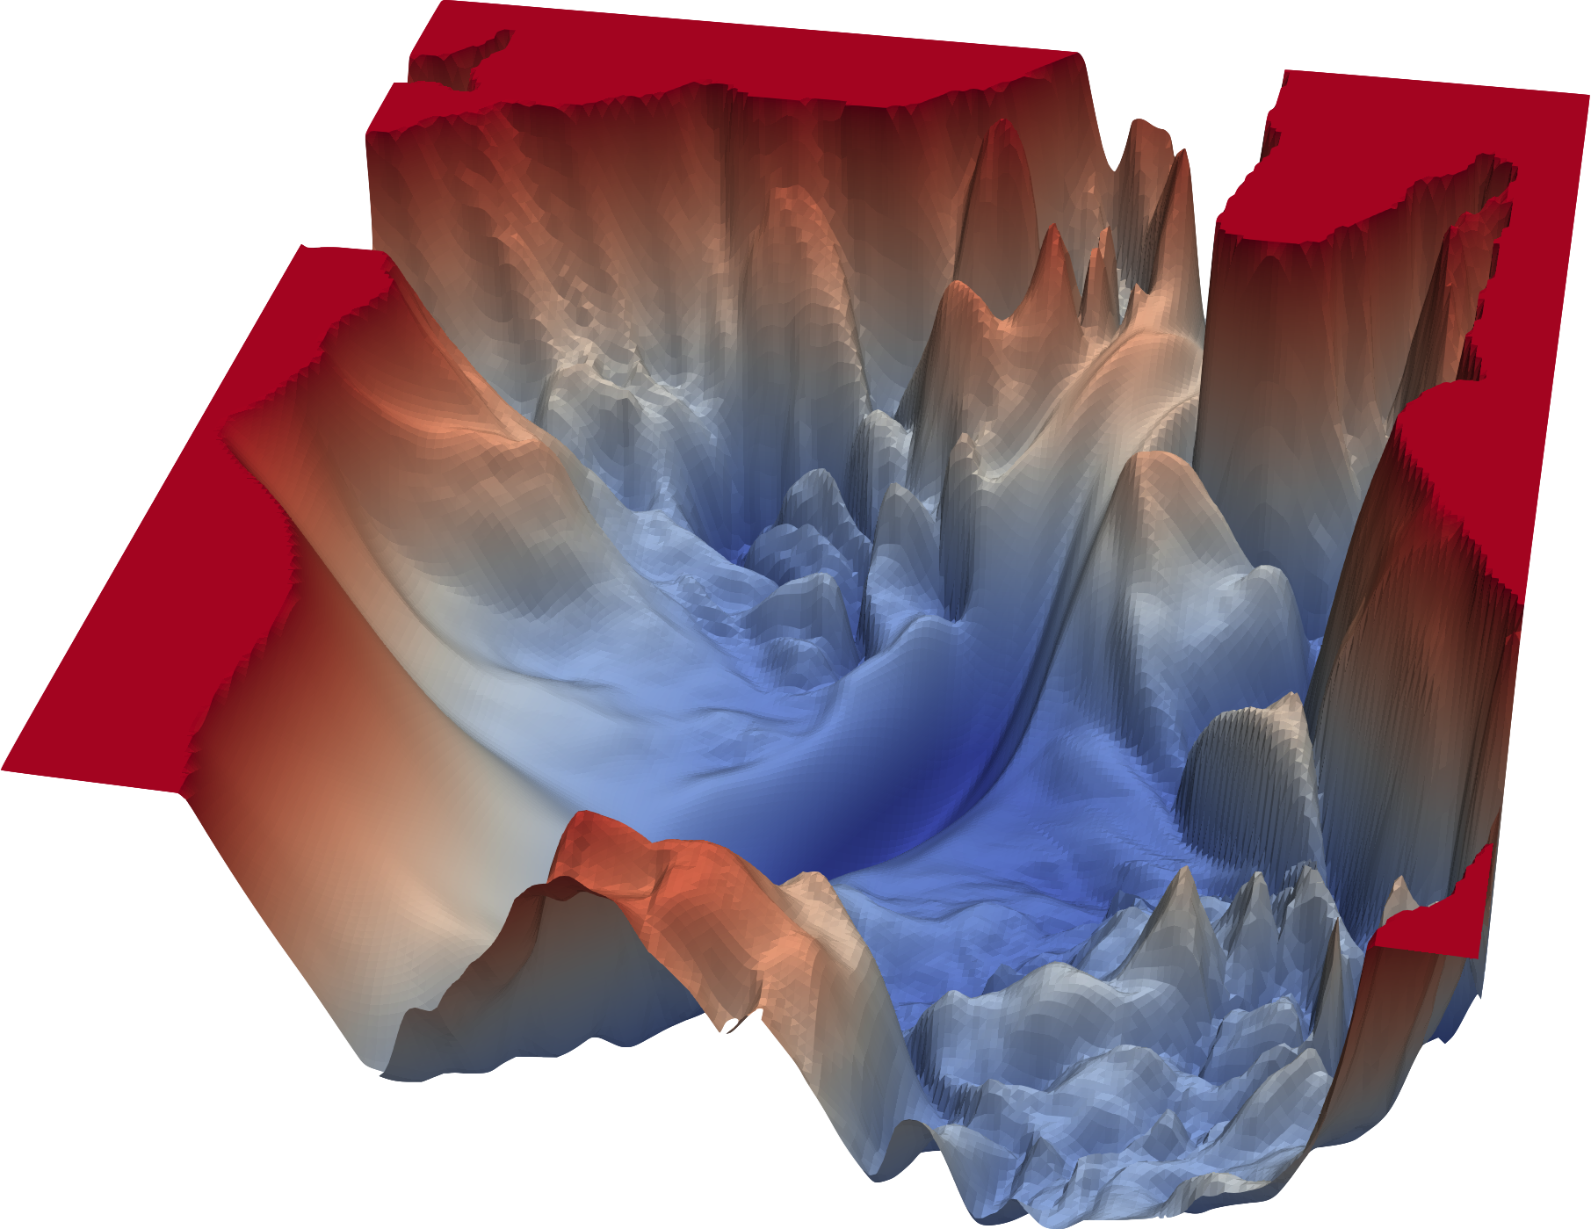
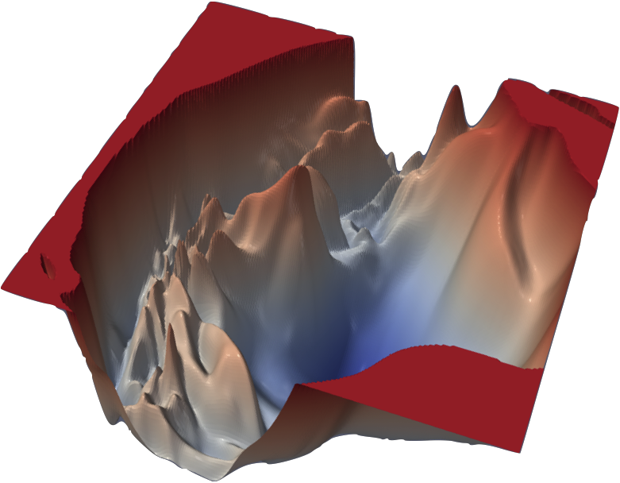
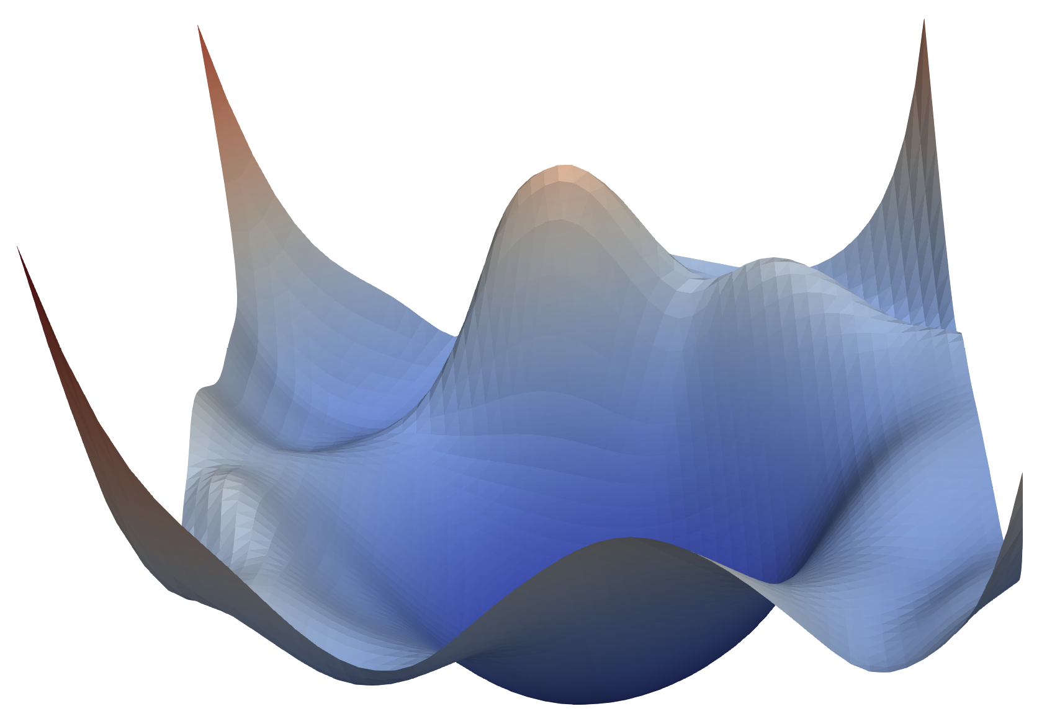
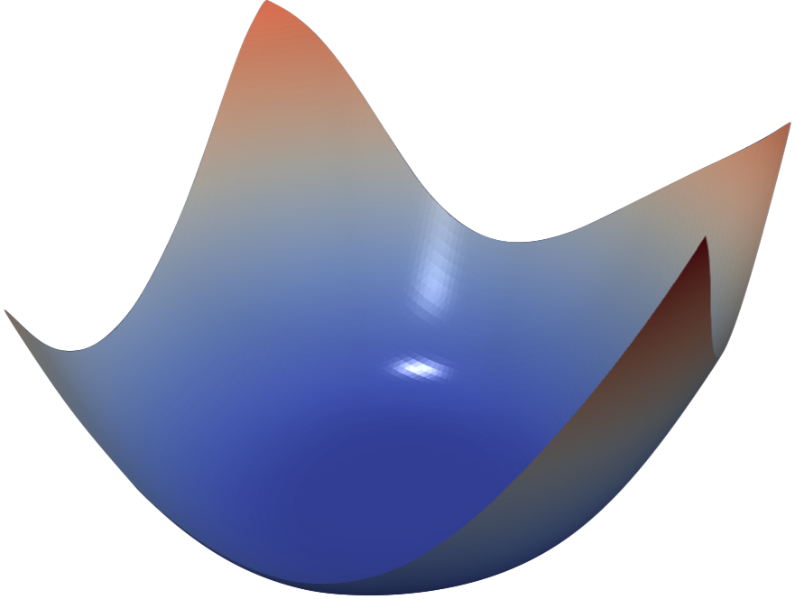
The loss surface
VGG-110
VGG-56
https://www.cs.umd.edu/~tomg/projects/landscapes/
ResNet-56
DenseNet-121
Visualizing the loss landscape of neural nets. Li, Hao, et al. NIPS 2018.a

Slide 25
Advances in neural architecture design
Highway Networks
FractalNet
ResNet
DenseNet
ResNeXt
Dual Path Network
…
Light-weighted models
MobileNet (V1, V2, V3)
CondenseNet
ShuffleNet (V1, V2)
SENet
…
2012-2015
Fast developing stage
High diversity
2015-2017
Mature stage
Starting to converge
2017-Present
Prosperous stage
Very high diversity
AlexNet
ZF-Net
DSN
NIN
VGG
GoogleNet
…
Neural Arch. Search
NASNet
DARTS
AmoebaNet
…
Dynamic models
MSDNet
Block-Drop
BrachyNet
…

Slide 26
Advances in neural architecture design
Light-weighted models
MobileNet (V1, V2, V3)
CondenseNet
ShuffleNet (V1, V2)
SENet
…
2012-2015
Fast developing stage
High diversity
2015-2017
Mature stage
Starting to converge
2017-Present
Prosperous stage
Very high diversity
Neural Arch. Search
NASNet
DARTS
AmoebaNet
…
Dynamic models
MSDNet
Block-Drop
BrachyNet
…

Slide 27
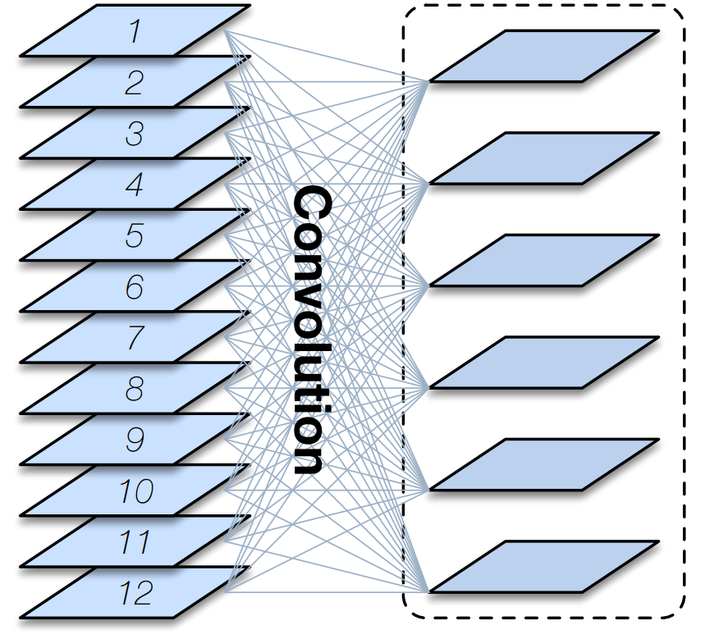
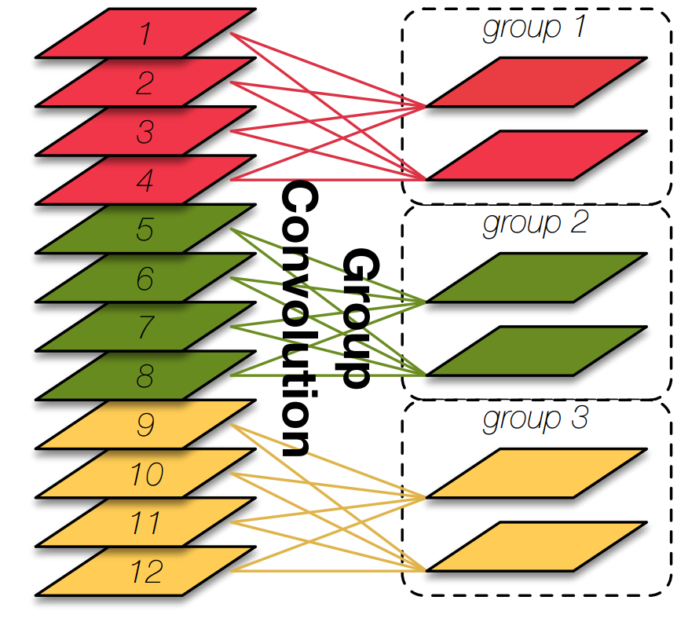
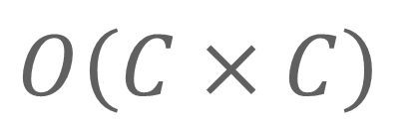
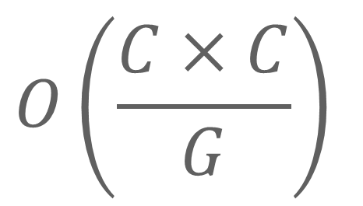
Group Convolution
Main Idea:
Split convolution into multiple groups
Standard Convolution
Group Convolution
Networks using Group Convolution:
AlexNet (Krizhevsky et al, NIPS’12)
ResNeXt (Xie et al, CVPR’17)
CondenseNet (Huang et al, CVPR’18)
ShuffleNet (Zhang et al, CVPR’18)
…
$$O\left(\frac{C×C}{G}\right)$$
$$O\left(C×C\right)$$

Slide 28
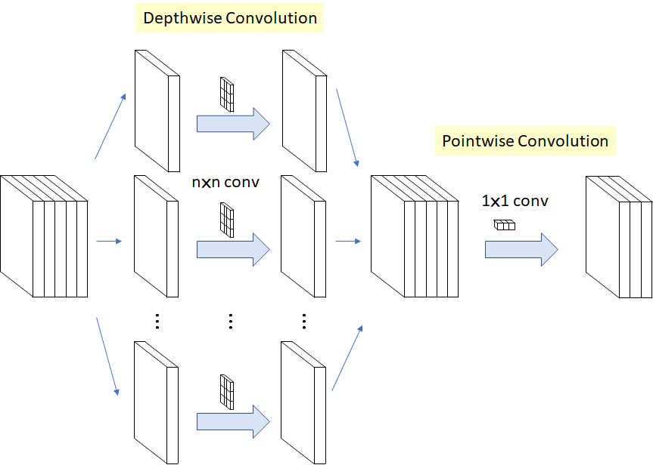
Depth-wise Separable Convolution (DSC)
Main Idea:
Split convolution into multiple groups, each group has one channel
Networks using DSC:
Xception (Chollet, CVPR’17)
MobileNet (Howard et al, CVPR’18)
MobileNet V2 (Sandler et al, 2018)
ShuffleNet V2 (Ma et al, CVPR’19)
NasNet (Zoph, CVPR’18)
…

Slide 29
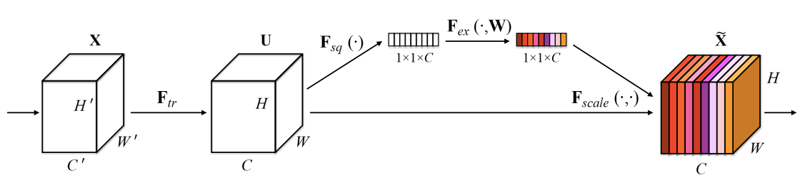
Squeeze and excitation network (Hu et al, CVPR’18)
Main Idea:
Channel-wise attention: second order operations

Slide 30
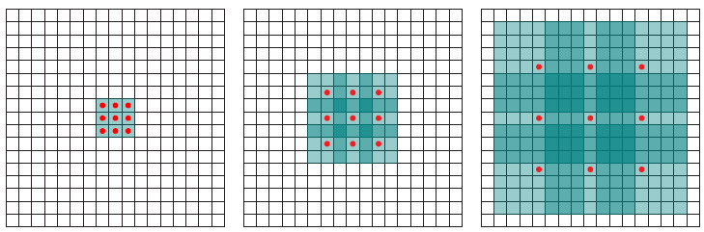
Dilated convolution (Yu & Koltun, ICLR’18)
Main Idea:
Increase receptive field via filter dilation

Slide 31
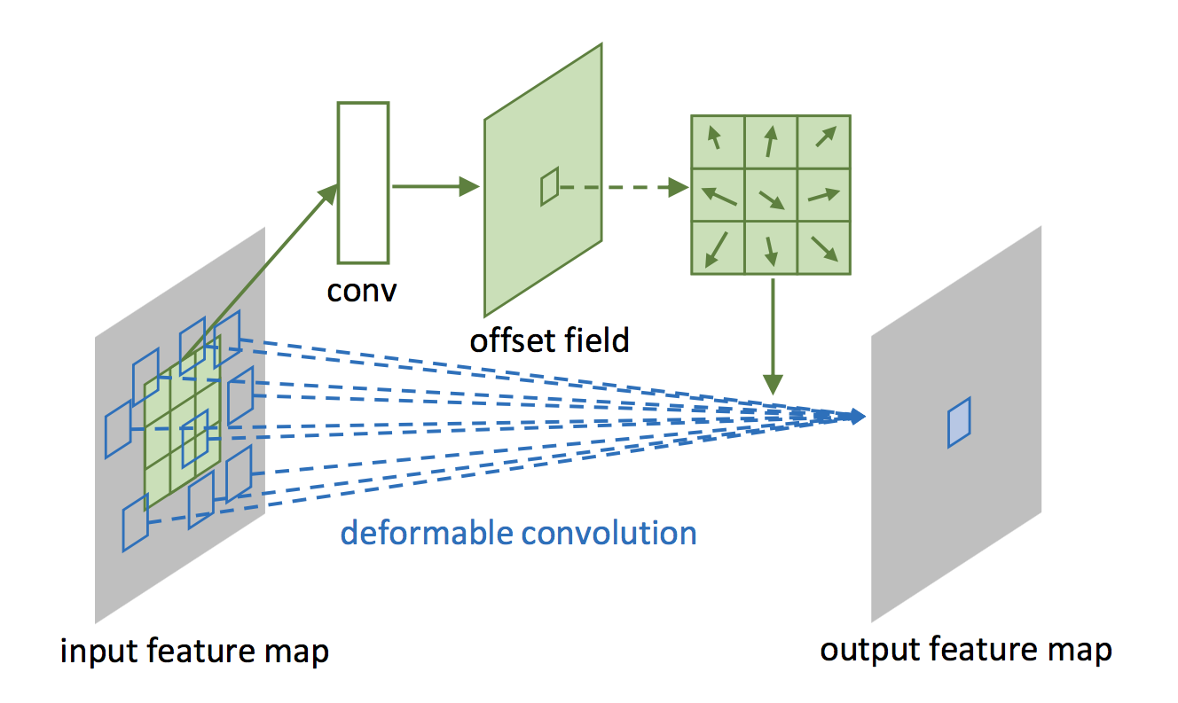
Deformable convolution (Dai et al, CVPR’18)
Main Idea:
Learn the offset filed for convolutional filters

Slide 32
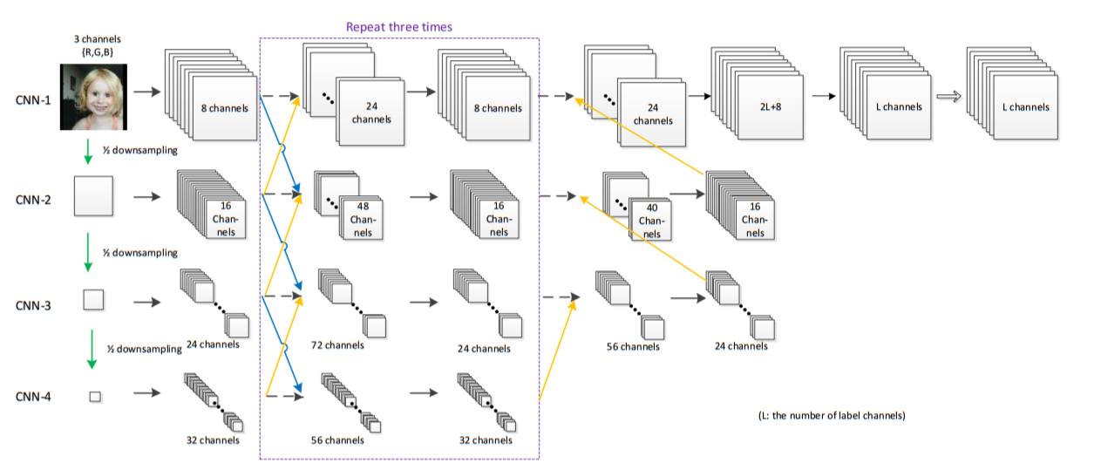
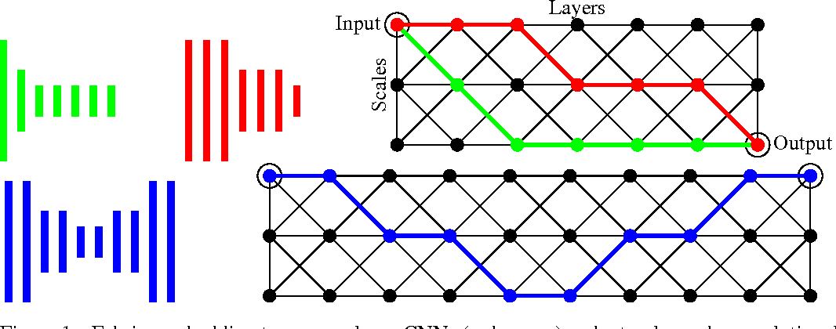
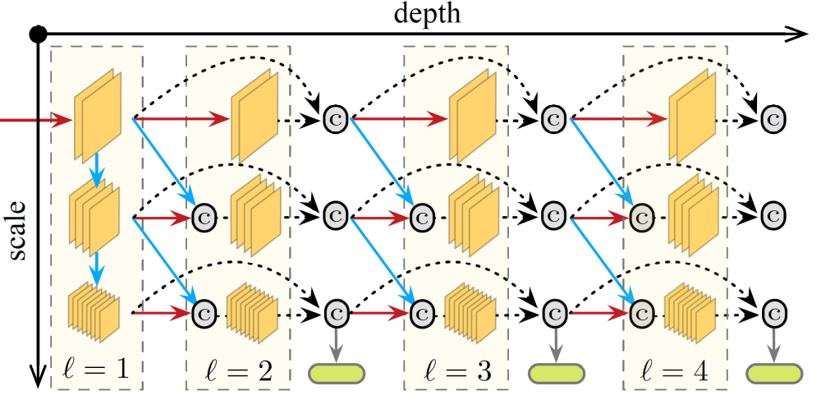
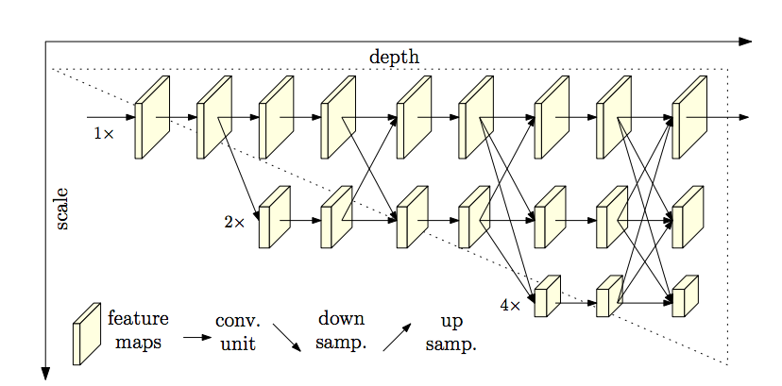
Multi-Scale Networks
Main Idea:
Multi-scale feature fusion: merge signals with different frequencies.
Interlinked CNN (Zhou et al, ISNN’15)
Neural Fabric (Saxena & Verbeek, NIPS’16)
MSDNet (Huang et al, ICLR’18)
HRNet (Sun et al, CVPR’19)

Slide 33
Advances in neural architecture design
Light-weighted models
MobileNet (V1, V2, V3)
CondenseNet
ShuffleNet (V1, V2)
SENet
…
2012-2015
Fast developing stage
High diversity
2015-2017
Mature stage
Starting to converge
2017-Present
Prosperous stage
Very high diversity
Neural Arch. Search
NASNet
DARTS
AmoebaNet
…
Dynamic models
MSDNet
Block-Drop
BrachyNet
…

Slide 34
Advances in neural architecture design
Light-weighted models
MobileNet (V1, V2, V3)
CondenseNet
ShuffleNet (V1, V2)
SENet
…
2012-2015
Fast developing stage
High diversity
2015-2017
Mature stage
Starting to converge
2017-Present
Prosperous stage
Very high diversity
Neural Arch. Search
NASNet
DARTS
AmoebaNet
…
Dynamic models
MSDNet
Block-Drop
BrachyNet
…

Slide 35
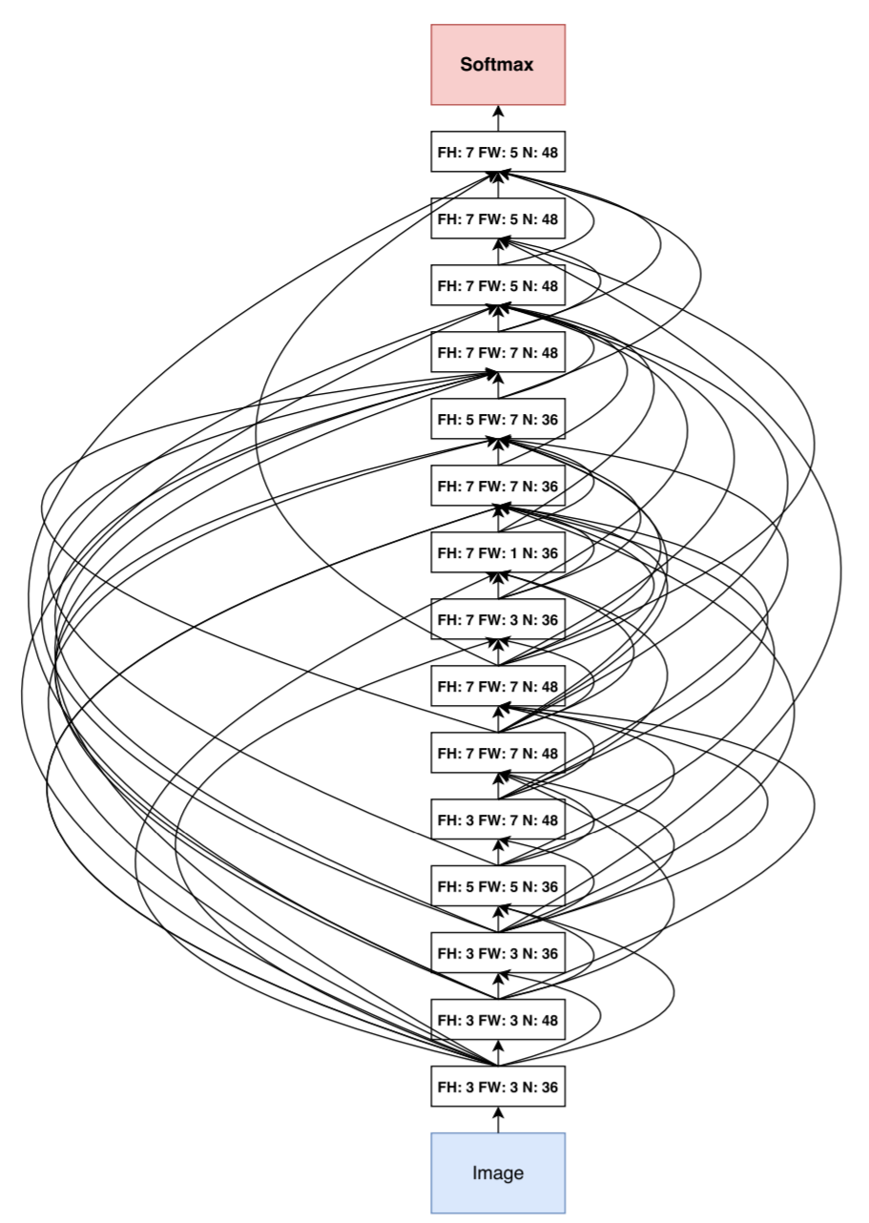
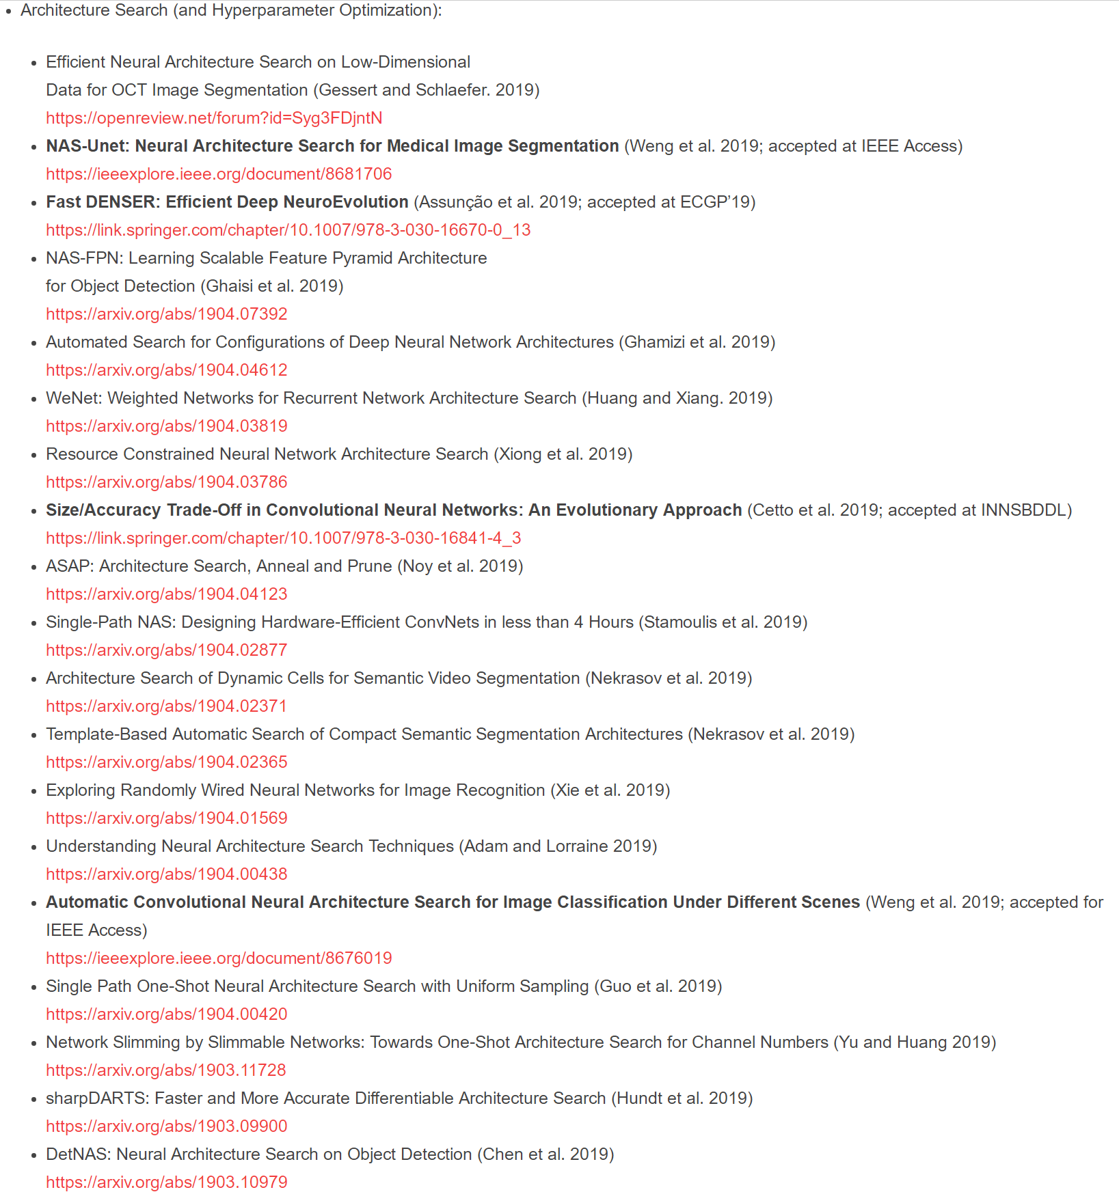
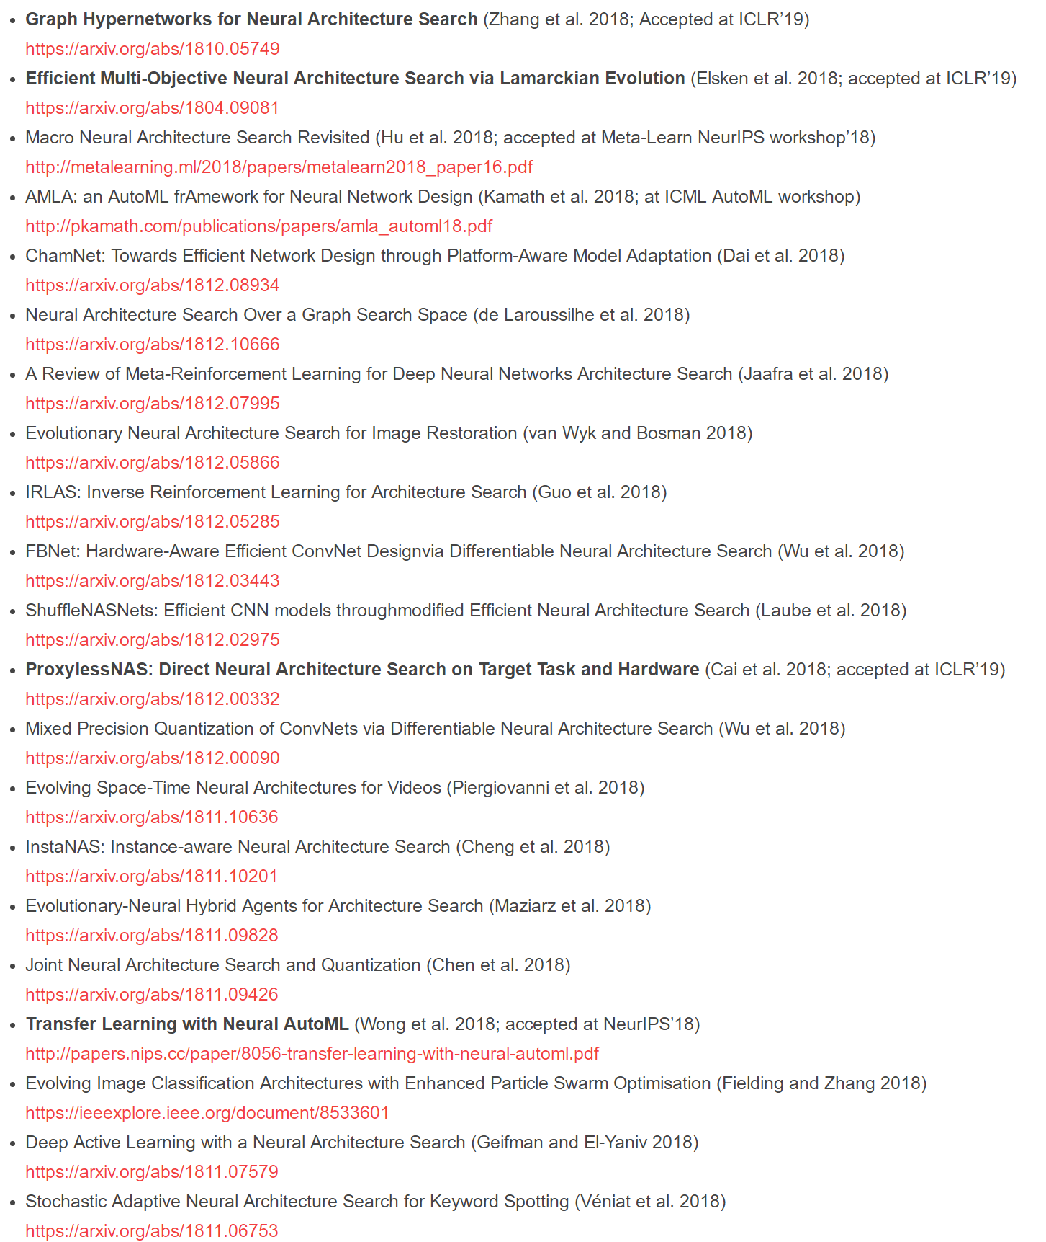
Neural Architecture Search [Zoph and Le, 2017 and many]
Main Idea:
Automatic architecture search using reinforcement learning, genetic/evolutional algorithms or differentiable approaches.
AutoML is a very active research field, see www.automl.org

Slide 36
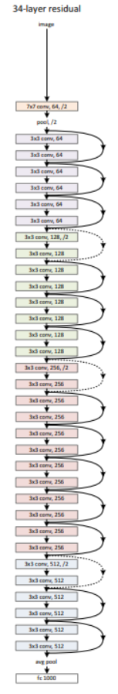
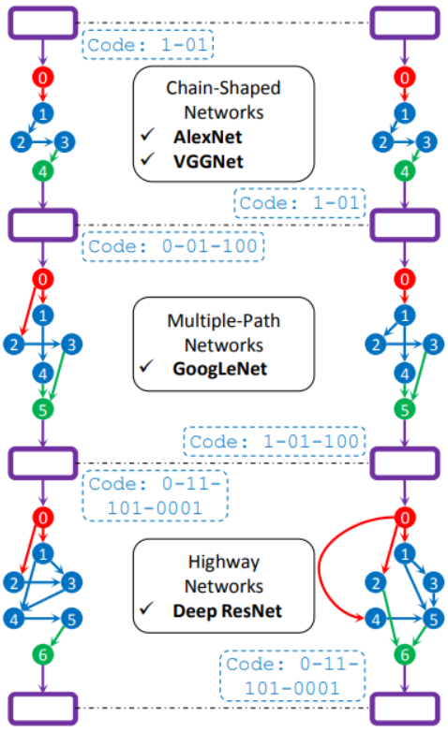
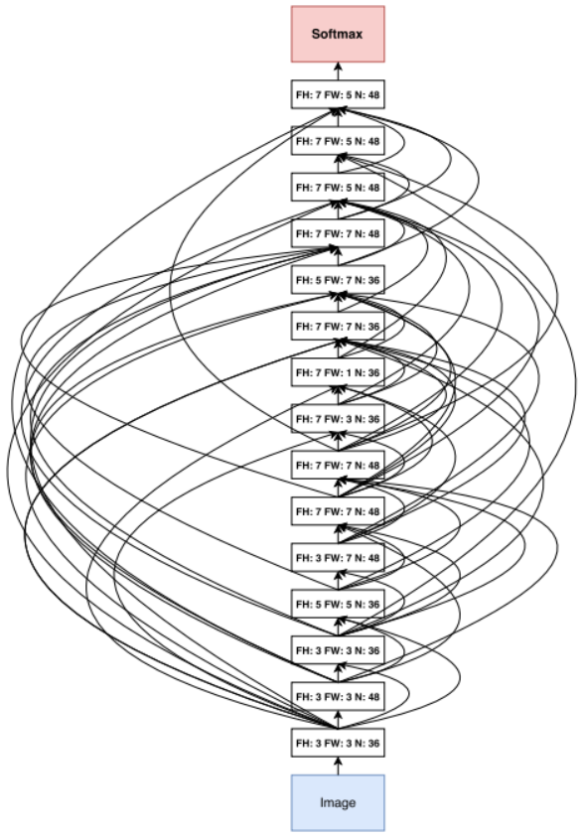
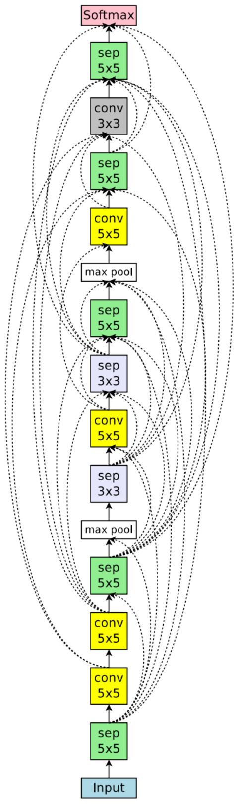
Model comparison: ResNet, GeNet, NASNet and ENASNet
ResNet
GeNet
NASNet
ENASNet

Slide 37
Neural architecture search
Defining the search problem
What to search?
Defining the search space
Search within what?
Designing search algorithms
How to search?
Specifying search objectives
How to evaluate?

Slide 38
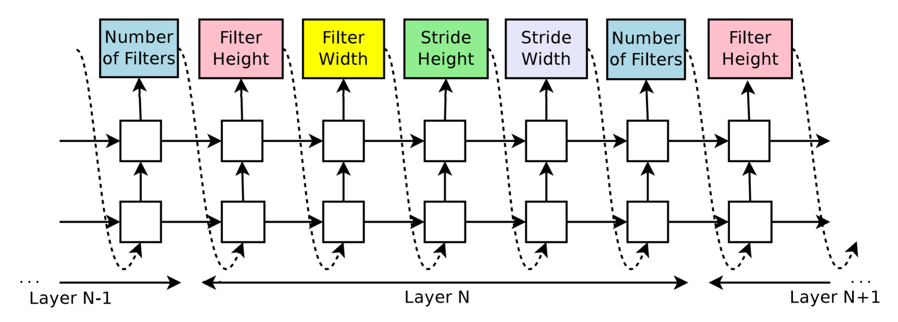
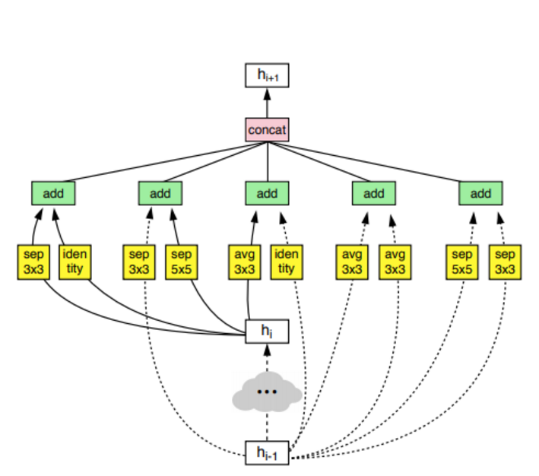
What to search?
Considering a network as a stack of cells

Slide 39
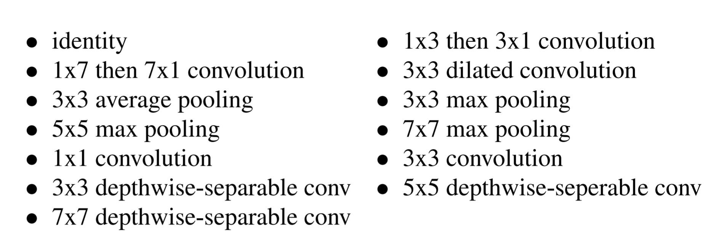
Search within what?
Whatever we have found that works
(Important and need expertise!)

Slide 40
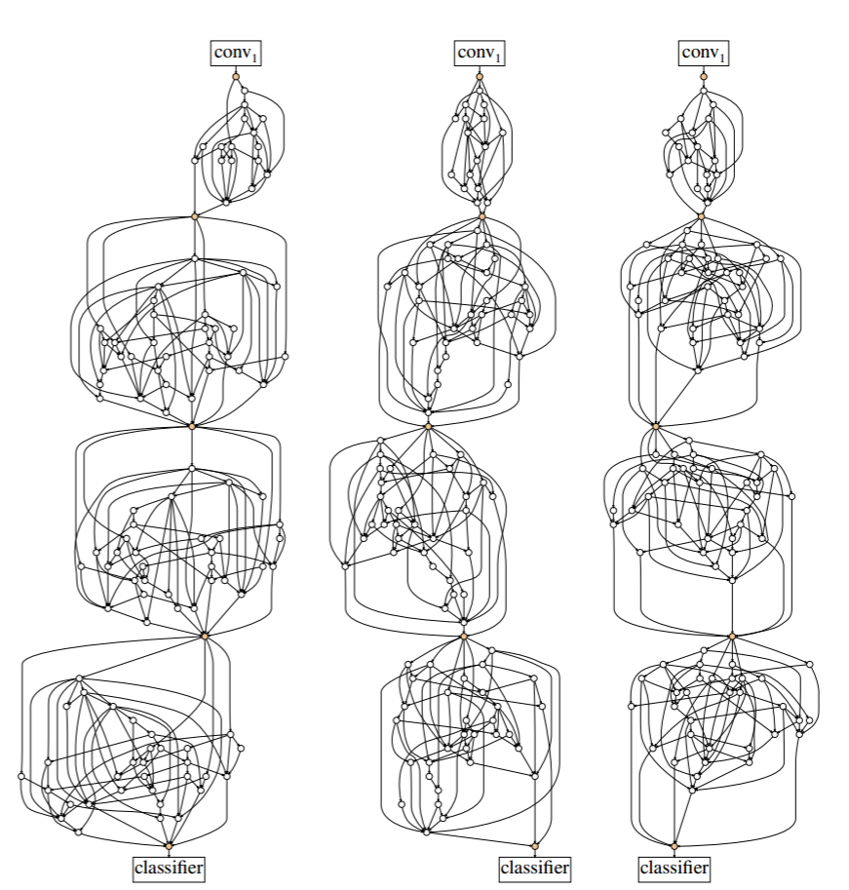
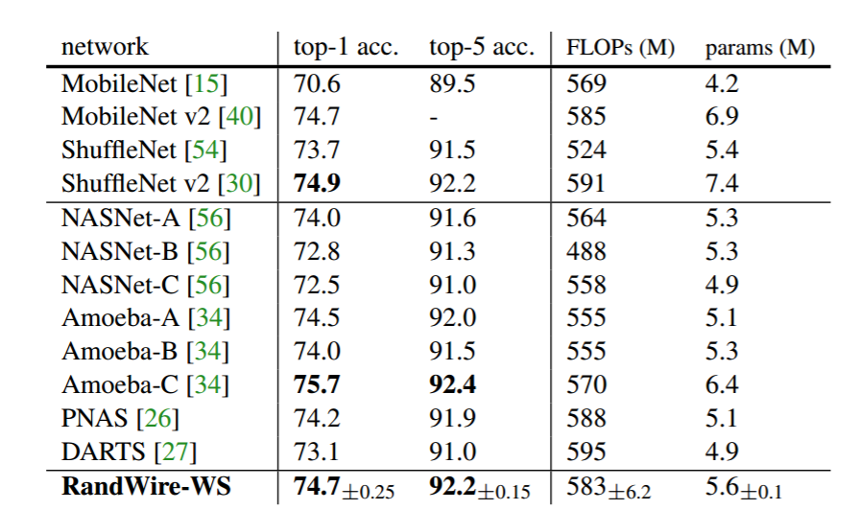
Randomly wired networks are almost as effective as
carefully searched architectures!
S. Xie et al., Exploring Randomly Wired Neural Networks for Image Recognition, arXiv preprint: 1904.01569, 2019.

Slide 41
How to search?
Reinforcement learning
Evolutionary Algorithm
Differentiable algorithm
DARTS
Fbnet
NASNet
Progressive NAS
GeNet (GA)
AmoebaNet (EA)

Slide 42
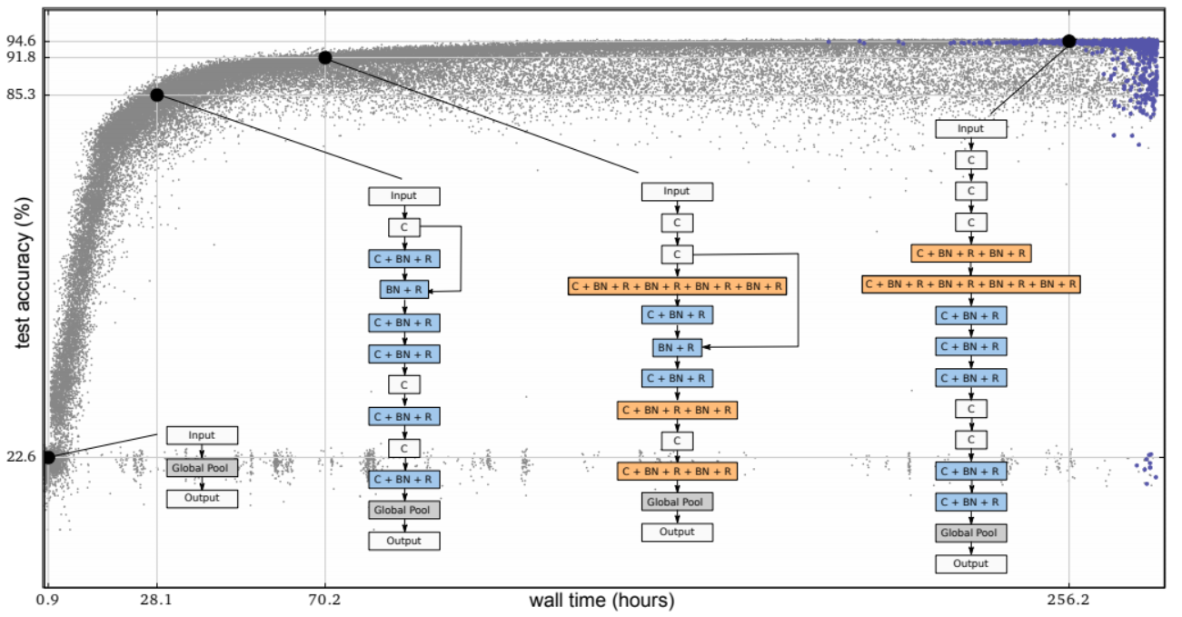
How to evaluate?
Accuracy - Speed Tradeoff
Not directly optimizable
Very expensive, usually experiment with small dataset

Slide 43
Advances in neural architecture design
Light-weighted models
MobileNet (V1, V2, V3)
CondenseNet
ShuffleNet (V1, V2)
SENet
…
2012-2015
Fast developing stage
High diversity
2015-2017
Mature stage
Starting to converge
2017-Present
Prosperous stage
Very high diversity
Neural Arch. Search
NASNet
DARTS
AmoebaNet
…
Dynamic models
MSDNet
Block-Drop
BrachyNet
…

Slide 44
Advances in neural architecture design
Light-weighted models
MobileNet (V1, V2, V3)
CondenseNet
ShuffleNet (V1, V2)
SENet
…
Neural Arch. Search
NASNet
DARTS
AmoebaNet
…
2012-2015
Fast developing stage
High diversity
2015-2017
Mature stage
Starting to converge
2017-Present
Prosperous stage
Very high diversity
Dynamic models
MSDNet
Block-Drop
BrachyNet
…

Slide 45
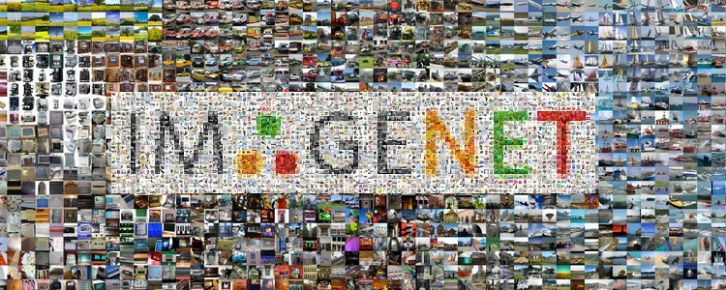
development of Deep learning
2012 2014 2014 2015 2017

Slide 46
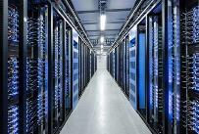
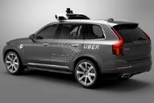


accuracy-time tradeoff

Slide 47

Bigger is better
Bigger models are needed for those noncanonical images.
*Photo Courtesy of Pixel Addict (CC BY-ND 2.0)

Slide 48
Bigger is better
*Photo Courtesy of Willian Doyle(CC BY-ND 2.0)

Slide 49
Why do we use the same expensive model for all images?

Slide 50
Can we use small&cheap models for easy images; big&expensive models for hard ones?

Slide 51
a naive idea of Adaptive evaluation
AlexNet
"easy" horse
Inception
ResNet
"hard" hoarse

Slide 52


Challenge: lack of coarse-level features
Fine-level features
Mid-level features
Coarse-level features
Input
Down-sampling
Down-sampling
Down-sampling
Output
Linear
Classifier
Classifier
Classifier
Classifiers only work well on coarse-scale feature maps
Nearly all computation has been done before getting a coarse feature

Slide 53
Solution: multi-scale architecture
Fine-level features
Mid-level features
Coarse-level features

Slide 54
Solution: multi-scale architecture
Fine-level features
Mid-level features
Coarse-level features

Slide 55
Multi-scale features
Test
Input
…
Fine-level features
…
Mid-level features
…
Coarse-level features
…
Classifier 1
Classifier 2
Classifier 3
Classifier 4
Classifiers only operate on high level features!

Slide 56
Multi-scale densenet
Test
Input
…
…
…
…
Classifier 1
Classifier 2
Classifier 3
Classifier 4

Slide 57
Multi-scale densenet
…
…
…
…
Classifier 1
Classifier 1
Classifier 2
Classifier 2
Classifier 3
Classifier 3
Classifier 4
cat: 0.2
cat: 0.4
cat: 0.6
0.2 ≱ threshold
0.4 ≱ threshold
0.6 > threshold

Slide 58

Multi-scale densenet
Results
2x-5x speedup over DenseNet

Slide 59




Visualization
Test
Input
…
…
…
…
Classifier 1
Classifier 2
Classifier 3
Classifier 4

Slide 60
Visualization
Class:
red wine
Class: volcano
"easy"
"hard"
(exit at first classifier)
(exit at last classifier)

Slide 61
Advances in neural architecture design
Highway Networks
FractalNet
ResNet
DenseNet
ResNeXt
Dual Path Network
…
Light-weighted models
MobileNet (V1, V2, V3)
CondenseNet
ShuffleNet (V1, V2)
SENet
…
2012-2015
Fast developing stage
High diversity
2015-2017
Mature stage
Starting to converge
2017-Present
Problem driven stage
Very high diversity
AlexNet
ZF-Net
DSN
NIN
VGG
GoogleNet
…
Neural Arch. Search
NASNet
DARTS
AmoebaNet
…
Dynamic models
MSDNet
Block-Drop
BrachyNet
…

Slide 62
neural architectures: What’s next?
Interpretable
Light-weighted
Adaptive
Transferable
General

Slide 63
Thank you !
For more information: www.gaohuang.net

